Slide 1
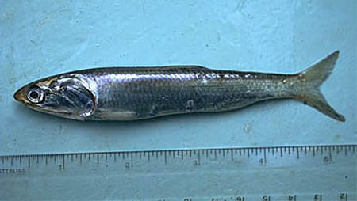
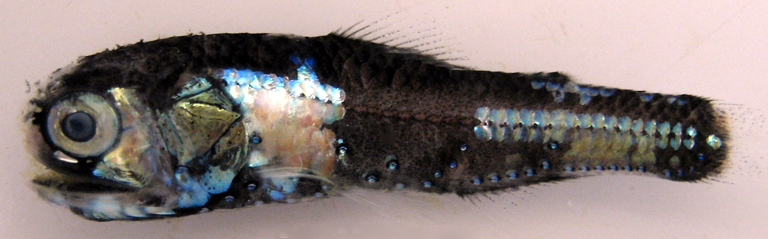
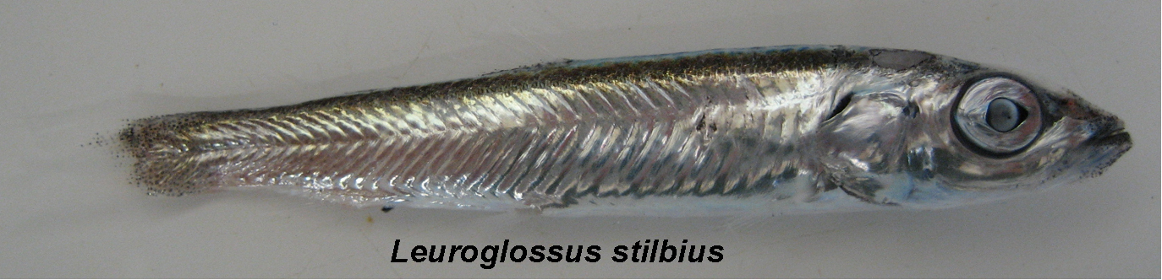
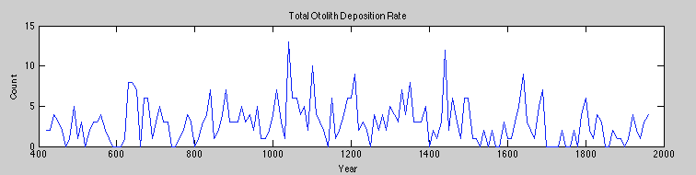
Marine Sediments and Fossils
Notes:
William Jones (Graduate Student, Scripps Institution of Oceanography)
Steve Walters (Teacher, Mission Bay High School, San Diego, CA)
Slide Description: The graph shows the otolith deposition rate (number of otoliths that have fallen in 100 cm² per 10 years) over two thousand years. What is very striking about this record is that it shows very high variability. Assuming otolith deposition rate reflects the abundance of fish in the water column at the time, this shows that the populations of fish vary considerably on the decadal to multi-decadal scale. This graph could not be created from fishing records since reliable fishing records to not extend back more than 100 years. This graph is part of William’s PhD research.
The fish pictures at the top are common fish found in the California current (from left to right, deep-sea smelth, anchovy, lantern fish. Images from P. Davison).
WHY :
Marine fish populations fluctuate naturally in abundance on multiple timescales. Pelagic fish spawning and recruitment success, for example, can vary with seasonal upwelling. Fish populations can also vary on an inter-annual to decadal scale in response to large-scale climate variability such as El Niño and the Pacific Decadal Oscillation (PDO).
The response of fish populations to natural climate variability has become increasingly affected directly and indirectly by human activities. Anthropogenic climate change and fishing can stress fish populations by altering growth rates, abundance, age structure, geographic range, and responsiveness to natural climate variability. One approach scientists use in order to parse natural variability and effects of human-caused climate change on fish is by studying fossil remains of fish found in marine sediments. Following this, students will learn WHY and HOW scientists study historic fish populations in this lab.
SUMMARY:
The Marine Sediment and Fossil Lab is a one-day lesson that gives students hands-on experience as a paleobiologist. The lesson begins with this PowerPoint, which explains how and why scientists study past populations. The class is then broken into 5 groups that rotate between one of five stations during the class period. Approximately 10-12 minutes per station. Each student works independently to fill out the Marine Sediments and Fossils Worksheet as they move from station to station.
PICTURE/GRAPHICS CREDITS:
Pictures from P. Davison and W. Jones. Graph from W. Jones.
WEBSITES/RESOURCES USED IN THIS PRESENTATION:
Baumgartner et al. 1992. Reconstruction of the history of Pacific sardine and northern anchovy populations over the past two millenia form sediments of the Santa Barbara Basin, California. CalCOFI Rep., Vol 33.
PhD research of William Jones
ADDITIONAL READING:
Baumgartner et al. 1992. Reconstruction of the history of Pacific sardine and northern anchovy populations over the past two millenia form sediments of the Santa Barbara Basin, California. CalCOFI Rep., Vol 33.
Louis W. Botsford. Human activities, climate changes affect marine populations. California Agriculture 51(4):36-44. DOI: 10.3733/ca.v051n04p36. July-August 1997. Link: http://californiaagriculture.ucanr.edu/landingpage.cfm?article=ca.v051n04p36&fulltext=yes
CONTEXT OR USE:
This activity is designed for 9th grade biology or higher. It would also work for an Earth Science class.
This activity will take a minimum of one 90 minute class period.
This is the second lesson in the series out of four. This lesson could, however, be moved to later in the series.
MISCONCEPTIONS:
Fossils are all very old
Fish populations do not fluctuate over time
It is impossible to study historic fish populations
EVALUATION TIPS:
Have the lab set up before students arrive to the classroom. It would also be helpful to complete each task before the students arrive, so you will have an estimate of how long each activity will take.
TEACHING NOTES.
Marine Sediments and Fossils Lesson Overview - Teacher Notes / Lab Setup
Teaching Materials
Marine sediment samples were obtained from the CalECHOES Research Cruise, which collected the sediments from the Santa Barbara Basin.
Fine mesh sieves (100 to 500 micron)
Dissecting microscopes
Fine tip Forceps
Marine fossils (scales, otoliths, foraminifera, fish bones).
Unsorted Marine Fossil material
500ml beakers
filter paper (or coffee filters)
Marine Fossils – or photographs of them (photographs available in provided PowerPoint).
Marine Fossil Identification Key (PowerPoint provided)
Box Core Photograph with varve increments (provided)
Marine Sediments and Fossils Worksheet
Small paintbrushes (for sorting sediment material)
Activity Description
The Marine Sediment and Fossil Lab is a one-day lesson that gives students hands on experience as a paleobiologist. The lesson begins with a short PowerPoint (Marine Sediment and Fossil PowerPoint), which explains how and why scientists study the past. The class is then broken into 5 groups that rotate between one of five stations during the class period. Approximately 10-12 minutes per station. Each student works independently to fill out the Marine Sediments and Fossils Worksheet as they move from station to station.
Lab Setup.
Station 1. Sample Processing: Washing Stations
Students wash a small amount of marine sediments using a sieve and running water in the sink. The object is to wash away the sediments so that only the fossils are left (foraminifera shells, gastropod shells, fish scales and bones, otoliths). If washed properly, the there should not be any ‘mud’ left in the sample – only a very small amount of fossils. Once sieved, the fossils are gently washed onto filter paper (coffee filters work great!) over a 500ml beaker and left to dry overnight. Mesh size from 500micron to 100 micron should work.
Station 2: Sample Processing: Picking Scales Station
Using a dissecting microscope, students pick fish scales out of pre-sieved marine sediments. To make the lesson more efficient. The sediments at this station should be pre-washed and dried. Do not use the seived sediments that the students wash at station 1 because they will not be dry.
Station 3: Aging the Core: Counting Varves Station
Students attempt to count the correct number of varves (yearly / seasonal layers) in a core photograph (labeled “BoxCorePhoto.docx “– the answer key is “BoxCorePhoto_Key.docx”). The photo is a close-up x-ray of the varves in a box core from the Santa Barbara Basin. The dark layers are dark because they are denser. These layers have high amounts of clay from the terrestrial environment, deposited during storm events that occur during the winter months in Southern California. The light layers are deposited during the spring / summer from biological production. The Santa Barbara Basin is highly productive due to upwelled nutrient-rich waters entering the basin from the north. One light and dark increment together represent one year.. This is what the students should look for when counting the varves and assigning ages. In this way, each of the layers can be assigned a date. Because biological production and the amount of rain fall that occurs in a year varies, the layers are not all the same size. As a reference, the very first varve at the top is from 2009 (the top most varve from 2010, when the core was collected, was not dense enough to be preserved). Students should work their way down from 2009 by counting the alternating dark and light layers as one year. The teacher should look at “BoxCorePhoto_Key.docx” before starting the lesson to familiarize themselves with counting the varves
Station 4: Fossil Sketching Station
Students examine several marine sediment fossils under a dissecting microscope and sketch them. If the teacher does not have access to actual marine sediment fossils (fish scales, otoliths, foraminifera, fish bones, etc) the students can sketch them from unlabeled photographs. The students do not yet know what the fossil is at the time that they are sketching – they are making their own “ID guide”.
Station 5: Fossil Identification station
Students use a reference catalogue to identify the fossils that they drew. The better their drawings, the easier they will be able to identify their fossils.
It may be is helpful to have a helping hand during the class period (more than one teacher or aid present).

Slide 2
Identify A Problem and Create Hypothesis
How will fish populations respond to future climate change?
Hypothesis:
Notes:
ENGAGE:
The purpose of this slide it to get students engaged thinking about climate change and the impact it may have on marine organisms (fish). It is assumed that students have been introduced to and have a general grasp on climate change. This slide also assumes they are familiar with making scientific hypotheses. The teacher can have the students write down a hypothesis (or a few) in their journal. After they have written something down, have the students share their ideas in a class discussion. Have students explain why they believe in their hypothesis.
For example, if a student says there will be fewer fish, they must be able to say why they think there will be fewer fish. There are really no wrong answers here. The truth is, the reaction of fish to climate change is not really known, although scientists can make educated guesses. Warm water fish species might increase in abundance and/or increase their ranges northward. Conversely, cool water species might decrease their populations and/or Changing water temperatures will also impact the timing of events in a fish’s life (phenology). For example, many species of fish will spawn in spring once the water temp reaches a certain temperature. Climate change may cause the waters to warm-up sooner, resulting in an earlier spawning time for these fish species.

Slide 3
Form A Hypothesis
How will fish populations respond to climate change?
Hypothesis: Warm water species of fish will increase their geographic range northward.
Notes:
After students share some hypothesis ideas and why they believe their hypothesis, have them try to explain HOW this hypothesis would be tested (experimental design). This is not an easy questions and the students will likely struggle. Possible answers include looking at fossils, fishing records, or setting up long-term observations studies.
Long term observation would be one way to test most hypotheses, but it would not be very meaningful if we did not know fish populations fluctuate naturally on a long time scale.

Slide 4
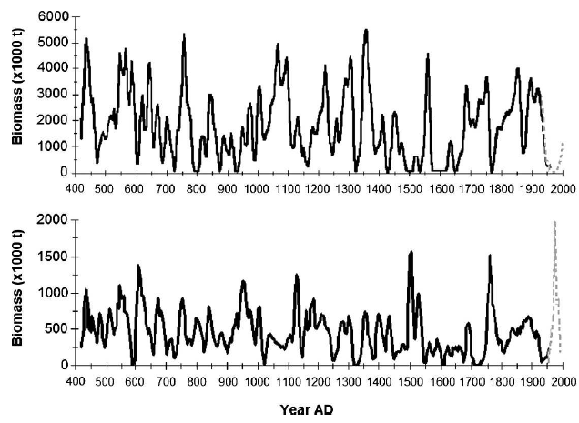
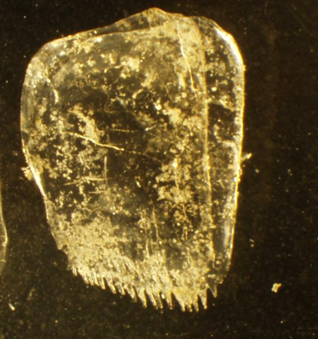
Understanding Long-Term Variability in Fish Populations
Modern fishing record
(~100 years)
Sediment Record
Sardine Scale Deposition Rate
Anchovy Scale Deposition Rate
Fish Scale
Baumgartner et al. 1992
Notes:
Purpose of the slide: The purpose of this slide is to demonstrate that modern fishing records do not extend back far enough to capture more than one or two natural cycles in many fish populations (including sardine and anchovy). Therefore, in order to study population variability on the scale of thousands of years, we can study fish remains in the sediment record. This is exactly what Baumgartner did in 1992. The graph shows scale deposition rates converted to biomass from Baumgartner et al. 1992. Baumgartner removed the scales from the sediments of the santa barbara basin and ‘calibrated’ the record by comparing the scale deposition rate from 1950 to 1990 to the abundance records of sardine / anchovy during this time. He then used the calibration to calculate biomass back in time based on the 2000 year scale record. The biomass is for the Santa Barbara Basin region only.
Main Point for the students to understand: We can study long-term fish population changes by using fossil remains. Once we know how fish populations vary / change naturally over a long period of time, we can have a better understanding of how humans have impacted fish populations in the last ~100 years.
If you look at the graph above for Sardine, there was a crash in the population in the mid 20th century (late 1940s). Before the crash, there was a large fishery off the coast of California for the species. This is when John Steinbeck wrote “Cannery Row ” (1945). When the population crashed, we did not know if it was due to overfishing or natural variability in the population. Once Baumgartner puplished his research, it was understood that the sardine population naturally goes through ‘boom and bust’ cycles, so the crash in the late 1940s was likely not due entirely to overfishing (although overfishing may have sped up the process).
Side note: the is a weak correlation between the sardine and anchovy fluctuations.

Slide 5
Methods
Collect Sediment Cores
“Date” the Sediment Increments
Weighing and Washing Sediments
Classify and Count the Fossils
Construct Time Series
Notes:
(This is a transition slide that the teacher won’t spend much time explaining as each step is explained later in this powerpoint)
This is a simple schematic showing how scientists study past fish populations.
Overview of the next several slides:
Sediment samples must be collected.
The first step in how scientists study past fish populations is collecting the sediments.
2. The sediment cores must be dated chronologically.
Once the sediments are collected, the individual varves in the sediment cores much be assigned a date. This is a very important step because the accurate dating is critical in order to be able to compare the results to existing time series data. If errors in dating are made, the result may be no correlation with existing proxies (such as temperature or productivity), when in reality the error is in dating and there may actually be a correlation.
3. The core is process to removed fossil by washing and weighing the sediment samples.
The next step is processing the samples by removing the fossils from the sediments.
4. After the fossils are removed, they are taxonomically classified and counted.
5. A time series using the collected data.
The final step is creating a time series with the data collected. If otoliths were collected, each otolith should have been assigned a date (from step 2) based on where it was removed from the core. This data can then be graphed for each otolith found.

Slide 6
Methods
Collect Sediment Cores
“Date” the Sediment Increments
Weighing and Washing Sediments
Classify and Count the Fossils
Construct Time Series
Notes:
Step 1. collecting the sediment samples.
The first step in how scientists study past fish populations is collecting the sediments.

Slide 7

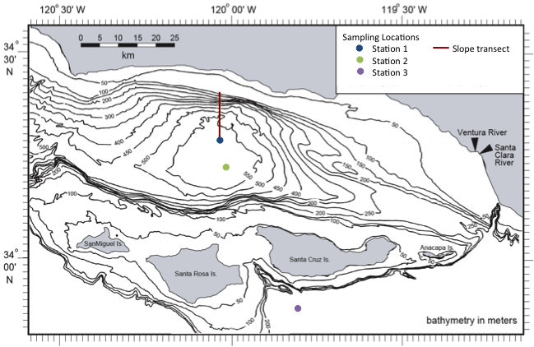
Sample Collection
Los Angeles
Station 1
Santa Barbara Basin
Notes:
Collecting samples often involves going out on a large research ship. In this case, William and Steve both participated in the CalECHOES Student Cruise on the R.V. Melville in Oct. 2010. During the cruise, they helped collect 3 kasten cores, 1 box core from the Santa Barbara Basin. These cores were used by William in his dissertation research.
Images –left; google earth, Right; W. jones
Santa Barbara Basin Background:
In the North Pacific, one of the most extensive and best-laminated sediment systems useful for reconstructing paleoclimate variability lies within the SBB. Most water below approximately 500 m is anaerobic, minimizing bioturbation and allowing for the preservation of millimeter-scale seasonal lamina. The SBB varved sediment record is sensitive to changes in the overlying water column, allowing researchers to use microfossil assemblages, oxygen and carbon isotopes, biomarkers, and other proxies to generate high-resolution records of climate variability on a wide range of time scales, including the glacial-interglacial, millennial, multidecadal, and subdecadal.

Slide 8
Methods
Collect Sediment Cores
“Date” the Sediment Increments
Weighing and Washing Sediments
Classify and Count the Fossils
Construct Time Series
Notes:
2. The sediment cores must be dated chronologically.
Once the sediments are collected, the individual varves in the sediment cores much be assigned a date. This is a very important step because the accurate dating is critical in order to be able to compare the results to existing time series data. If errors in dating are made, the result may be no correlation with existing proxies (such as temperature or productivity), when in reality the error is in dating and there may actually be a correlation.

Slide 9
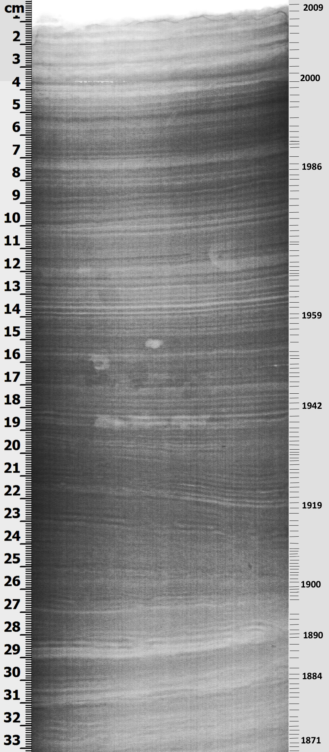
Dating the Sediment Core
Identify major events with known ages.
Count increments/varves.
Compare to cores that have already been ‘dated’.
Notes:
This slide illustrates how dates are assigned to individual varves (or increments).
The photo to the left is a close-up x-ray of a sediment core. The dark layers are dark because they are denser. These layers have high amounts of clay from the terrestrial environment and are deposited during the winter when storm events occur. The light layers are deposited during the spring / summer from biological organisms (plankton). These layers are less dense. One light and dark increment together represent one year. In this way, each of the layers can be assigned a date. Because biological production and the amount of rain fall that occurs in a year varies, the layers are not all the same size.
The two cores shown on the left are color photographs. The gray layers are now the dense clay layers.
The red-dotted lines point out the major flood events in the two cores. Again, they are grey because of the high amount of terrestrial clay. These flood events have known ages based on the flood history of California and from carbon 14 isotope dating. The increments between the flood events are then counted and assigned individual dates. By comparing more than one core, the chronology is more robust (this technique is called cross-dating and is also used in dating tree rings).
For William’s PhD research, he assigned dates to the cores he helped collected in 2010 by comparing the x-ray and color photographs to those of cores which had been already been dated and published in the literature.
Images: w. jones

Slide 10
Methods
Collect Sediment Cores
“Date” the Sediment Increments
Weighing and Washing Sediments
Classify and Count the Fossils
Construct Time Series
Notes:
3. The core is process to removed fossil by washing and weighing the sediment samples.
The next step is processing the samples by removing the fossils from the sediments.

Slide 11
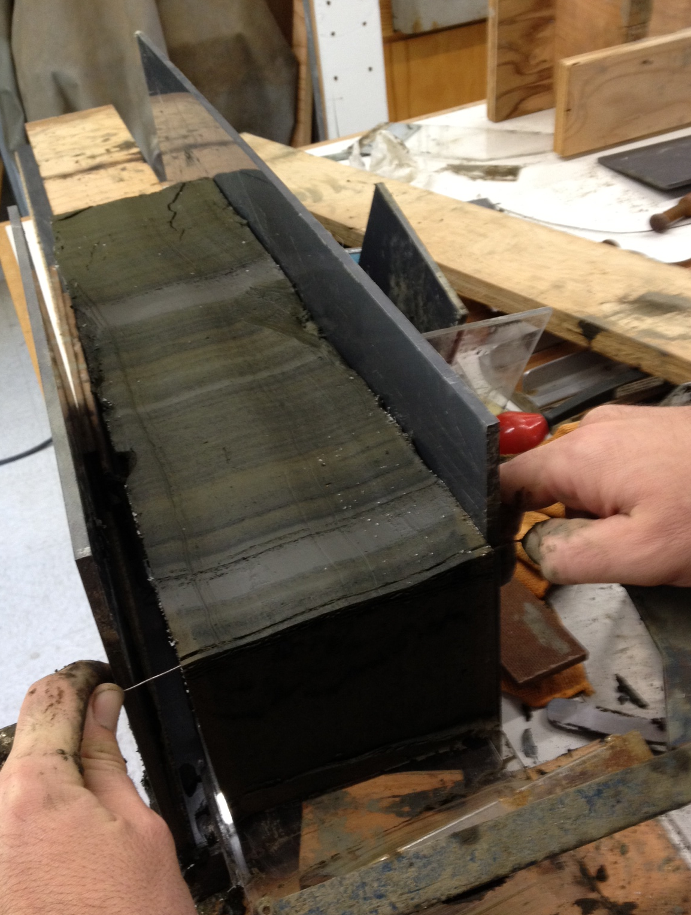
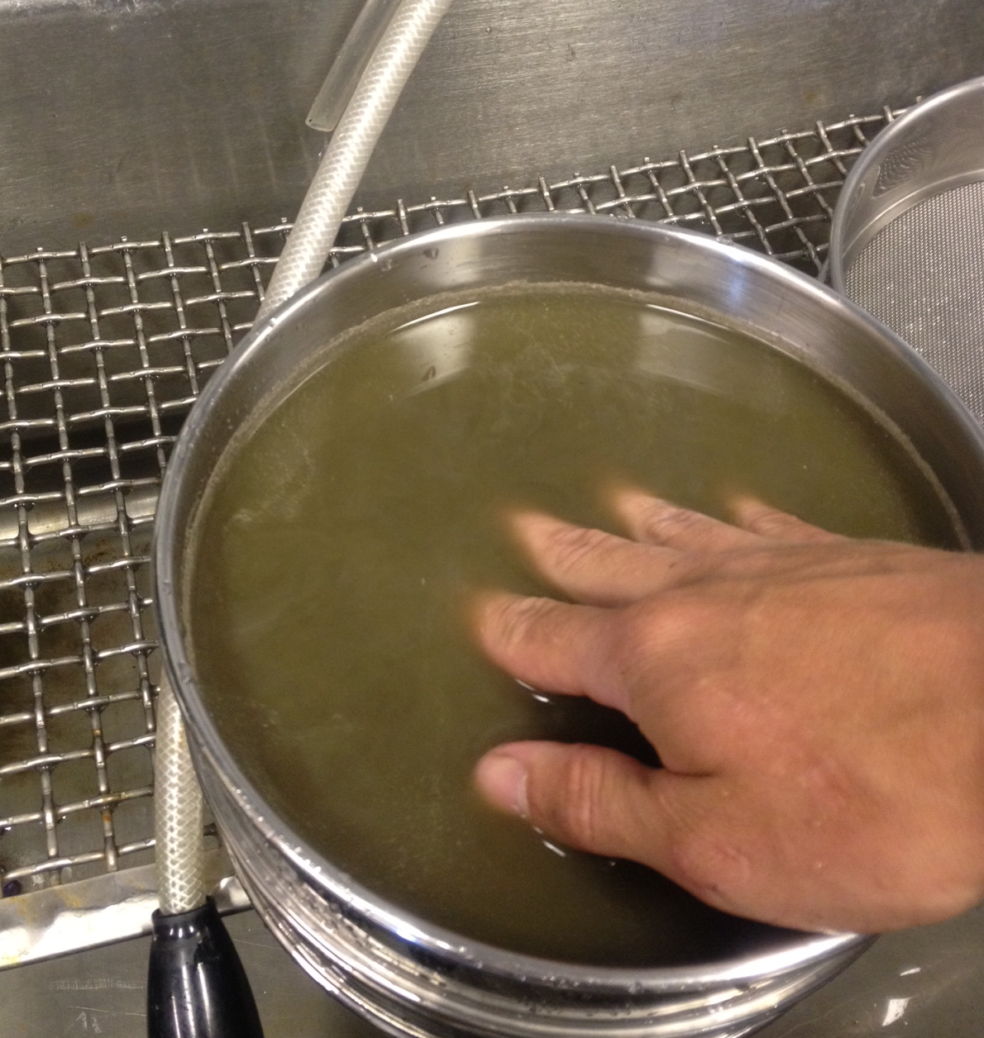
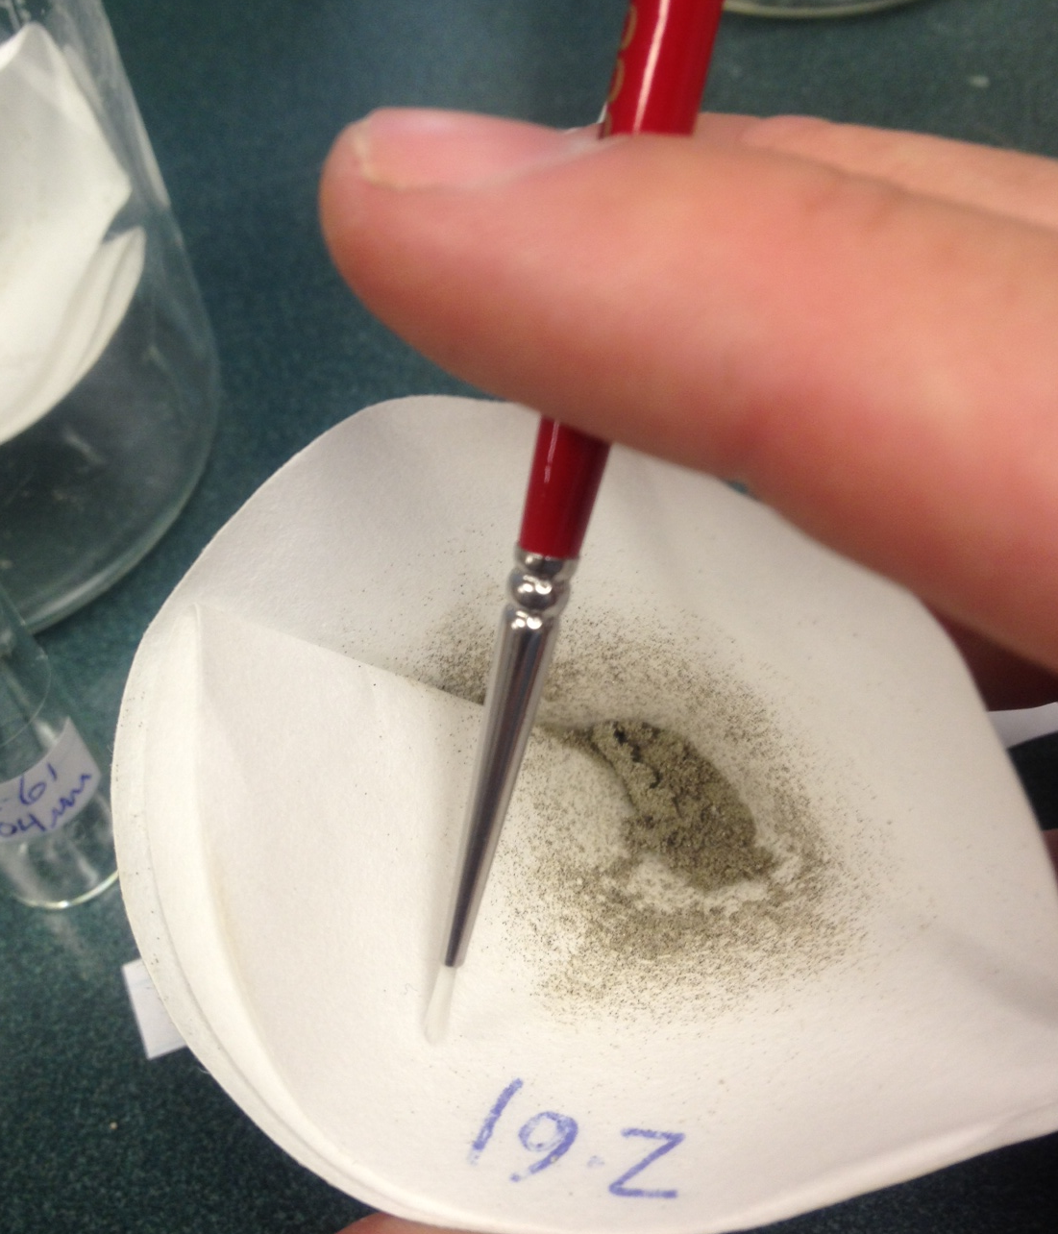
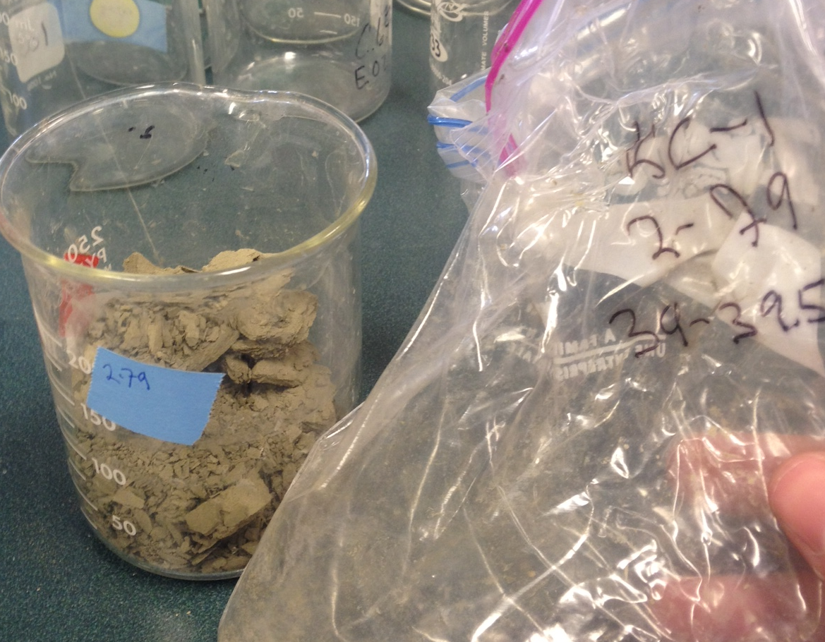
Sample Processing: Weighing and Washing
Sediment Core
sectioning
104micron sieve
Dry weight
Remaining
sample
Notes:
After the sediment cores have been accurately dated, the next step is to remove the fossils from the sediments.
Steps for processing marine sediment cores.
The first step is to cut sediment cores into manageable slabs as shown in the upper left corner. The most common technique is to cut them into 0.5 to 1cm deep sections. For a 3 meter core, this would produce 300 – 600 ‘samples’.
Each sample is then dried and weighed. This step is important for calculating the water weight of each of the sample (samples are weighed before and after drying)
After weighing, samples are re-suspended in water and sieve in a fine mesh to remove fine-grain particles (~100 micron mesh).
Remaining sample is then filtered out on filter paper. Only fossils remain (fish bones, otoliths, fish scales, foraminifera, teeth, squid beaks, etc).
Images: w. jones

Slide 12
Methods
Collect Sediment Cores
“Date” the Sediment Increments
Weighing and Washing Sediments
Classify and Count the Fossils
Construct Time Series
Notes:
After the fossils are removed, they must be identified using a microscope and identification guide.

Slide 13
Fossil Identification
Foraminifera / plankton
Fish bones
Fish Scales
Fish Otoliths (ear bones)
Squid beak / statoliths (squid equivalent to otolith)
What else is there?
Notes:
Most of the marine fossils (90% by mass) removed from Santa Barbara sediment cores would fall one of the 5 categories above – foraminifera/plankton remains, fish bones, fish scale, fish otoliths, or squid remains.

Slide 14
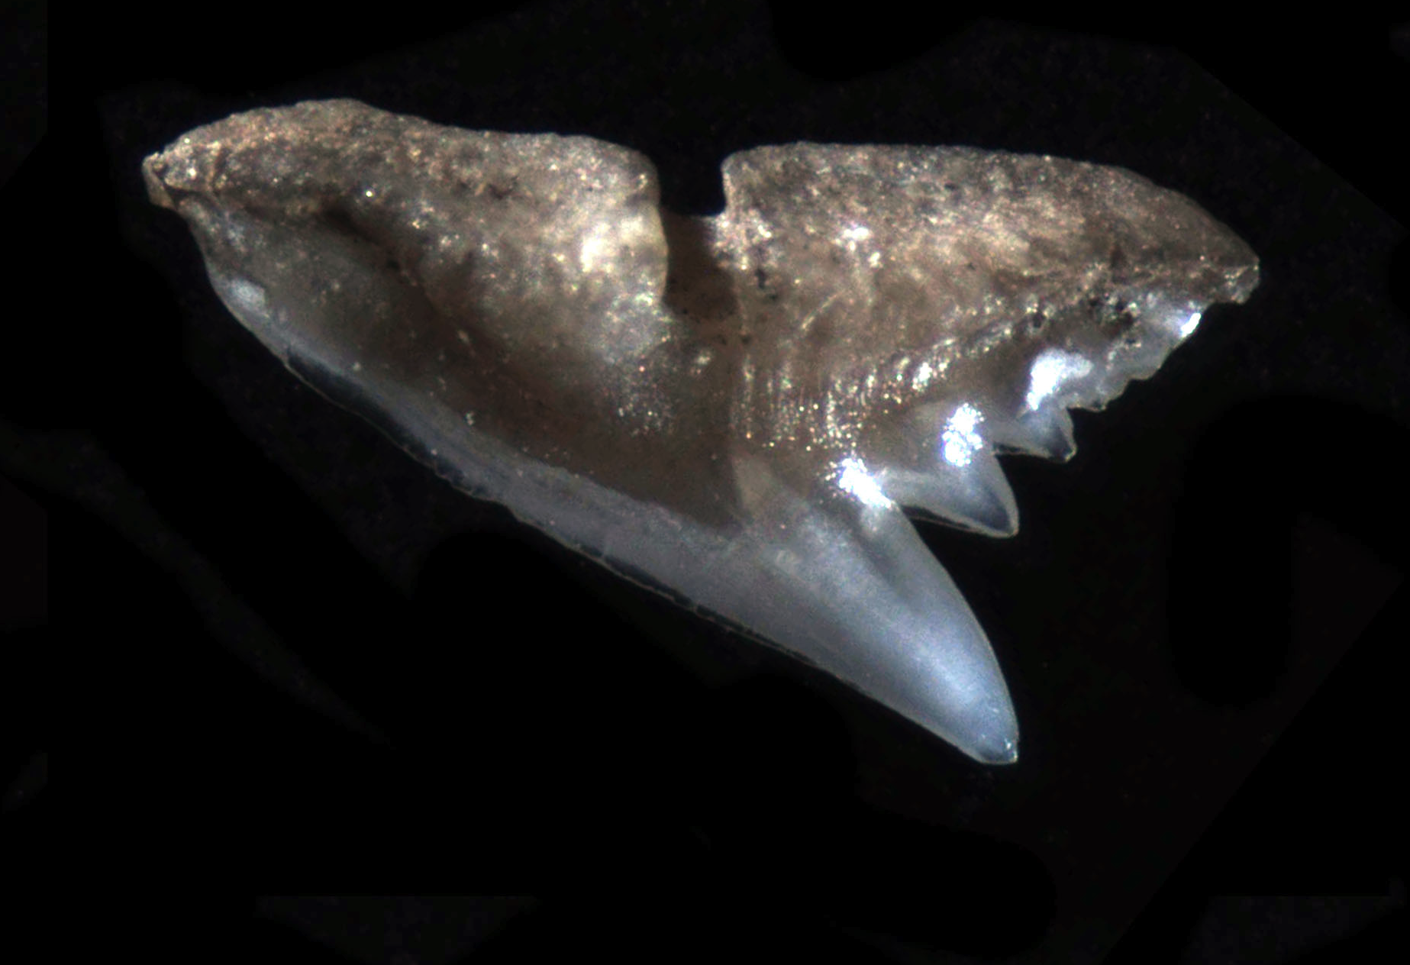
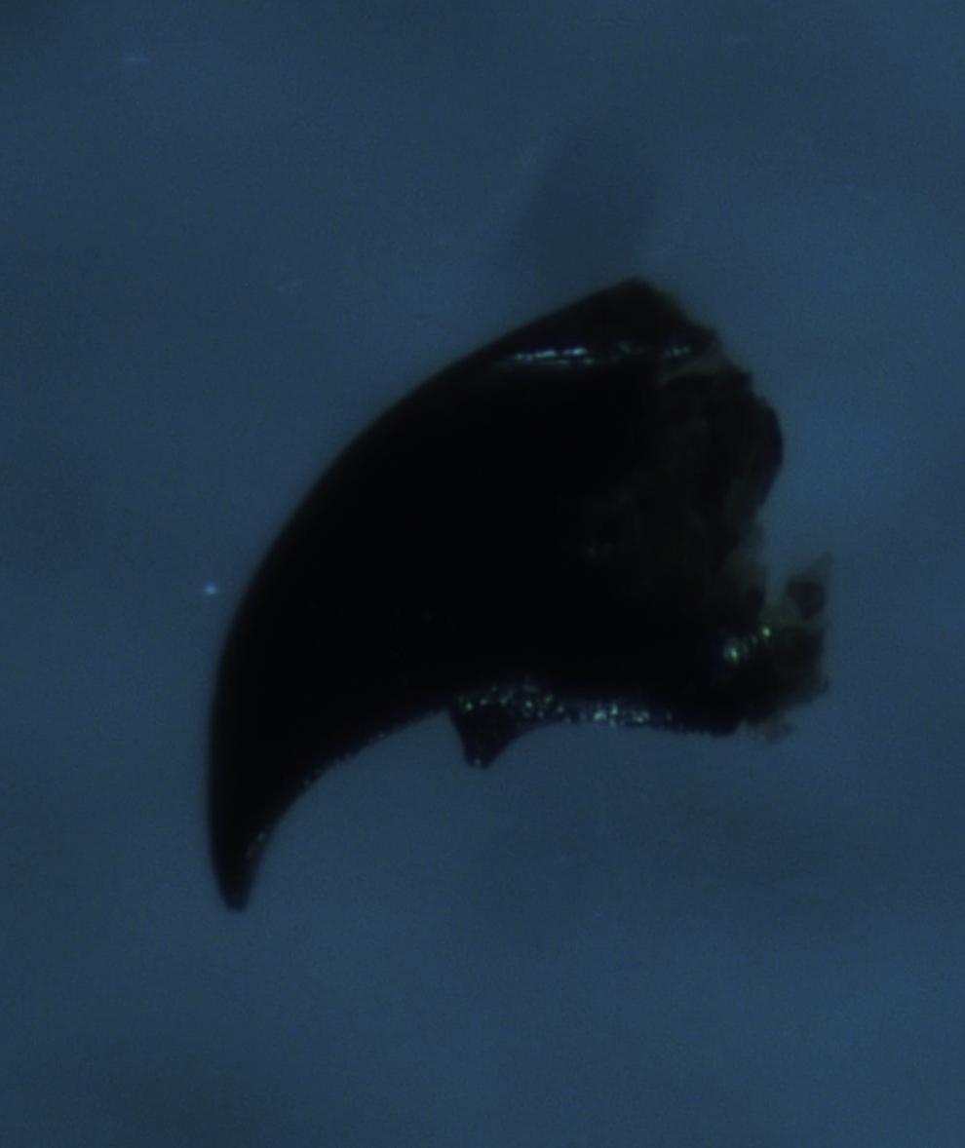
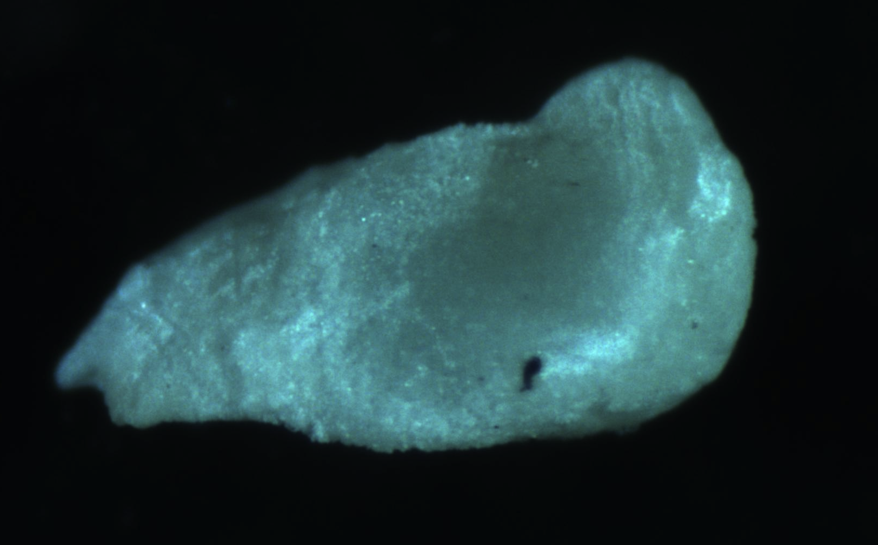
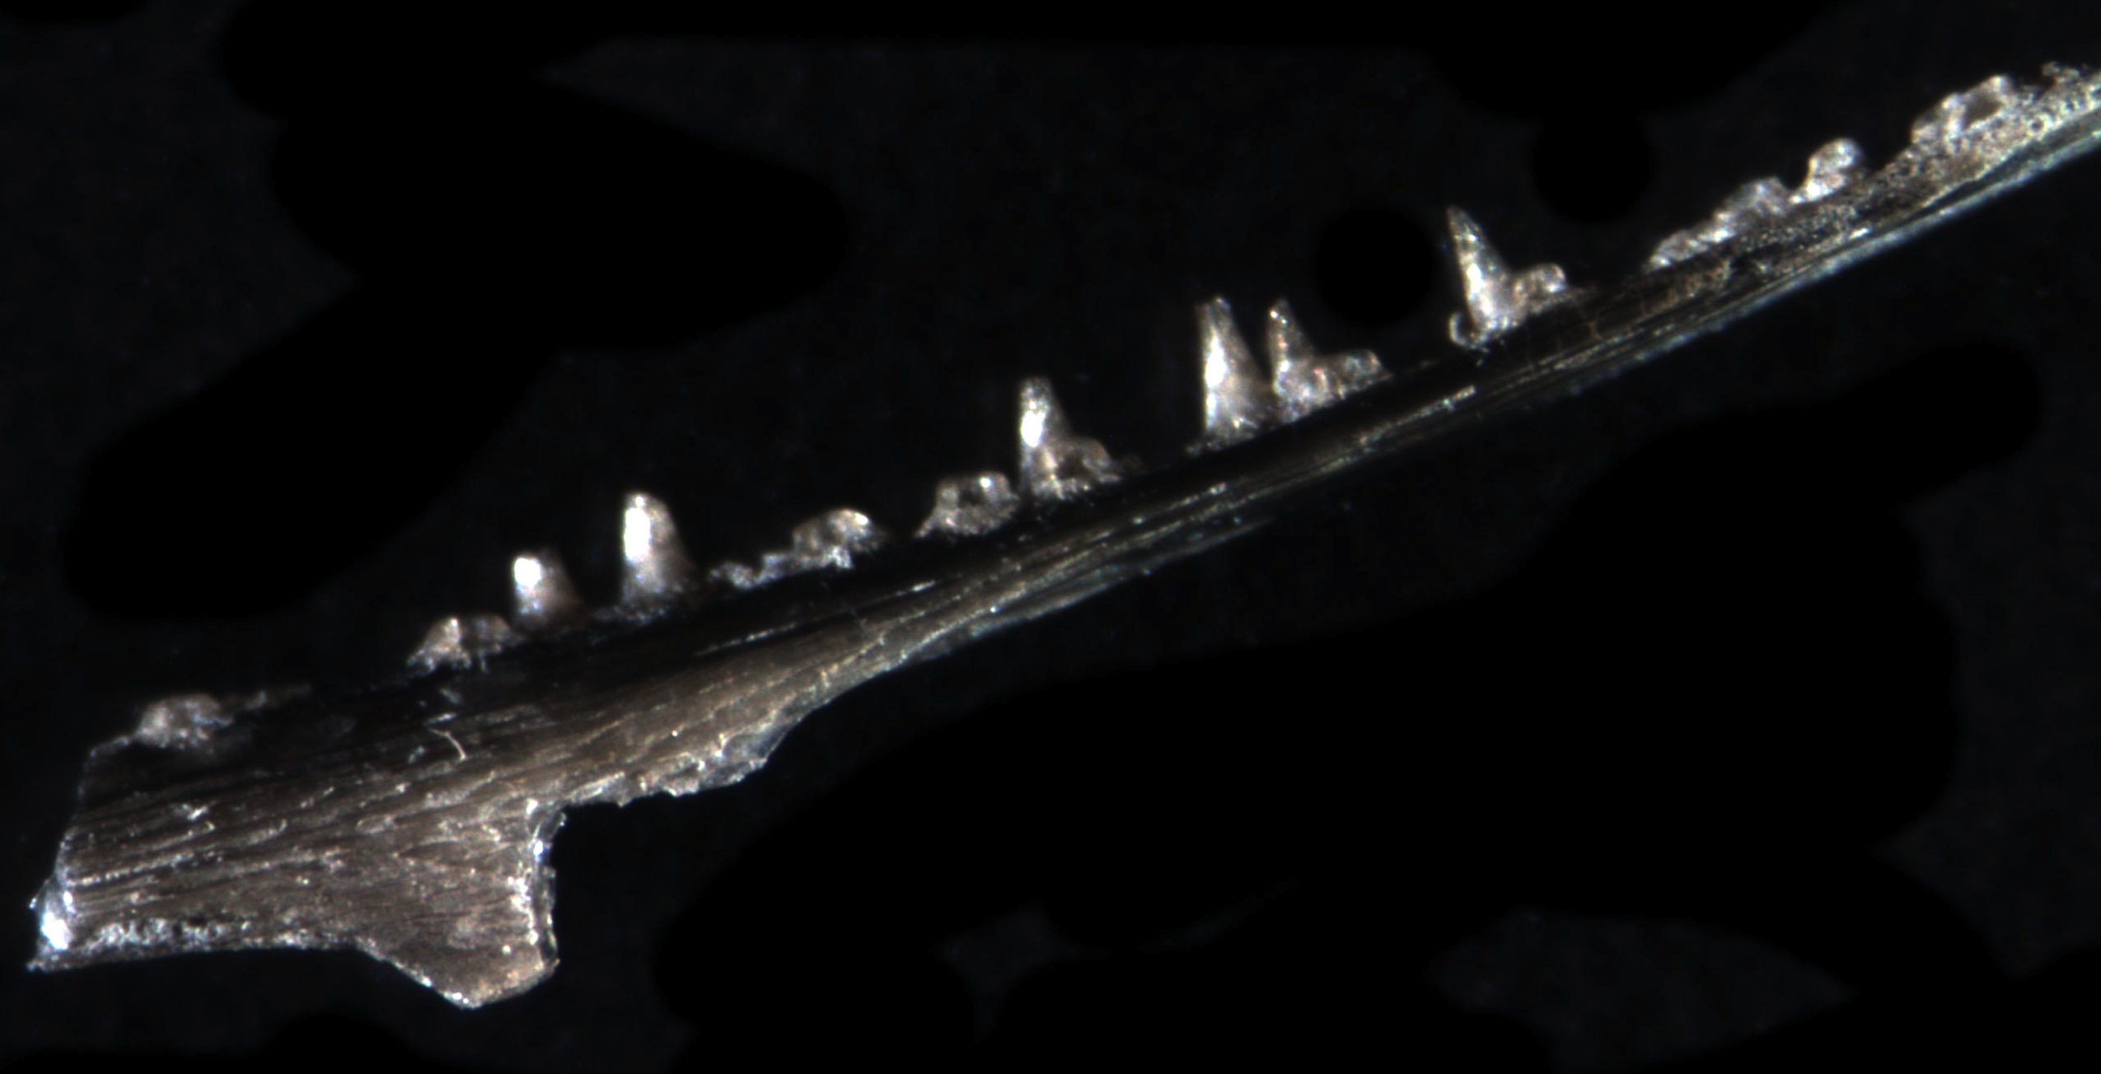
Shark tooth
0.5 mm
Squid Beak
0.5 mm
0.5 mm
0.5 mm
Squid statolith
Fish Bones (jaw)
Notes:
Example of what is removed from the sediments.
Upper left: Shark tool (likely from a “Dogfish” shark)
Upper Right: Squid beak – possibly from a market squid
Lower Left: Squid statolith
Lower Right: Fish jaw bone
images: w. jones

Slide 15
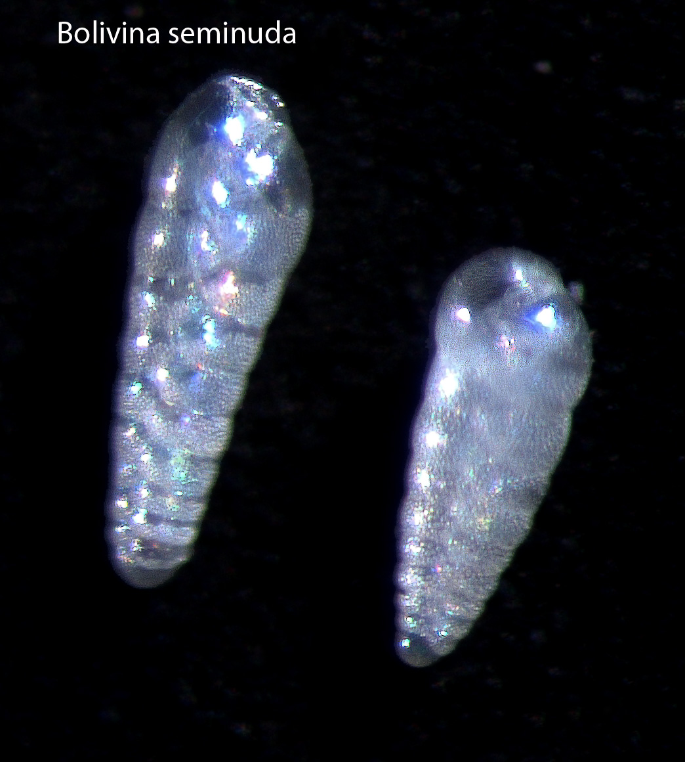
Foraminifera
shells
Bseminuda_t
0.1 mm
Notes:
Foraminifera shells.
Image: w. jones

Slide 16
Methods
Collect Sediment Cores
“Date” the Sediment Increments
Weighing and Washing Sediments
Classify and Count the Fossils
Construct Time Series
Notes:
After the fossil are removed and identified from the sediment cores, then a time series can be constructed using the core chronology. Since the location where each fossil came from within the core is known (accuracy is dependent on the width of the sub-sample slabs – 0.5cm slabs would have higher accuracy than 1cm slabs), each fossil can be assigned a fairly specific date. Counts of the fossils can then be graphed as a time series.

Slide 17
Otolith Time Series
Notes:
Otolith count vs. time from a Kasten core taken from the Santa Barbara Basin (same as shown on the first slide).
The graph shows the otolith deposition rate (number of otoliths that have fallen in 100 cm² per 10 years) over two thousand years. What is very striking about this record is that it shows very high variability. Assuming otolith deposition rate reflects the abundance of fish in the water column at the time, this shows that the populations of fish vary considerably on the decadal to multi-decadal scale. This graph could not be created from fishing records since reliable fishing records to not extend back more than 100 years. This graph is part of William’s PhD research.
This time series can now be compared to other existing time series from the Santa Barbara Basin or region. Other time series include tree ring data, precipitation, productivity, upwelling index, temperature, abundance of other fossils (such as foraminifera or squid), and reconstructions of long-term environmental fluctuations such as the Pacific Decadal Oscillation.
In summary, the long-term variability of the entire fish assemblage off the coast of Southern California remains largely unknown. Without an understanding of natural variability in marine fish assemblages, impacts of recent and future perturbations, both natural and human induced (climate change), are difficult to assess. Traditional fish records and scientific observation do not extend back far enough to study the long-term variability of many fish populations. Thus, scientists study the remains of fish from marine sediments.

Slide 18
Today’s Lab
Collect Sediment Cores
“Date” the Sediment Increments
Weighing and Washing Sediments
Classify and Count the Fossils
Construct Time Series
Notes:
In today’s lab, students will get the opportunity to go through 3 of the 5 steps of how scientists study historic (fish) populations. The lab will be conducted in 5 stations (see next slide).

Slide 19
Station Activities: ~10-12 min at each station
  ‘Washing’ station – wash a pinch of sediment through the sieve at the sink to obtain the fossils.
  Picking fish scales out out of washed sediments.
  Counting yearly increments (varves) in Santa Barbara Core – picture and in the real sediment slab.
Notes:
Instructions for the 5 stations that the students will each visit.
Station 1. Sample Processing: Washing Stations
Students wash a small amount of marine sediments using a sieve and running water in the sink. The object is to wash away the sediments so that only the fossils are left (foraminifera shells, gastropod shells, fish scales and bones, otoliths). If washed properly, the there should not be any ‘mud’ left in the sample – only a very small amount of fossils. Once sieved, the fossils are gently washed onto filter paper (coffee filters work great!) over a 500ml beaker and left to dry overnight. Mesh size from 500micron to 100 micron should work.
Station 2: Sample Processing: Picking Scales Station
Using a dissecting microscope, students pick fish scales out of pre-sieved marine sediments.
Station 3: Aging the Core: Counting Varves Station
Students attempt to count the correct number of varves (yearly / seasonal layers) in a core photograph (labeled “BoxCorePhoto.docx “– the answer key is “BoxCorePhoto_Key.docx”). The photo is a close-up x-ray of the varves in a box core from the Santa Barbara Basin. The dark layers are dark because they are denser. These layers have high amounts of clay from the terrestrial environment, deposited during storm events that occur during the winter months in Southern California. The light layers are deposited during the spring / summer from biological production. The Santa Barbara Basin is highly productive due to upwelled nutrient-rich waters entering the basin from the north. One light and dark increment together represent one year. This is what the students should look for when counting the varves and assigning ages. In this way, each of the layers can be assigned a date. Because biological production and the amount of rain fall that occurs in a year varies, the layers are not all the same size. As a reference, the very first varve at the top is from 2009 (the top most varve from 2010, when the core was collected, was not dense enough to be preserved). Students should work their way down from 2009 by counting the alternating dark and light layers as one year.
Station 4: Fossil Sketching Station
Students examine several marine sediment fossils under a dissecting microscope and sketch them. If the teacher does not have access to actual marine sediment fossils (fish scales, otoliths, foraminifera, fish bones, etc) the students can sketch them from unlabeled photographs. The students do not yet know what the fossil is at the time that they are sketching – they are making their own “ID guide”.
Station 5: Fossil Identification station
Students use a reference catalogue to identify the fossils that they drew. The better their drawings, the easier they will be able to identify their fossils.

Slide 20
Station Activities: ~10-12 min at each station
  4. Fossil Sketching Station: Draw what you see: Forams, Bones, Shells, scales, otoliths. you must draw 3 of them.
  5. Identify what you sketched using reference notebook.
Notes:
Instructions for the 5 stations that the students will each visit.
Station 4: Fossil Sketching Station
Students examine several marine sediment fossils under a dissecting microscope and sketch them. If the teacher does not have access to actual marine sediment fossils (fish scales, otoliths, foraminifera, fish bones, etc) the students can sketch them from unlabeled photographs. The students do not yet know what the fossil is at the time that they are sketching – they are making their own “ID guide”.
Station 5: Fossil Identification station
Students use a reference catalogue to identify the fossils that they drew. The better their drawings, the easier they will be able to identify their fossils.

