Slide 1
Santa Barbara Basin Sediment
Reference Fossil Photographs
Notes:
All images taken by W. Jones, unless otherwise noted.
Teacher Note: Print a couple of these guide and put them in a spiral bound note book. The guide will be used at station 5, where students will attempt to identify the fossils they drew at station 4. If actual marine fossils are not available for station 4, the teacher can pick out a few of the images in this powerpoint and have the students draw them at station 4.

Slide 2
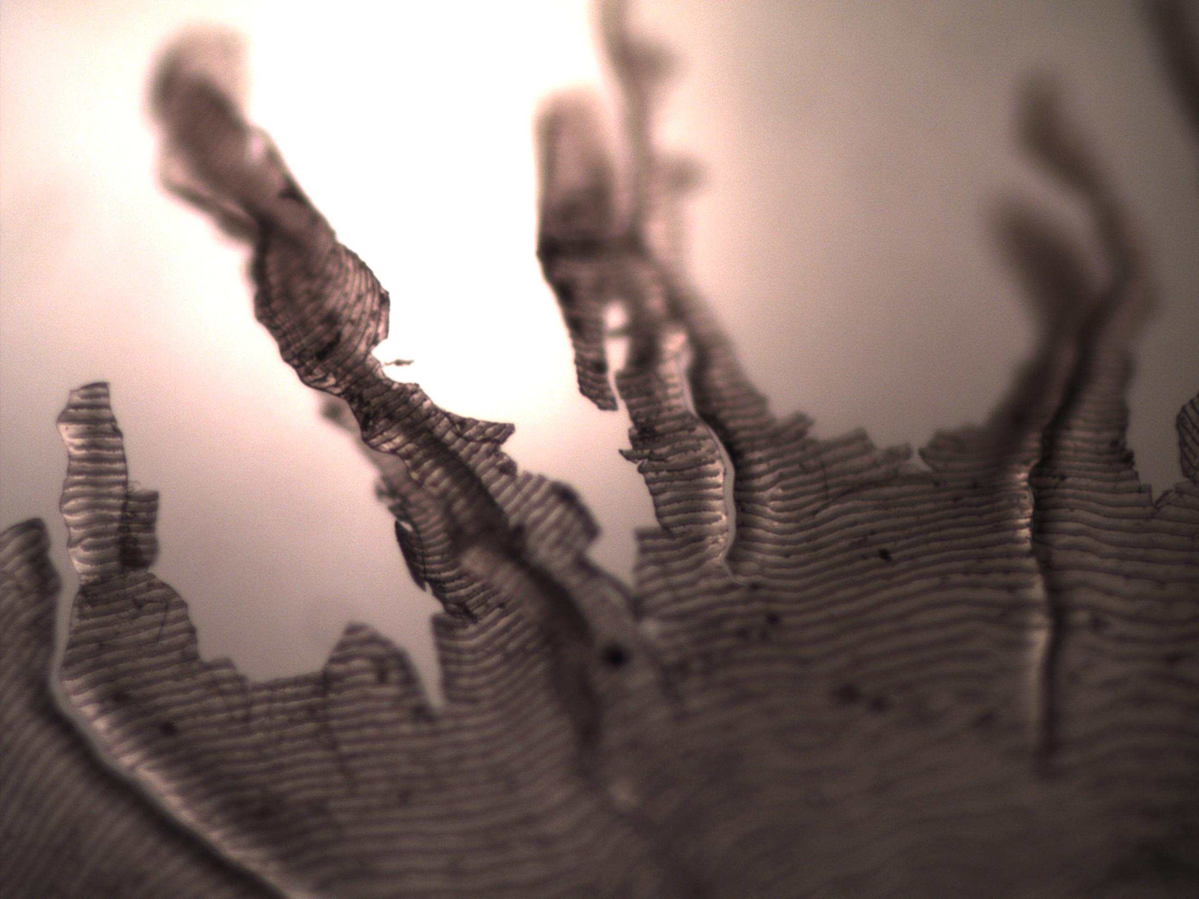
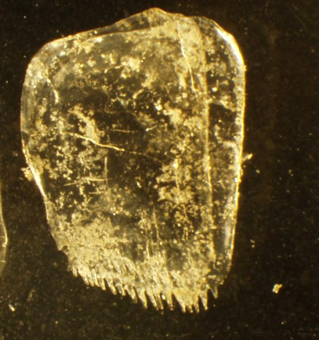
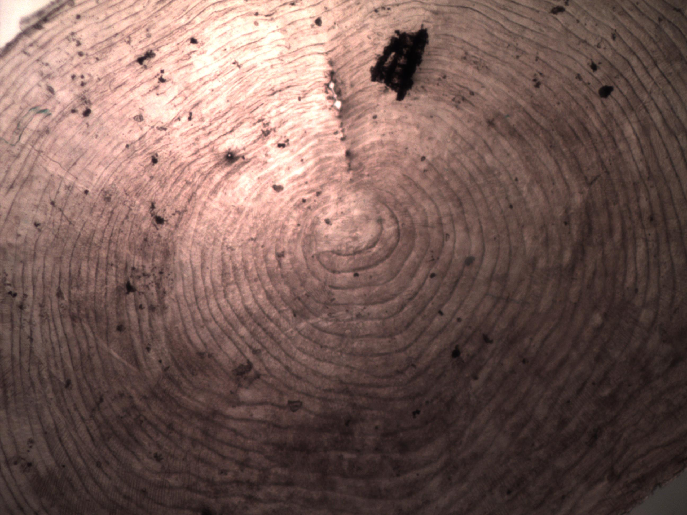
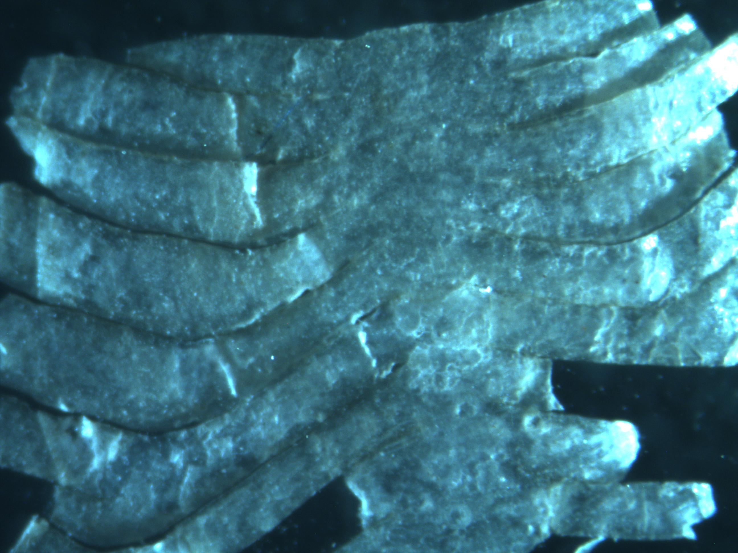
Fish
Scales
Notes:
Fish scales are transparent with a slight gold color. They also have very find microstructure / rings if viewed under the microscope (e.g. bottom right). Many of the scales will be broken and fragmented like the one pictured in the top left panel. The top right shows a whole fish scale. Whole fish scales are typically several mm across (2-3mm). Broken pieces can be very small.

Slide 3
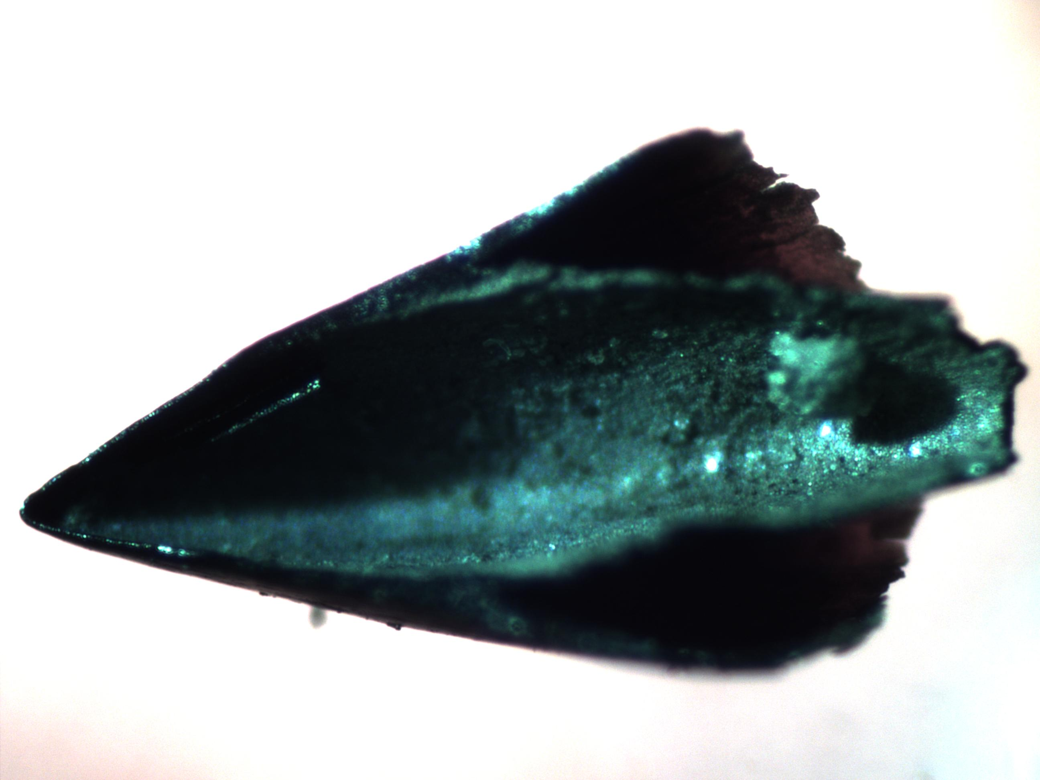
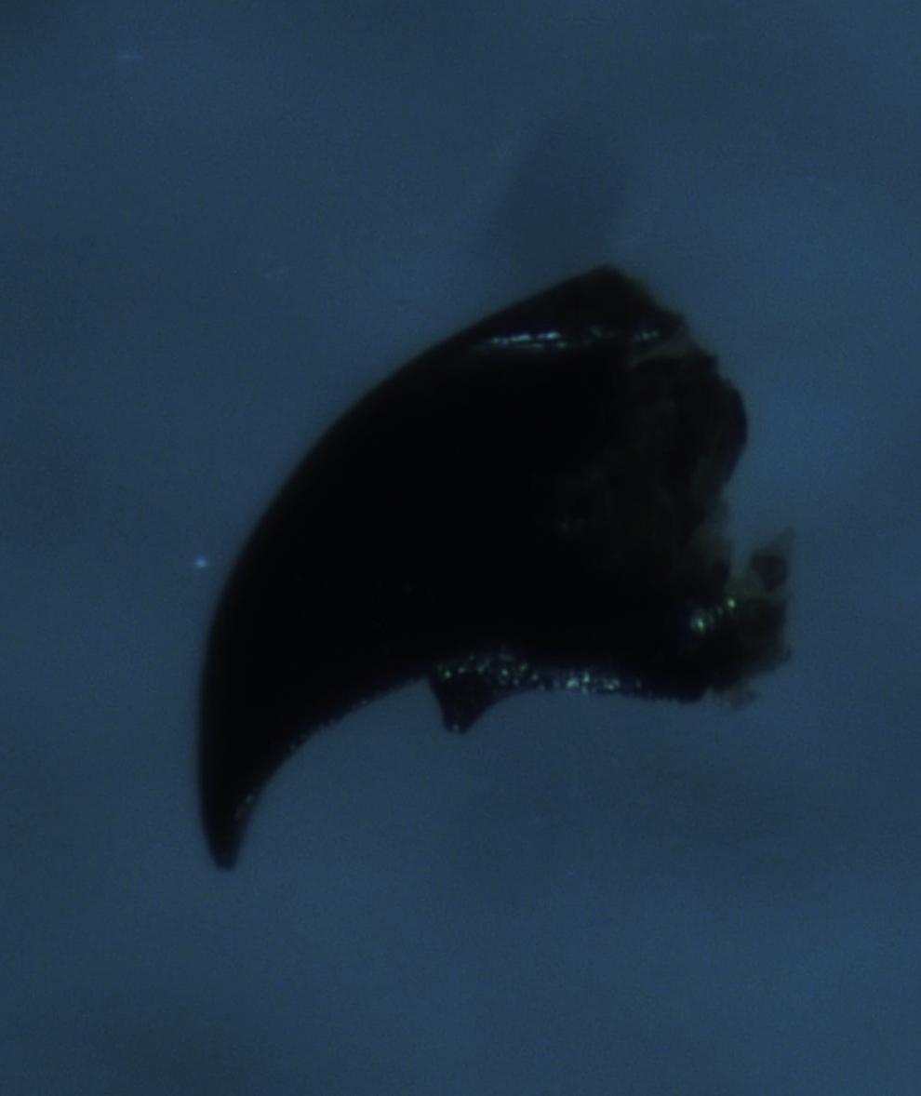
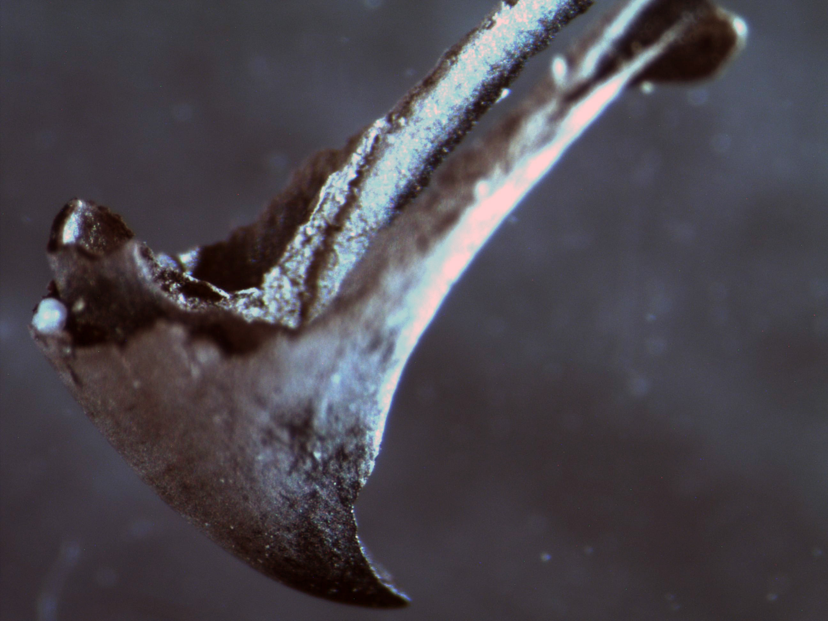
0.5 mm
Squid Beak
0.5 mm
0.5 mm
Notes:
The beaks are from approximately 6 small species of squid found in the California Current Region (e.g., market squid). They are typically about 1mm long, but can be much larger.

Slide 4
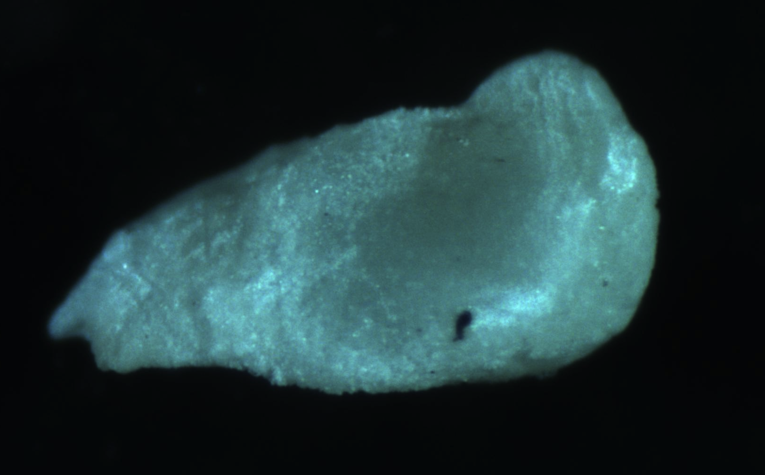
0.5 mm
Squid statolith
Notes:
Statoliths function like the otolith of a fish. They are found in the inner ear of squid and help with hearing and movement/balance. Also like otoliths, they are made of aragonite. They are typically about 1mm long.

Slide 5
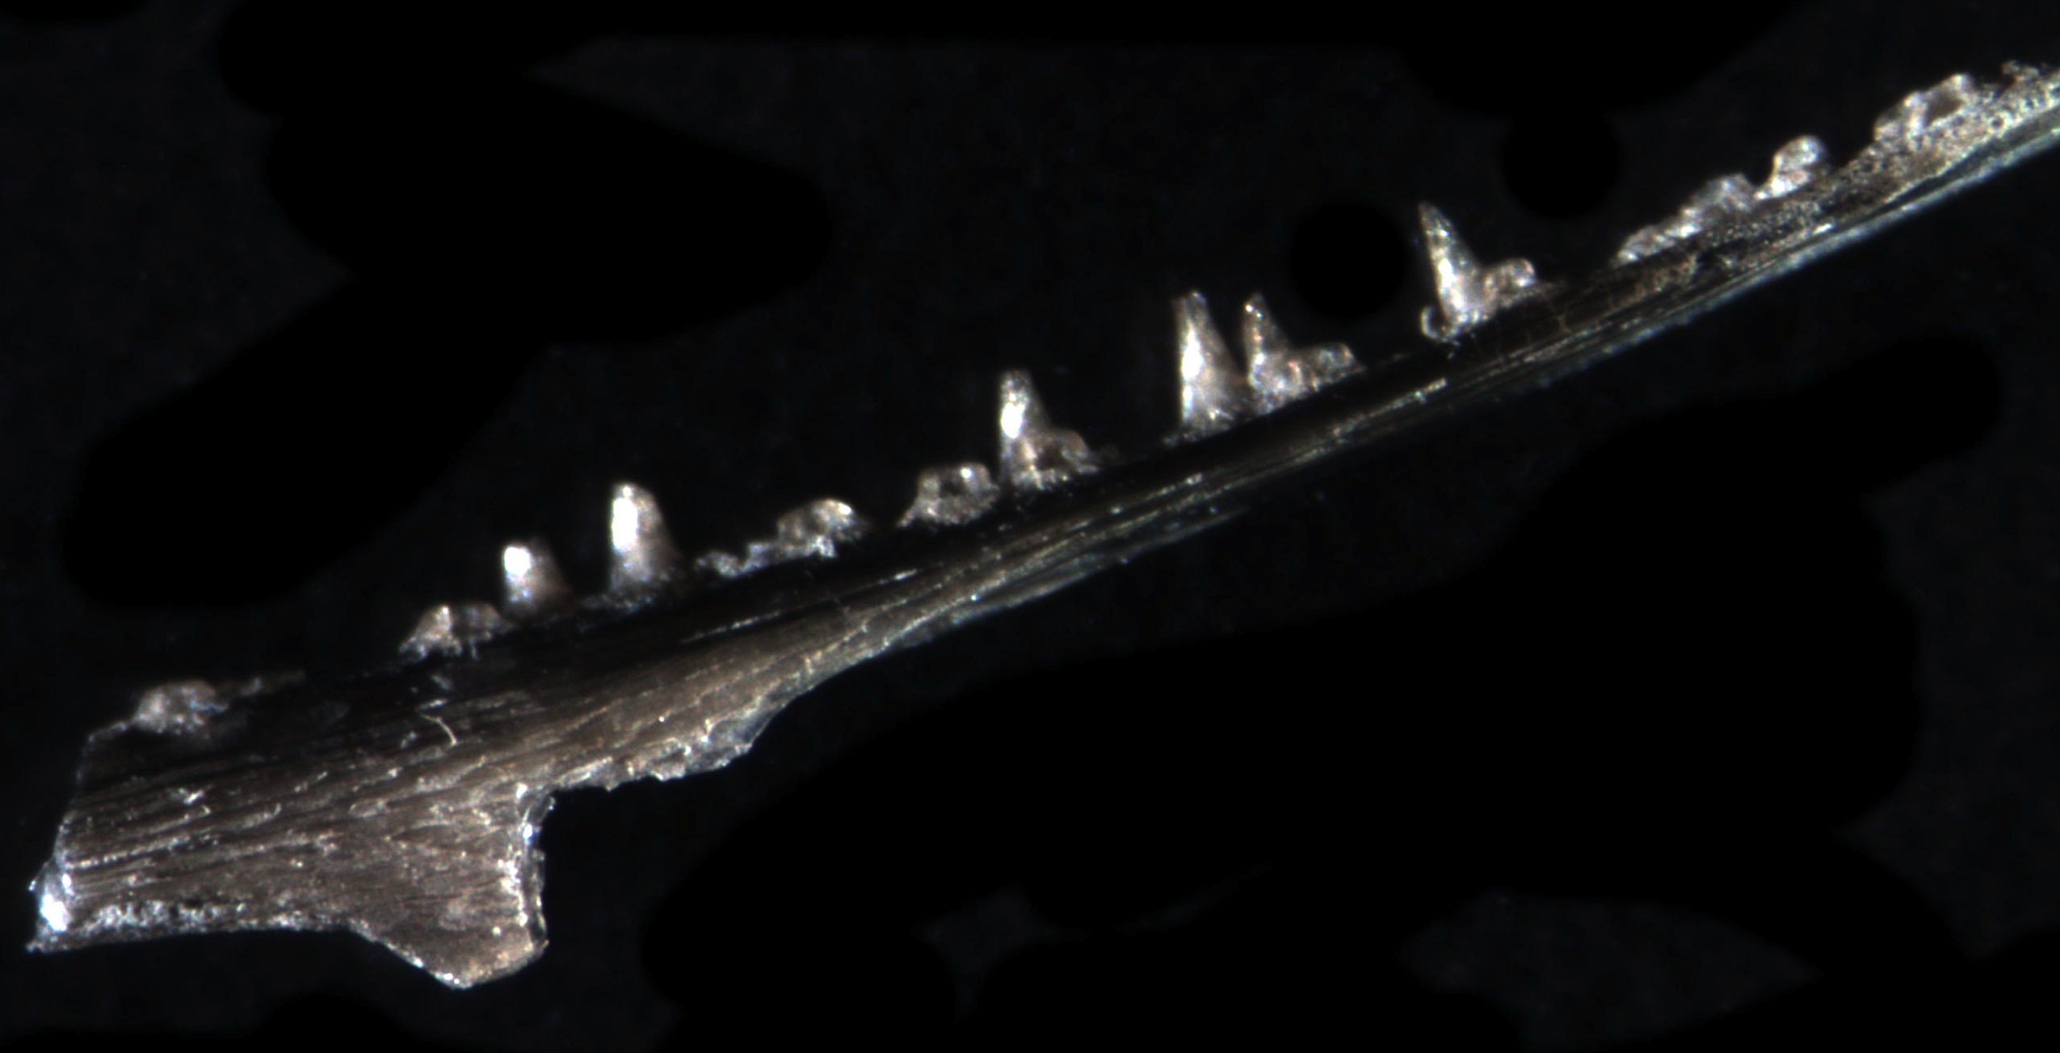
0.5 mm
Fish jaw
Notes:
Many fish bones are present in the Santa Barbara basin. Most are simple spines or fragments. The more identifiable bone fragments include jaw bones and vertebra (next slide).

Slide 6
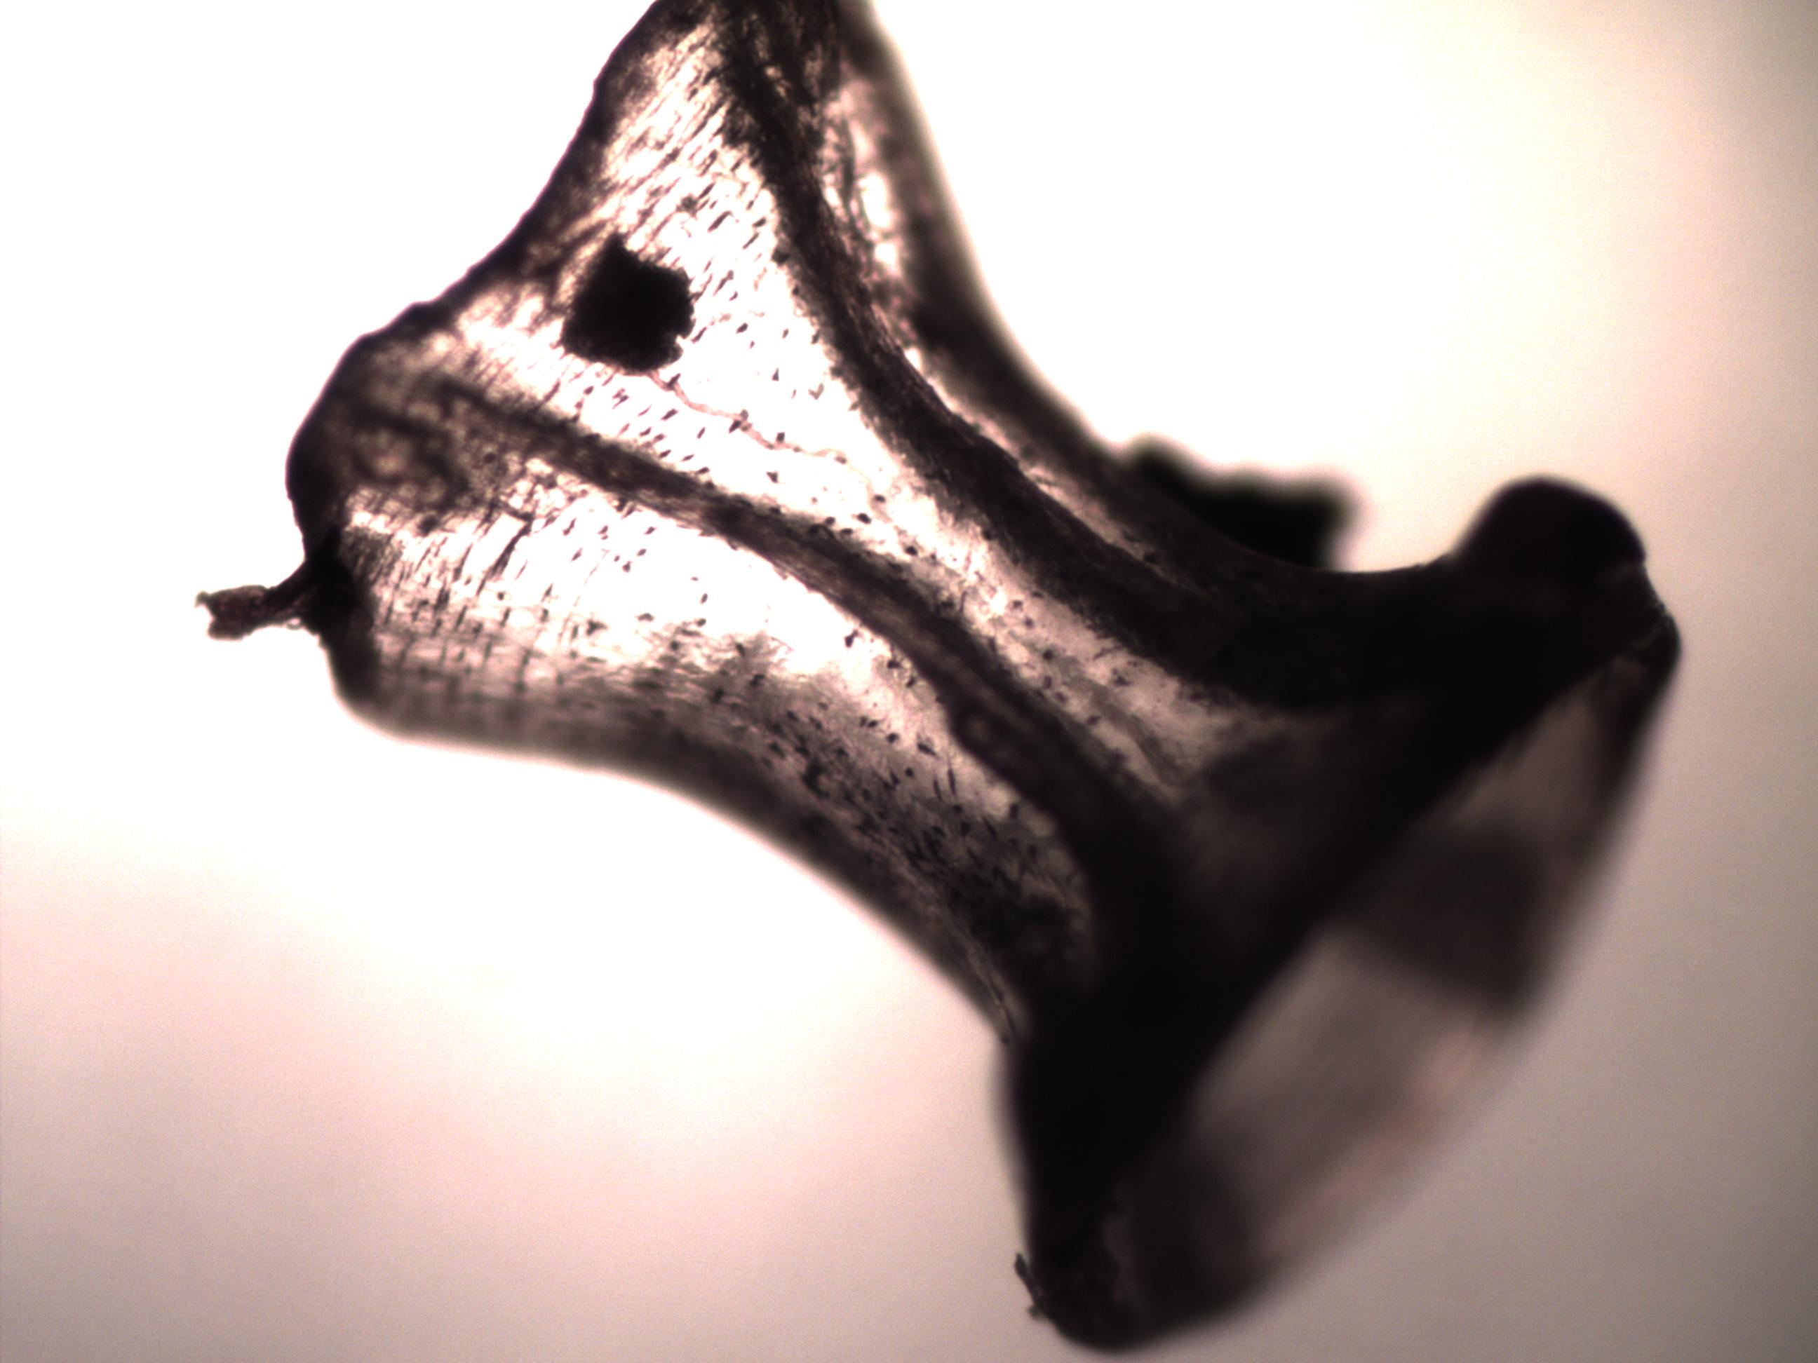
Fish Vertebrae
0.5 mm
Notes:
Fish vertebrae are among the most common and easily identified fish bone remains found in the sediments. Other fish bones that are easy to identify include fish jaw bones and fish spines.

Slide 7
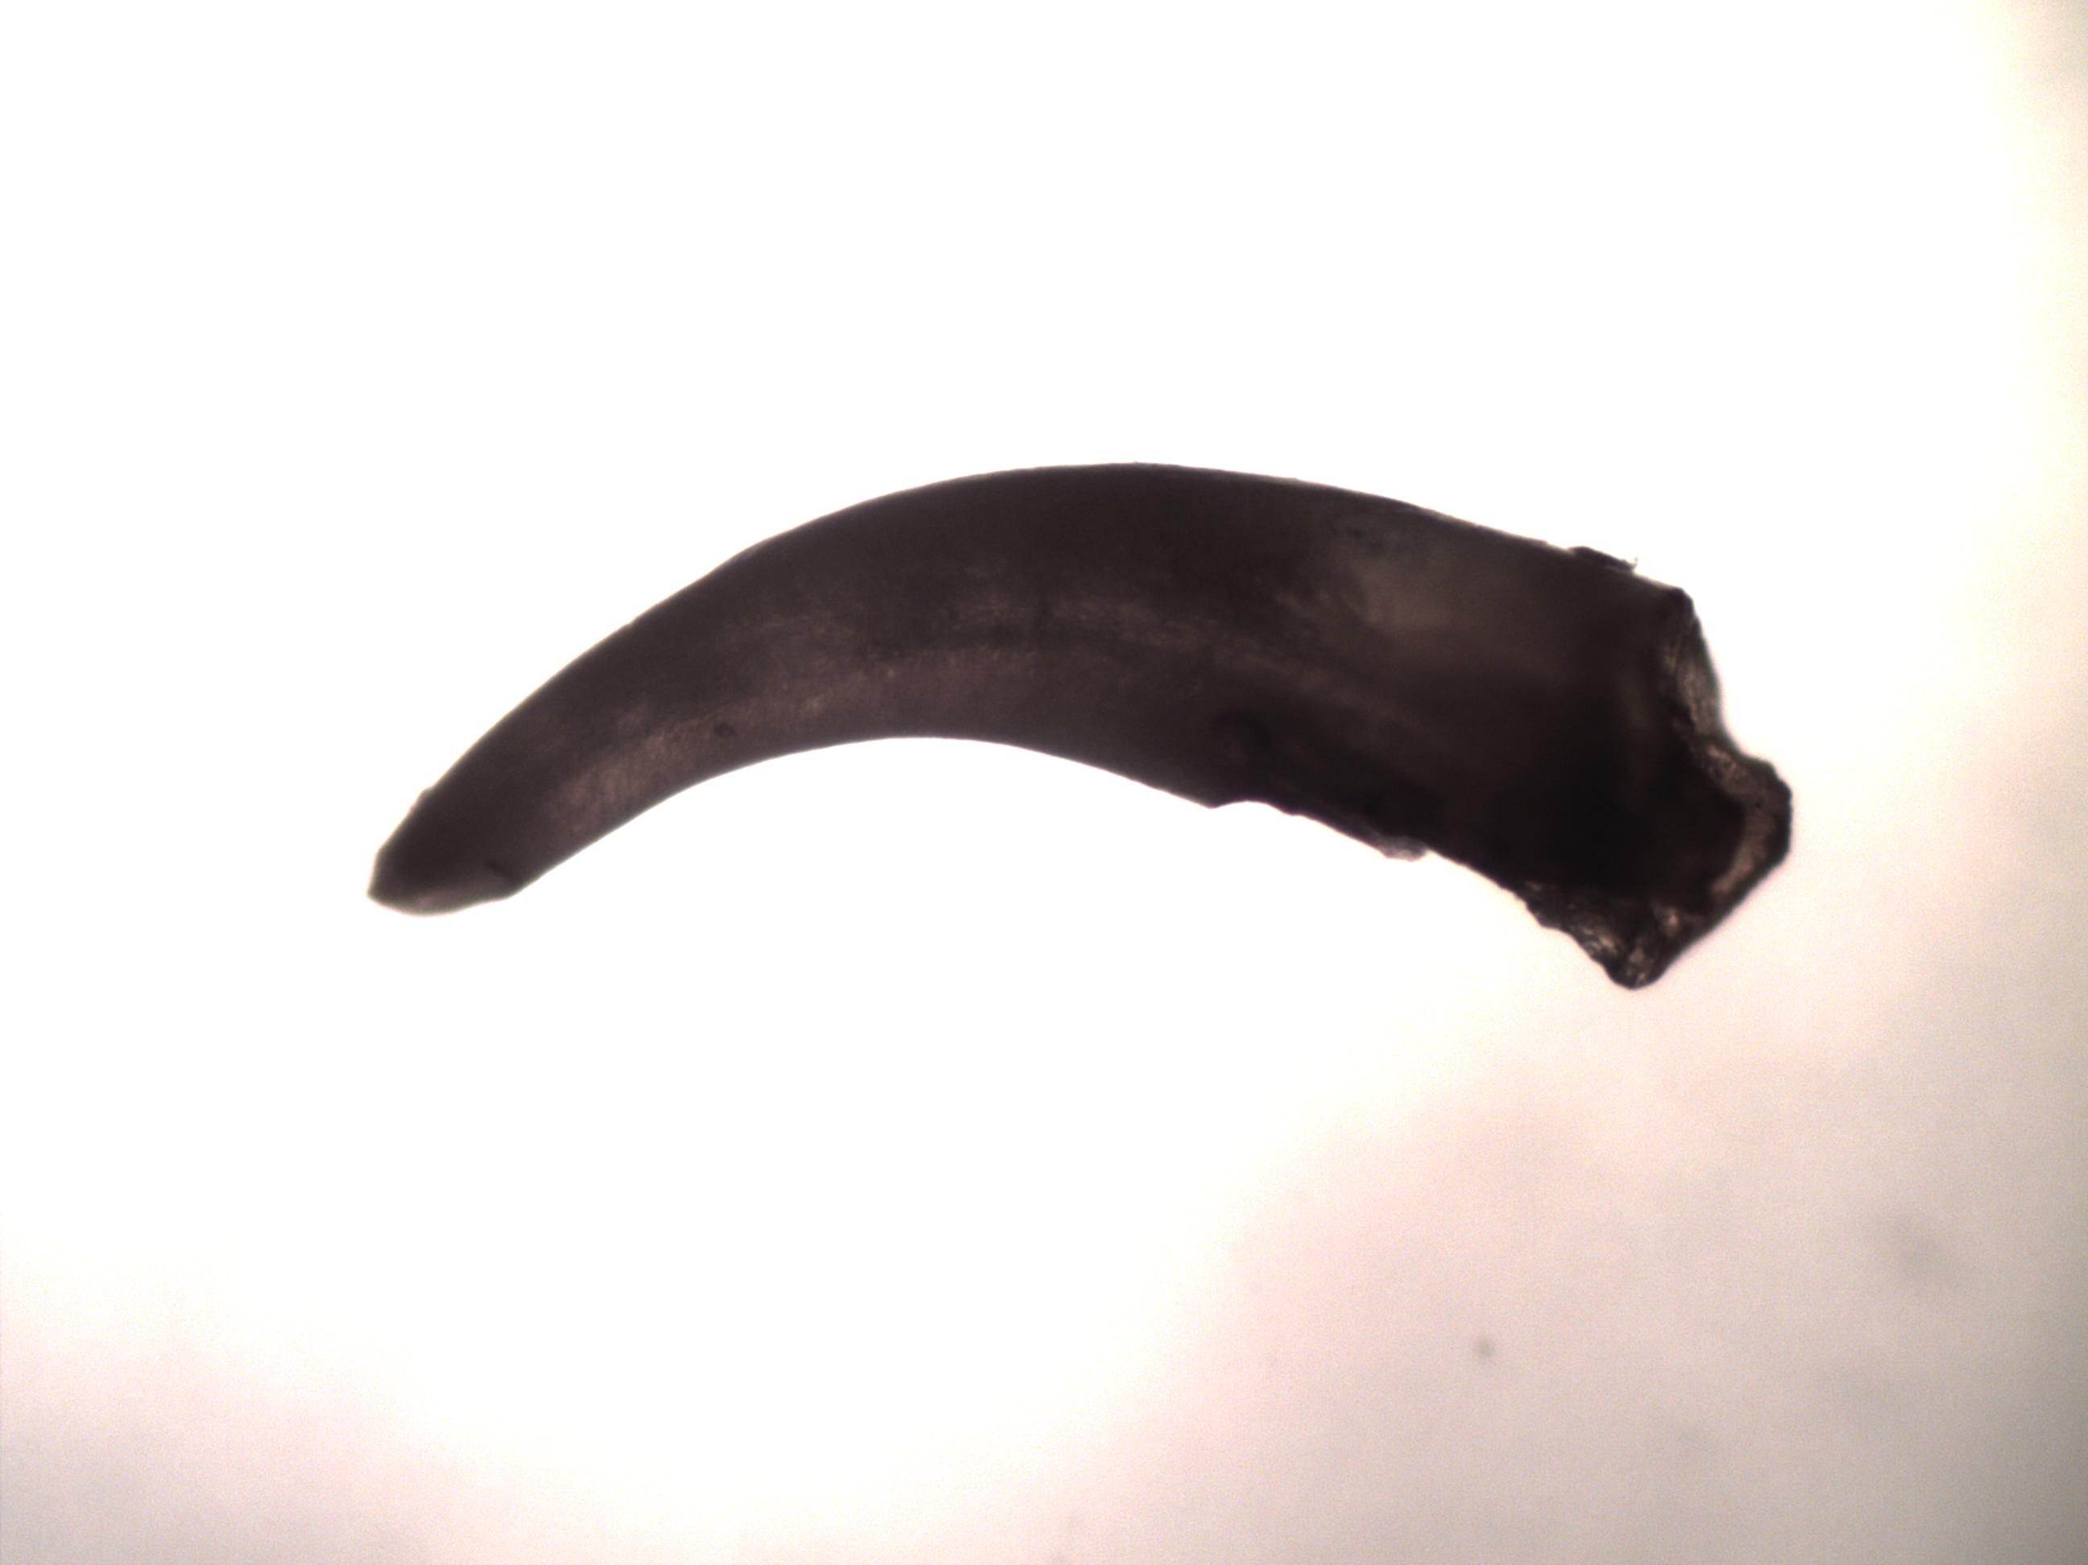
Fish Tooth
0.5 mm
Notes:
Fish teeth can very greatly in size. Small ones from midwater fish can be 100 microns, while larger teeth can be almost 1mm in length.

Slide 8
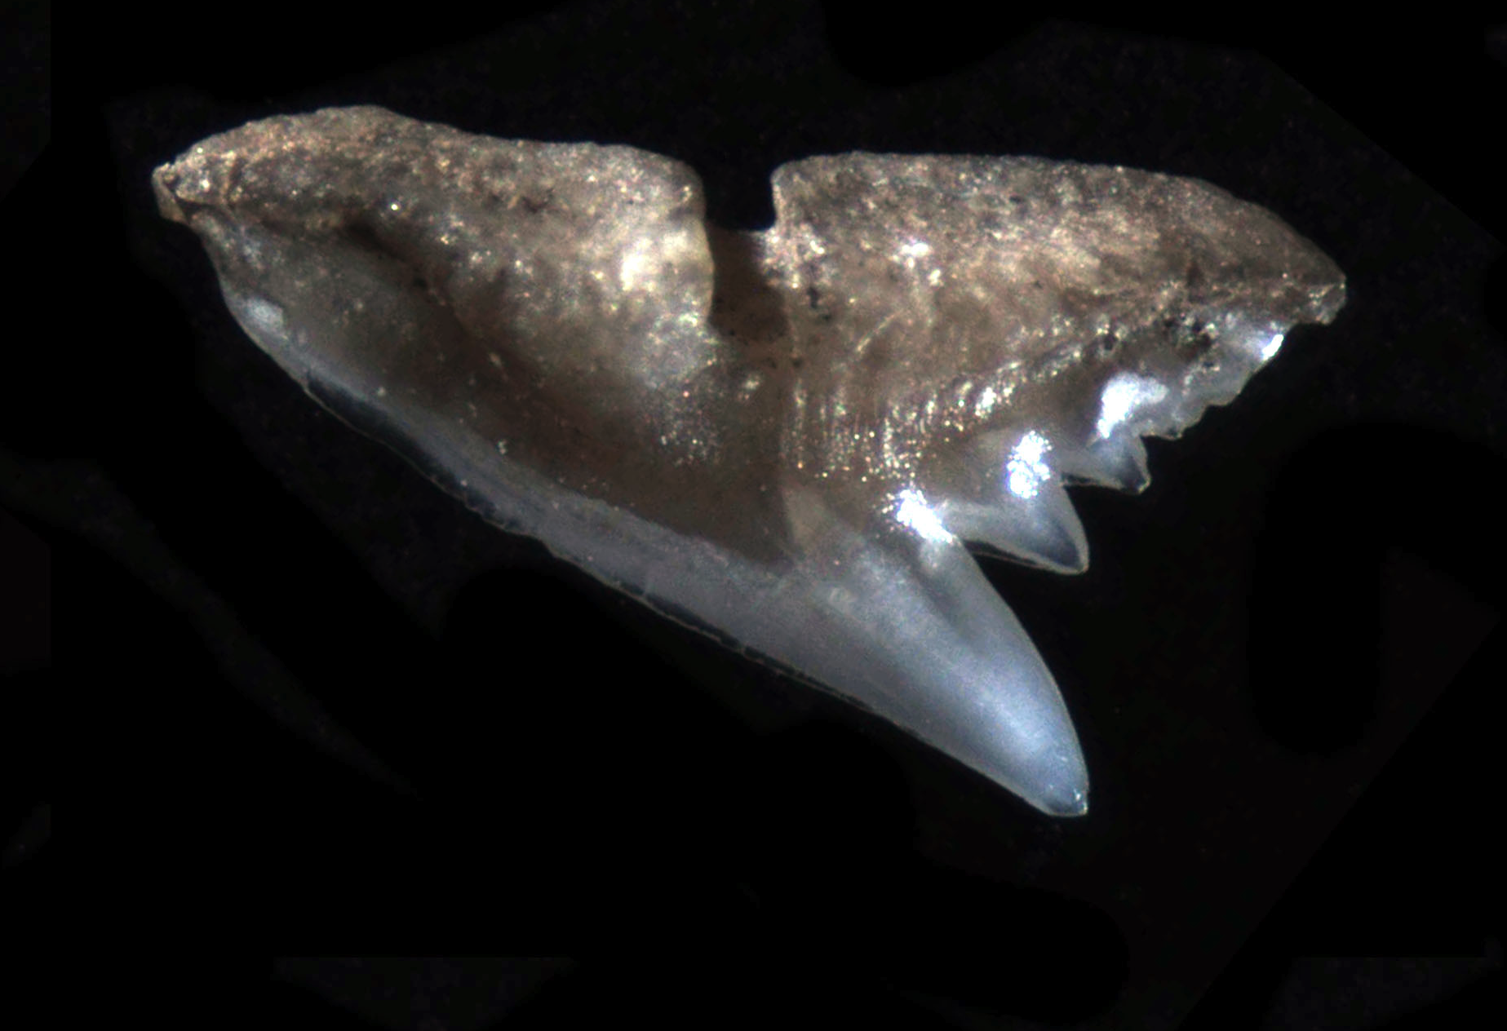
Shark tooth
0.5 mm
Notes:
Like fish, teeth shark teeth are very rare, but very cool to find!

Slide 9
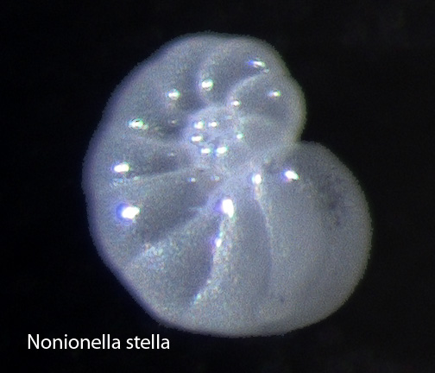
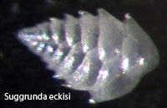
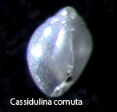
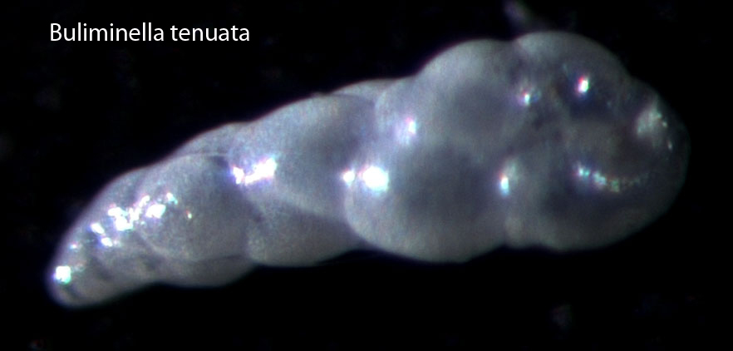
Foraminifera Shells
0.1 mm
Notes:
Foraminifera shells often make up the bulk of the mass of the fossil remains. There are several species, the most common ones shown above. The shells are aragonite and very fragile. Handle them with care.

Slide 10
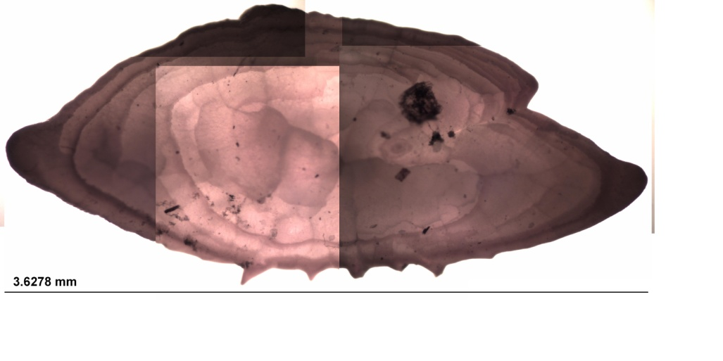
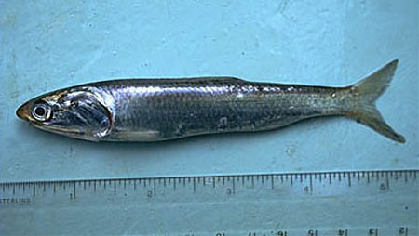
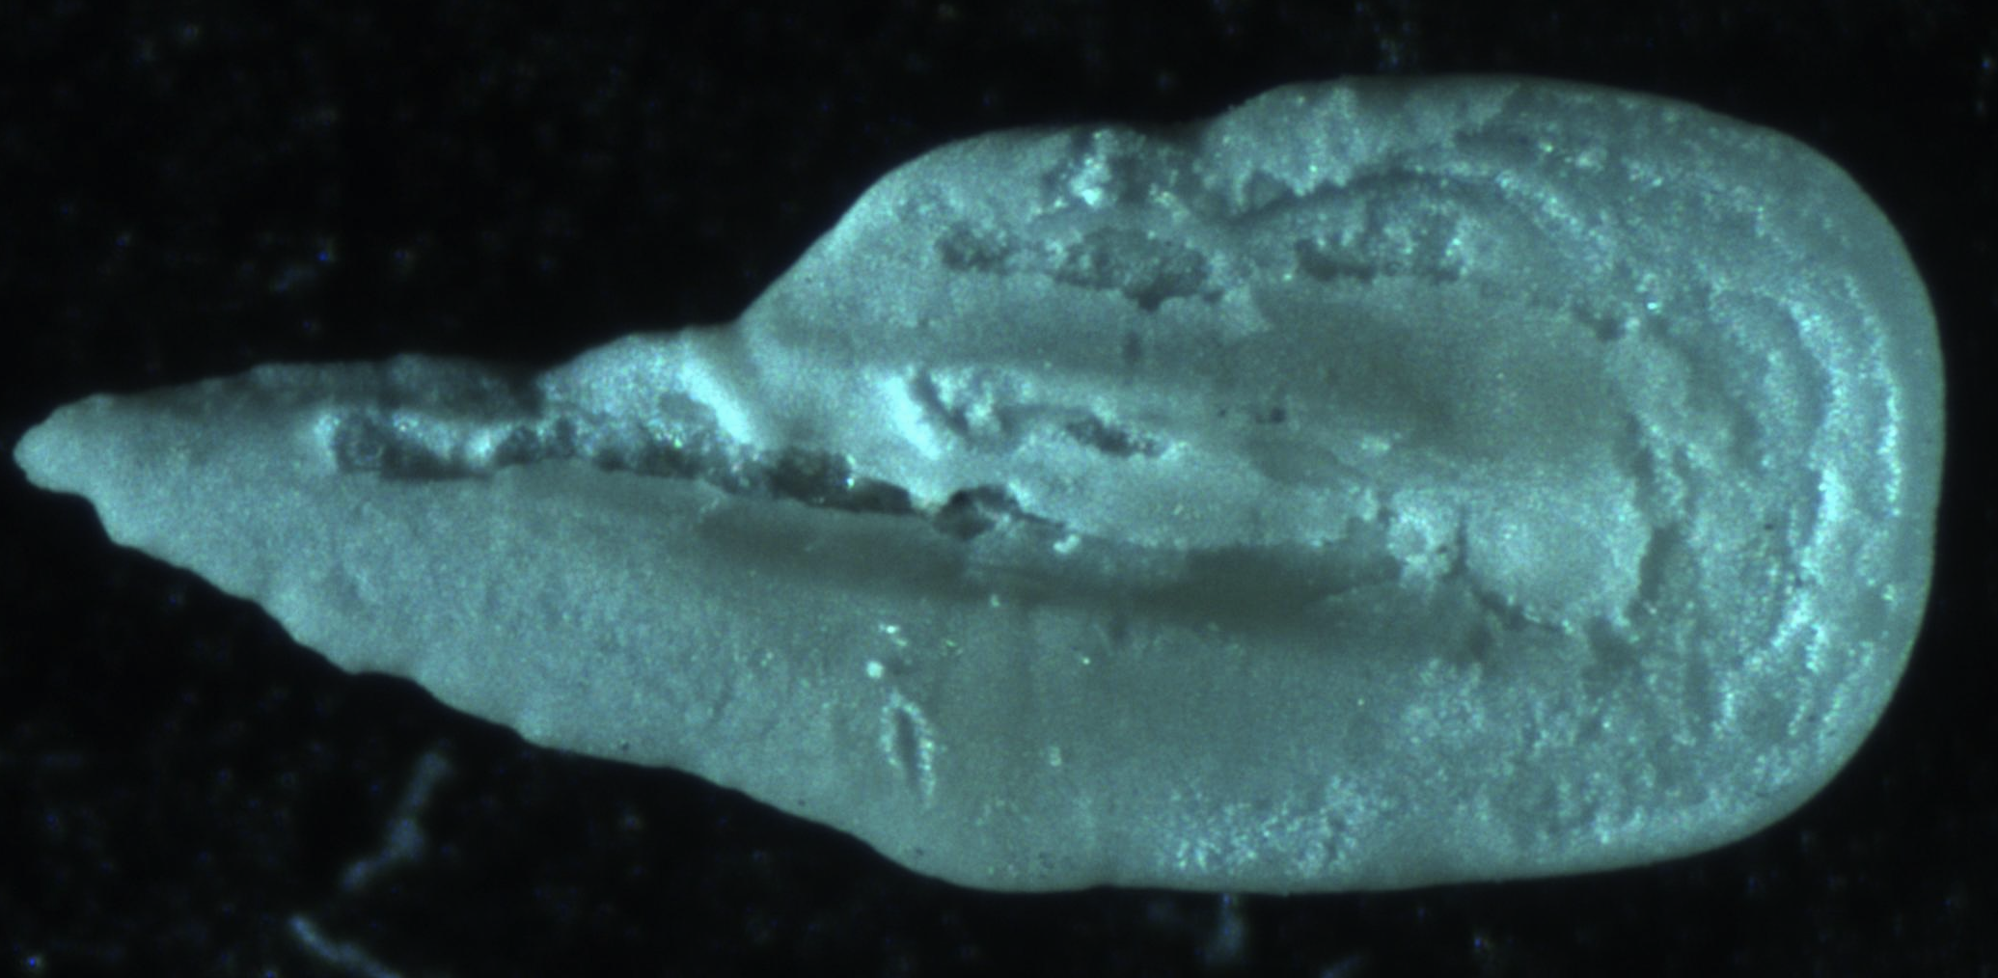
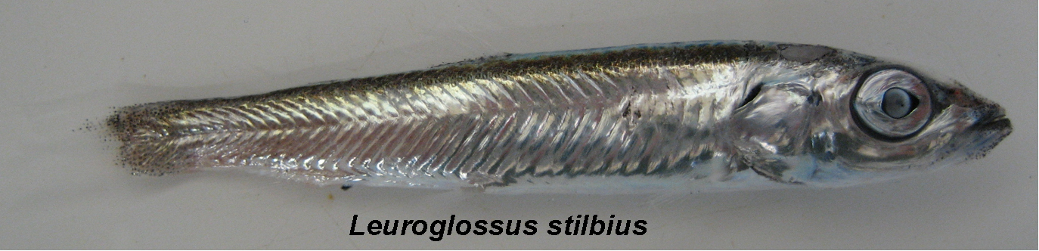
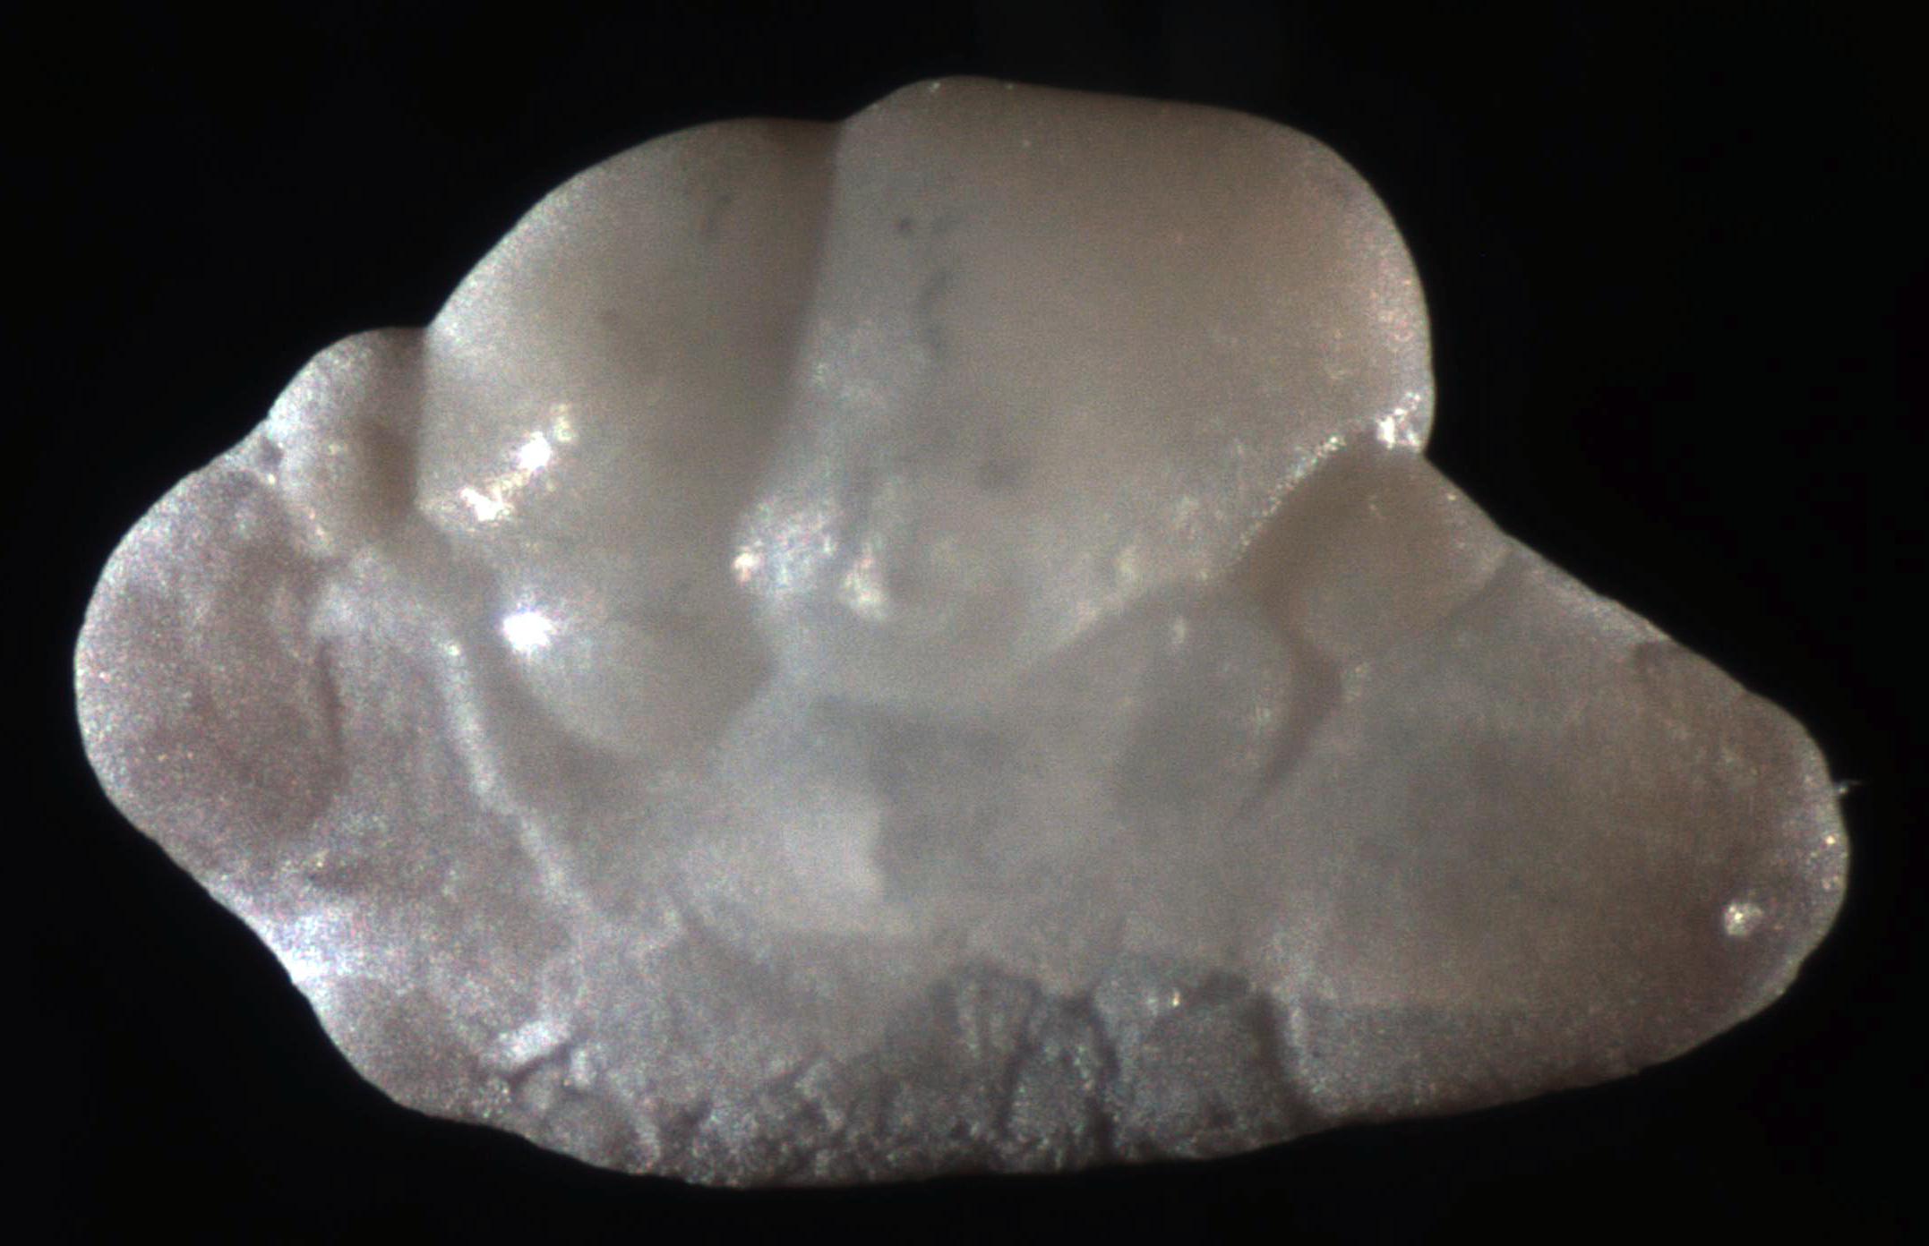
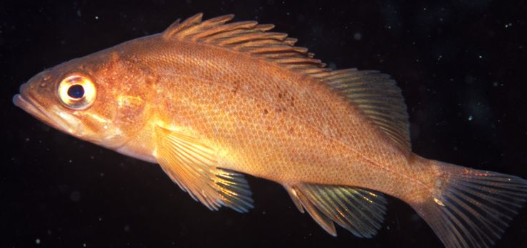
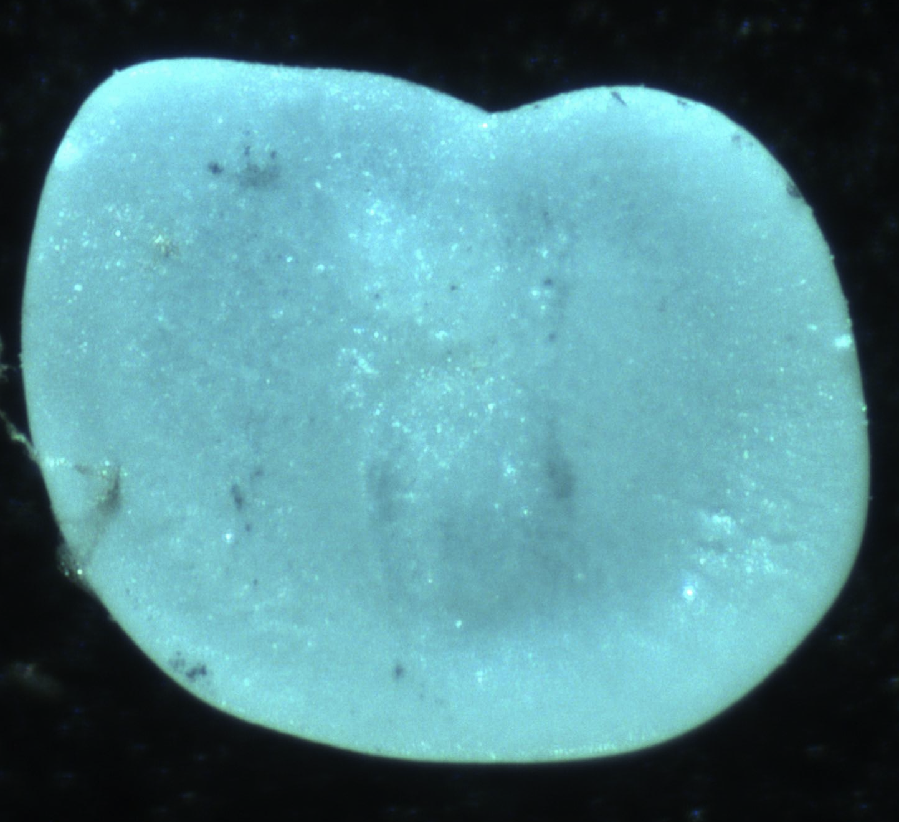
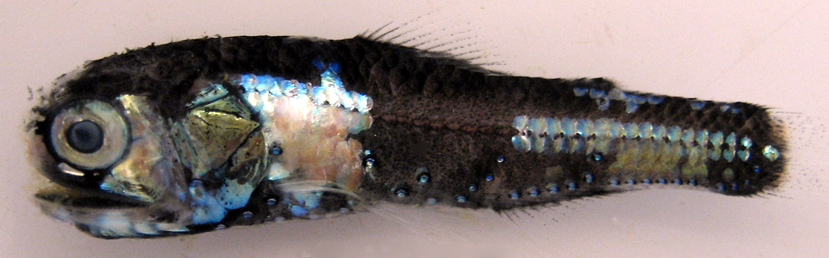
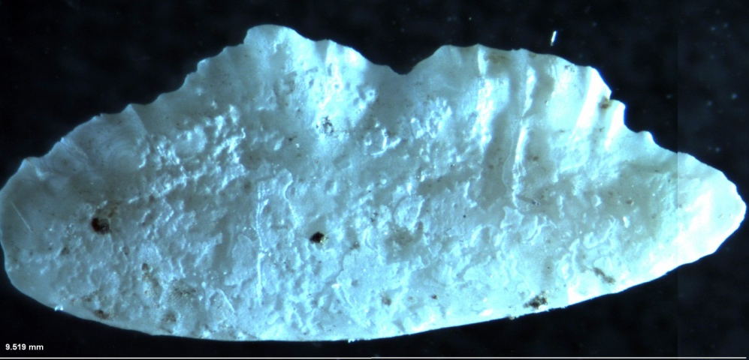
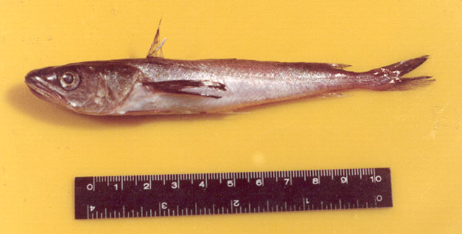
E. Mordax (Anchovy)
Fish Otoliths
Bathylagidae (deep sea smelt)
Sebastes spp (Rockfish)
Myctophidae (lantern fish)
M. productus (Hake)
Notes:
Fish otoliths (more info on otoliths in the next lesson) are aragonite protein structures used for hearing and balance in fish (like our inner ear). The shape is species specific, so the species of fish can be identified based on the shape of the otolith (assuming the otolith is not altered from degradation processes). Pictured above are the five most common groups of fish otoliths found in the Santa Barbara Basin otoliths (W. Jones, unpublished). The average size of an otolith found in the sediments of the Santa Barbara Basin is ~300 microns (W. Jones, unpublished).
Fish Images – P. Davison.
Otolith Images – W. Jones

