Slide 1
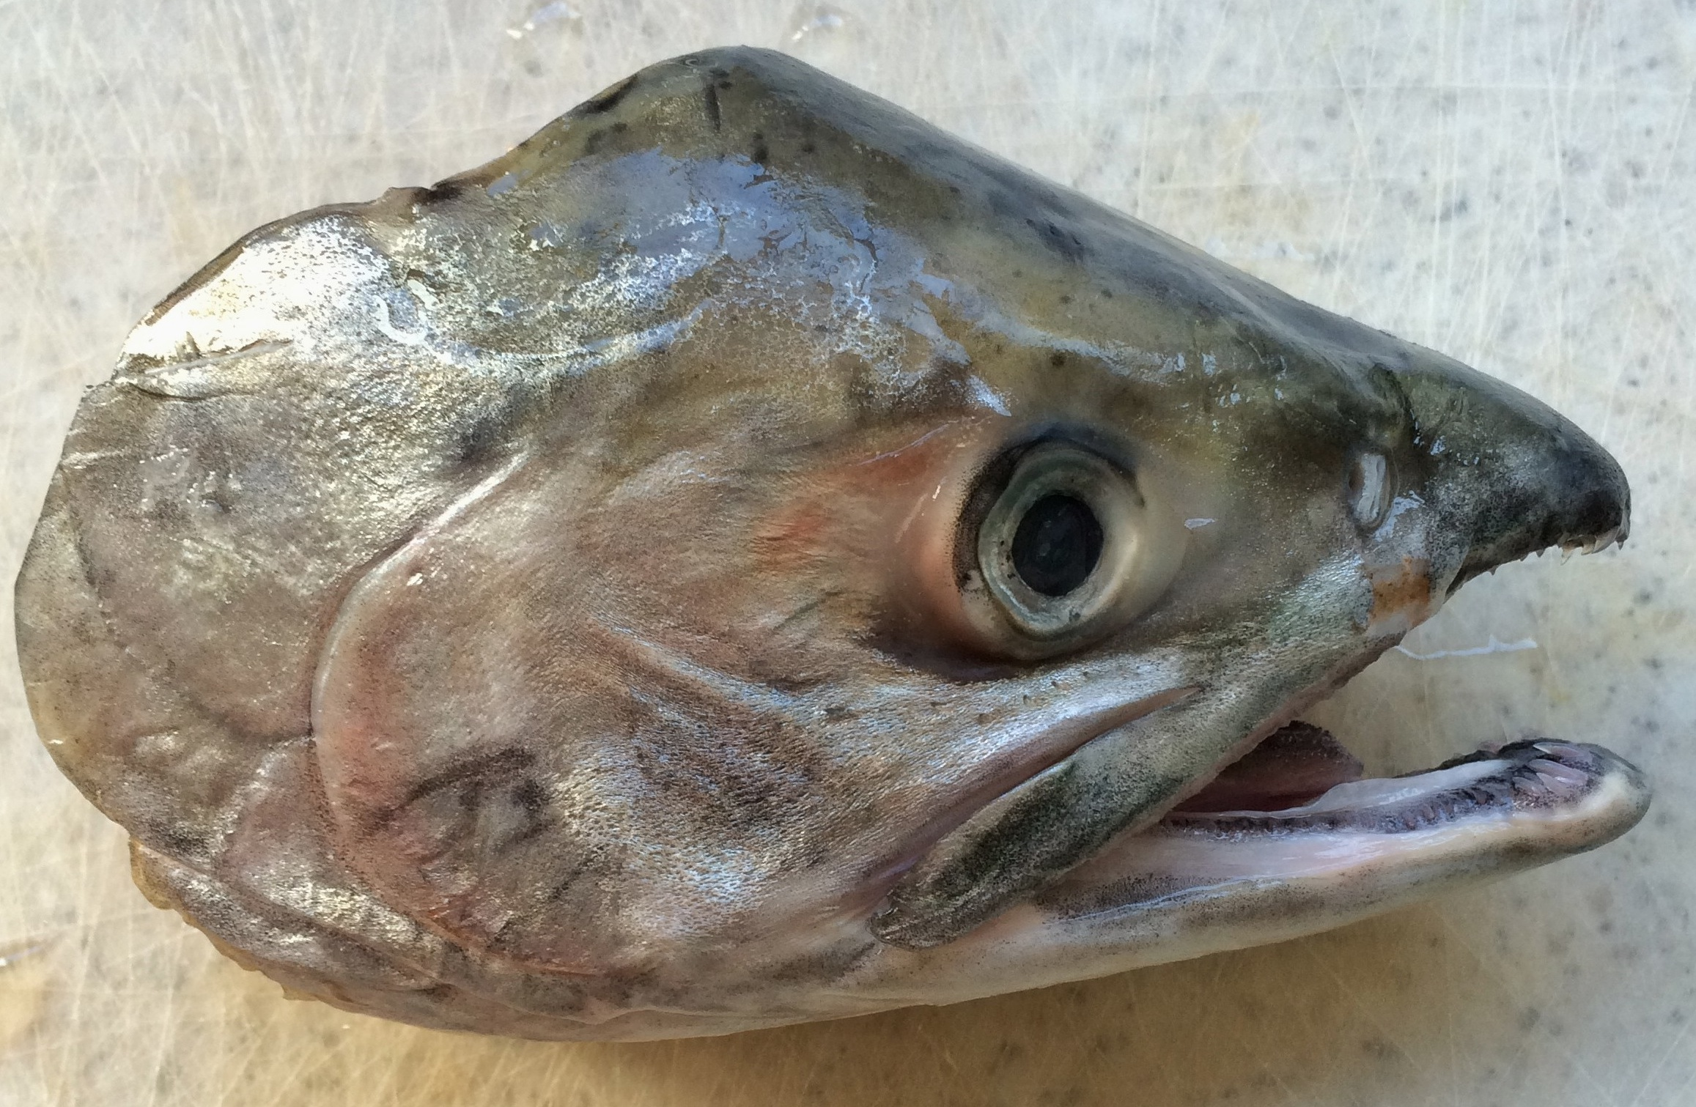
Fish Head Dissection Lab
Bill Jones – SIO
Steve Walters – Mission Bay High School
Notes:
William Jones (Graduate Student, Scripps Institution of Oceanography)
Steve Walters (Teacher, Mission Bay High School, San Diego, CA)
WHY: Fish otoliths, or” ear bones”, are important structures for both a fish and scientists. In a fish, they function like the inner ear of a human, helping with balance, orientation, and sometimes hearing. For a scientist, otoliths can reveal information about the age, size, and growth of a fish. In this lesson, students will learn hands-on why and how fisheries scientist dissect fish. The first part of this lesson is a dissection lab where students will learn the external and internal structures on a fish, focusing primarily on the head. They will then extract the otoliths, or ear bones, from the salmon head and measure the length of the otoliths. The students will use these measurements to reconstruct the original body length size of salmon. Finally, students will extend their roll as a scientist by analyzing the fish size structure results, looking for similarities and differences between the size of the farmed Atlantic and wild caught Chinook salmon they dissected.
OBJECTIVES for Students:
Learn why and how fisheries scientist dissect fish
Identify and describe the appearance and function of external and internal structures of fish anatomy, focusing on the head.
Compare and contrast the features of a salmon to other organisms, including other fish.
Dissect a salmon head, including the removal of the otoliths, or “ear bones”.
Reconstruct the original size of the fish using the otolith size.
Analyze the fish size results, noting differences between the two salmon species.
Understand the function/role of the otolith for the fish and fisheries scientists.
SUMMARY:
Students will initially be given a brief lecture on the basics of fish anatomy and what a dissection involves. This presentation is found in the file called “Lesson 3 Fish Head Dissection PPT”. The teacher will lead the students through a discussion of the external anatomy of a fish and adaptations that make it a fish. The class will be divided into groups of 4. Each group will dissect one fish head following the instructions laid out on the “Fish Head Dissection Instruction Sheet”. During the dissection, students will answer the questions on the “Fish Head Dissection Observations Worksheet”. Toward the end of the dissection, students will remove the otoliths from the fish head. Students will measure the width and length of the otolith. On the second day, the students will explore the otolith length data and use it to reconstruct the reconstruct the original size of the fish. Finally, they will compare the size distribution of Alaskan vs. farmed salmon.
PICTURE/GRAPHICS CREDITS: Images: All images in this powerpoint from W. Jones unless otherwise noted.
ADDITIONAL READING:
More info on otoliths:
Online Otolith Lab: UAS Fisheries Technology Program
http://elearning.uaf.edu/cc/otolith/whatis.htm
Fish identification:
http://www.chefs-resources.com/Salmon-Facts-Identifying-Types-of-Salmon#ixzz2yEk1B4FP
http://www.chefs-resources.com/Salmon-Facts-Identifying-Types-of-Salmon#ixzz2yEkUflbm
Also see youtube videos on how to remove otoliths under “Teaching Notes”.
CONTEXT FOR USE:
This lesson can take the place of a regular perch dissection.
This learning activity is anticipated for use in 9th grade biology or higher. It is best suited for a 90-minute class period.
MISCONCEPTIONS:
Fish are gross
Eels are not fish
Fish look the same
EVALUATION TIPS:
Students will answer questions about fish anatomy and function while they are carrying out the fish dissection on the Fish Head Dissection Worksheet. Students will then measure the size of the otolith. In the second part of the lesson, they will use this measurement to estimate the size of the fish that the otolith was removed from while they complete the “Exploring Otolith Data” worksheet. Students are also expected to participate in the discussion about what makes a fish a fish in the beginning of the powerpoint presentation.
TEACHING NOTES.
On day one, students will initially be given a brief lecture on the basics of fish anatomy and what a dissection involves. This presentation is found in the file called Fish Head Dissection Presentation. The class will be divided into groups of 4. Each group will dissect one fish head following the instructions laid out on the “Fish Head Dissection Instruction”. During the dissection, students will answer the questions on the “Fish Head Dissection Worksheet”.
The otolith dissection will be the most difficult task.
Here is a video showing the technique used in the dissection guide of this lesson:
https://www.youtube.com/watch?v=kuWd28VONZY
Note, in this video they use small scissors. Since our fish are larger than the fish in the video, the small wire cutters will be used instead of scissors. The final cut made in the video (after the gills are cut away) is the most difficult cut. The cut with the wire cutters into the salmon must be made very deep and you will have to pry away /break the backbone to get through it. Stunts may need help with this. The most common error is that the cut isn’t made deep enough. The second most common error is that the cut is made in the wrong place. It would be best if the teacher practices the technique on a few salmon heads before giving the lesson.
A second technique is to cut through the whole head (video below). If you are unsuccessful with the first method, you might try this second method. However, it requires the use of a much larger cutting tool (large knife or hack saw). For this reason, the first method is recommended. This is also a very good video to show the internal structures of the head – particularly the otolith and brain cavities (the large hole inside of the head in the video). Pay close attention to where the otoliths are located – knowing the exact location and the bone structure around the otoliths will help finding the otoliths using the first technique.
https://www.youtube.com/watch?v=sf62o1dCGkc
After students dissect out the otolith (they might need help with this), the teacher should help the students clean them gently with water (many of the otoliths will have a membrane sac still around it – fine tip tweezers can be used to pull the material off the otolith). After they are cleaned, the students need to measure the length and width of the otoliths. The measurement will be used in the next lesson. The best way to do this is to have 3-4 dissection microscopes set up in the front of the classroom, where students can bring their otoliths up and measure them with a small ruler under the scope. Be sure to record all the otolith length measurements. The otoliths should be cleaned and air-dried before being stored in a small glass or plastic vial.
Salmon heads were donated by Catalina Offshore Products in San Diego – contact info below. They were extremely nice and willing to donate more in the future.
Arlin Gold
Retail Coordinator
Catalina Offshore Products
619.704.3638
Arlin@catalinaop.com
A couple of the questions on the “Fish head dissection worksheet” require the students to observe and compare the body form of different fish and to speculate about its potential living environment (open ocean, deep sea, bottom, coastal, etc). This required having several different types of fish available for the students to look at. Different fish species can be obtained form a variety of locations - asian markets, bait shops, aquarium shops, Scripps oceanography (or other university) fish collections, or from students if any of them are fisherman. The students should also be provided with a copy of the “Fish Body Form” pdf to help them speculate about the possible environment that the fish lives in. For this question, remind them about the Michael Phelps vs. fish example from the powerpoint. They can do the same thing comparing the similarities and differences between two different species of fish.
Fish used in the original lesson by William Jones and Steve Walters;
Sardine
Anchovy
Hake
Myctophid (lantern fish)
Flatfish (Sandab)
Rockfish
Hatchet fish
Deep sea eel (viper eel)
White seabass
If the teacher does not have access to a fish collection or live specimens from a market, they can print of pictures of different types of fish. Suggestions: benthic species (sandab, flounder, halibut), deep sea species (viper eel, snipe eel), mesopelagic species (lantern fish, hatchet fish), pelagic species (anchovy, sardine).
Teaching Materials for dissection
Each dissection group needs:
Dissection kit; dissecting pins, tray, forceps, scissors, scalpel, probe.
Hand lens / magnifying lens
Dissecting microscope
Small wire cutters
Salmon head
4-8 different fish species
Fish Body Form PDF
Fish Head Dissection Instruction Sheet
Fish Head Dissection Observations Worksheet
Safety goggles
Lab apron
Gloves
On day two, Students will measure the width and length of the otolith and use that to reconstruct the reconstruct the original size of the fish. In their worksheet (“Exploring Otolith Data” worksheet), they will compare the size distribution of two groups of Chinook salmon caught using two different fishing methods; Lake Michigan salmon caught by recreational fisherman using pole and line and Alaskan salmon caught by commercial fisherman with nets. The first step will be to plot the otolith vs. body length data for the Lake Michigan salmon and describe the relationship. Next they will use this relationship to estimate the size of the Alaskan salmon based on the length of the otoliths they removed in the previous less. They will then make a histogram (also called a bar graph), which will allow them to compare the size distribution of the two groups of fish. The final step is analyzing or interpreting the results. This is perhaps the most important step where the teacher can check the understanding of the students. They must be able to explain the graphs to someone who has never seen the graph before (and doesn’t have the graph in front of them).
All of the data from 2014 Mission bay high school is in the excel document “Salmon_Otolith_Data”.
NOTE FOR THE TEACHER:
All of the salmon provided by Catalina Offshore products were Alaskan Salmon. No farmed salmon were provided. They originally promised a mix of both Alaskan salmon and farmed salmon. We started the dissection lab thinking we’d have both types of fish head. After a couple of classes, however we realized all the salmon were Alaskan salmon. We therefore had to modify the lesson. Instead of comparing farmed and wild caught salmon, we compared data Chinook salmon caught from Lake Michigan vs. the wild caught Alaskan salmon (all the data is on the “Salmon_Otolith_Data” excel file. This turned out to be a very interesting comparison. The wild caught salmon are commercially fished with large nets. Fisherman target large schools as they are returning to the rivers to spawn. One might expect that this would result in a catch of fish that is all around the same size. In fact, as you can see this at the end of this powerpoint in the graph on the “teacher only slides”. The fish ranged in size from 51 cm to 59 cm. The other set of fish were caught by recreational fisherman from lake Michigan. Fisherman in Lake Michigan use pole and line to catch the salmon. Taking one individual at a time - rather than a group from a large school. One would expect that the fish caught using pole and line would therefore show a much larger size distribution. Again you can see this in the graph at the end of this powerpoint (This is the graph the students are trying to create on the second day of the lesson). This is one of the things we wanted our students to take away from this lesson: different fishing methods target different size fish. We knew the body size and the otolith size of the Lake Michigan Salmon (shown in table 1 in “Salmon_Otolith_Data”). We then used this data to create a linear relationship between the BL and OL (I did this in excel by plotting the data points as a scatter plot and then selecting “add linear trend line” and “show equation on graph”). This is plotted shown at the end of this powerpoint under the “teacher only slides”. The equation is: BL = 3.66 * (OL) + 32.7. To find the estimated body length of an Alaskan salmon, simply plug in the otolith length measurement (in mm). The output will be the body length in cm.

Slide 2
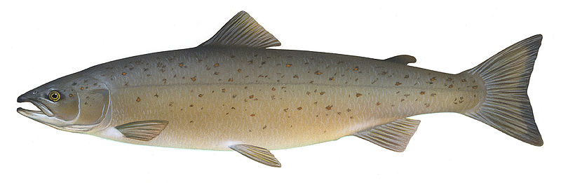
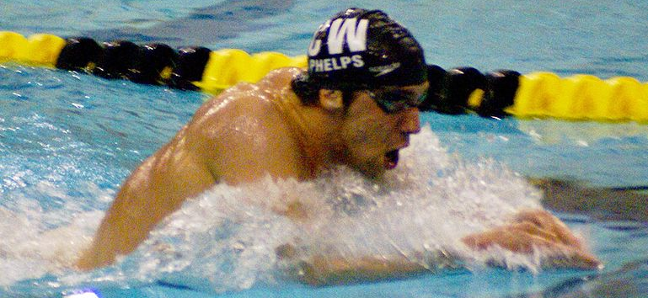
What Makes a Fish, a Fish?
Notes:
Purpose of the slide: To engage the students and get them thinking about the external / internal adaptations/characters that are unique to a fish. Draw out prior knowledge. The goal is to get students to understand that a fish has unique adaptations that allow it to live in water.
First, ask the students what features Michael Phelps and the fish share. A typical fish has many organs that are found in other vertebrates like reptiles, birds and mammals. As different as these groups of animals are, they share similar organs such as a brain, eyes, inner ears, spinal cord, nostrils, etc.
Next, ask the students what makes a fish, a fish? Facilitate a class discussion with the questions below. Write the features/adaptations unique to a fish on the board. You could make a venn-diagram comparing the features of Michael Phelps and a fish.
If the students are quiet, you can help lead them on:
What about fins? Do fins make a fish a fish?
Whales have fins, are they fish? (no they are not fish, they are mammals).
What about scales? Lizards have scales.
.Encourage the students look at the shape and location of fish features.
Why is the mouth on the end?
Where is the neck?
Why are there no eyelids? etc.
Do all fish look the same? Why not?
Final question:
What organism (Michael Phelps) or the fish is better adapted to the water? Why?!
Draw out the understanding that this animal is well suited for its environmental niche because of its adaptations.
Characteristics of a fish (that Michael Phelps does not have):
Fish are somewhat torpedo-shaped (although not all fish are like this… such as flounder). Having a shape like this makes it easier to glide through the water.
fins for locomotion.
swim bladders – helps maintain buoyancy and moving up and down in the water column
Gills – how fish ‘breath’. Gil filaments contain many tiny blood vessels that exchange gases (Co2 for oxygen) as water passes over them.
Salmon pic: http://images.fws.gov/ Author Knepp, Timothy.
M. Phelps swimming: Karen Blaha from Columbia, MO
http://commons.wikimedia.org/wiki/File:Phelps_400m_IM_Missouri_GP_2008.jpg

Slide 3
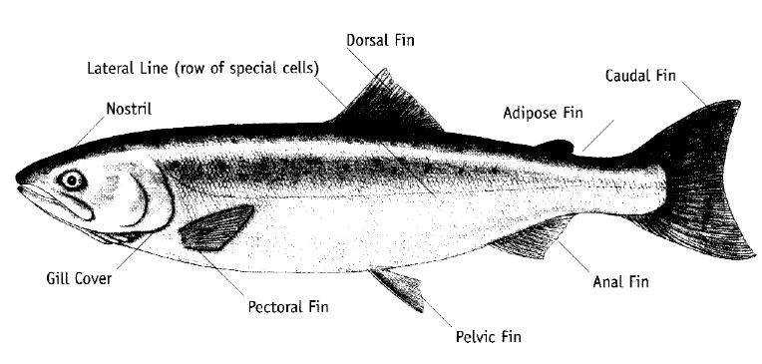
Fish External Anatomy
Maxilla
Mouth
Mandible
Notes:
Purpose of this slide is to review the extern fish anatomy.
1.Basics: eye, mouth, scales
2.Fins: dorsal, caudal, pelvic, pectoral
3.Senses: nares and lateral line
Source: http://www.marine.usf.edu/pjocean/packets/f99/f99u2le2.pdf
General body form: Fish are somewhat torpedo- shaped. Having a shape like this makes it easier to glide through the water. This is called a Fusiform body shape. The body is compressed at the sides and tapers more at the tail than at the head. Each fish has a set of vertebrae and segmented muscles that repeat from head to tail. This group of bones and muscles help the fish to propel itself from side to side as it swims through the water.
Fins: A fish has a number of fins. A fin is a membrane supported by rays or spines that function in swimming or orientation in the water. One or more dorsal fins may be located along the center of the back. A caudal fin lies at the end of the tail and is the primary organ for generating thrust to move through the water. One or more anal fins are situated on the ventral midline near the caudal fin. There are two pairs of Lateral fins on fish. The first lateral fin is the pectoral fin. It is usually found on the body behind the gills. The second lateral fin, the pelvic fins, are found on the belly behind the head, and before the anal fins.
Scales / Skin: Fish need scales to protect
their bodies. The bodies of most fish are covered with overlapping rows of scales. A thin layer of skin, the epidermis, lies under the scales. This layer contains the pigment cells that give the fish its color and cells that secrete a slippery mucous layer that covers the entire body. This mucous layer protects the fish from harmful bacteria and toxins that may be present in it’s watery habitat. Mucous also helps to protect fish when humans handle them!
Swim Bladder
Most fish have an organ called the swim bladder. It is a flexible, gas-filled sac located in the dorsal or top portion of the body cavity and helps to control the fish's buoyancy. Since fish have a density that is heavier than water, they need this swim bladder to not sink when they stop swimming.
Gills
Located on either side of a fish’s head, gills remove oxygen from the water and diffuse carbon dioxide from the body. The gills are covered by a flexible bony plate called the operculum. Some fish have spines located on the operculum as a defense mechanism to protect them from predators.
Lateral Line
Running down the length of a fish’s body is the lateral line. It is made up of a series of microscopic holes located just under the scales of the fish. One of the fish's primary sense organs, the lateral line can sense low vibrations in the water, and is capable of determining the direction of their source.
Nares
All fish possess a sense of smell. Paired holes called nares, are used for detecting odors in the
water, and are located on a fish’s snout. Some fish, such as some shark varieties, catfish, and eels, have a very sharp sense of smell.
Mouth
The mouth parts of a fish will vary in size and may or may not contain teeth. The location of the mouth on a fish’s body can also give us a clue as to what may be the fish’s diet. A superior mouth, a mouth pointing upward, means the fish will eat food located above it; where as a fish with an inferior mouth, a mouth pointing downward, will eat food located below it.
Vocabulary
-Anal Fin -fin located near the anal opening; used for balance and steering.
-Caudal or Tail Fin-fin at the tail of a fish; used for propulsion.
-Circulatory System-delivers blood and oxygen throughout the body via the heart.
-Digestive System–breaks down and processes proteins, carbohydrates and fats.
-Dorsal Fin–backside (top) fin on a fish; used for balance and protection.
-External Anatomy-the outside body parts, such as, fins, scales, mouth.
-Gills–organ used to obtain oxygen from the water and rid carbon dioxide.
-Gill Rakers–filter feed tiny prey; appendages along the front edge of the gill arch.
-Gonads–the sex organs; males have testes, females have ovaries. Some fish are
hermaphroditic, meaning having both sets of gonads (male &
female) in one fish.
-Lateral Line–organ of microscopic pores that sense low vibrations and water pressure.
-Nares-organ to smell; similar to nostrils.
-Nervous System-organs receiving and interpreting stimuli for nares, eyes, lateral line, muscles, and other tissues.
-Pectoral Fin-fins on the sides; used for balance and assist turning.
-Pelvic Fin-belly fins on a fish; used for balance and steering.
-Reproductive System–the organs and tissues involved in reproduction, including gonads, eggs, sperm.
-Respiratory System–organs and tissues involved in the oxygen & carbon dioxide gas exchange, including gills, gill rakers, and gill filaments.
-Scales-protective cover on a fish; similar to skin.
-Slime–slippery covering on scales, protecting fish from bacteria, parasites, etc.
-Swim bladder–found only in “ray-finned” fish; a double sac used to assist in buoyancy.
-Urinary System–the kidneys remove nitrogen (ammonia) from the blood and regulate water balance in the blood and tissues.
-Vertebrate– an organism with a backbone or spine.

Slide 4
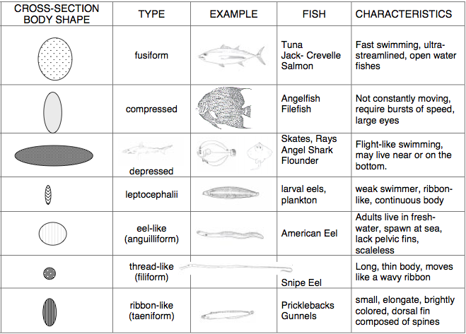
Notes:
There is great diversity in the size, shape and details of fishes. Some fish are stringlike, like the eel, or globe-shaped like the puffer or greatly flattened, like the flounder. Some fish lack eyes, and others lack some of the features by which fish are recognized, including gills, fins, and scales. Their appearance is greatly influenced by their Environment.
The body form of a fish can give a quick assessment of the fish's way of life. In the diagram, the different body shapes and forms are described. Different shapes allow some fish to be fast or slow, bottom dwellers or live in the pelagic zone, and others to survive the extremes of the ocean.
Source: http://www.marine.usf.edu/pjocean/packets/f99/f99u2le2.pdf

Slide 5
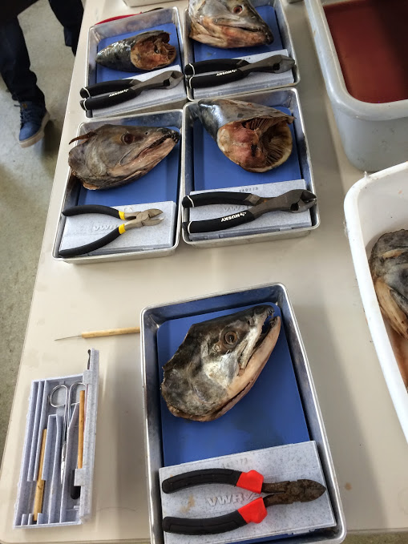
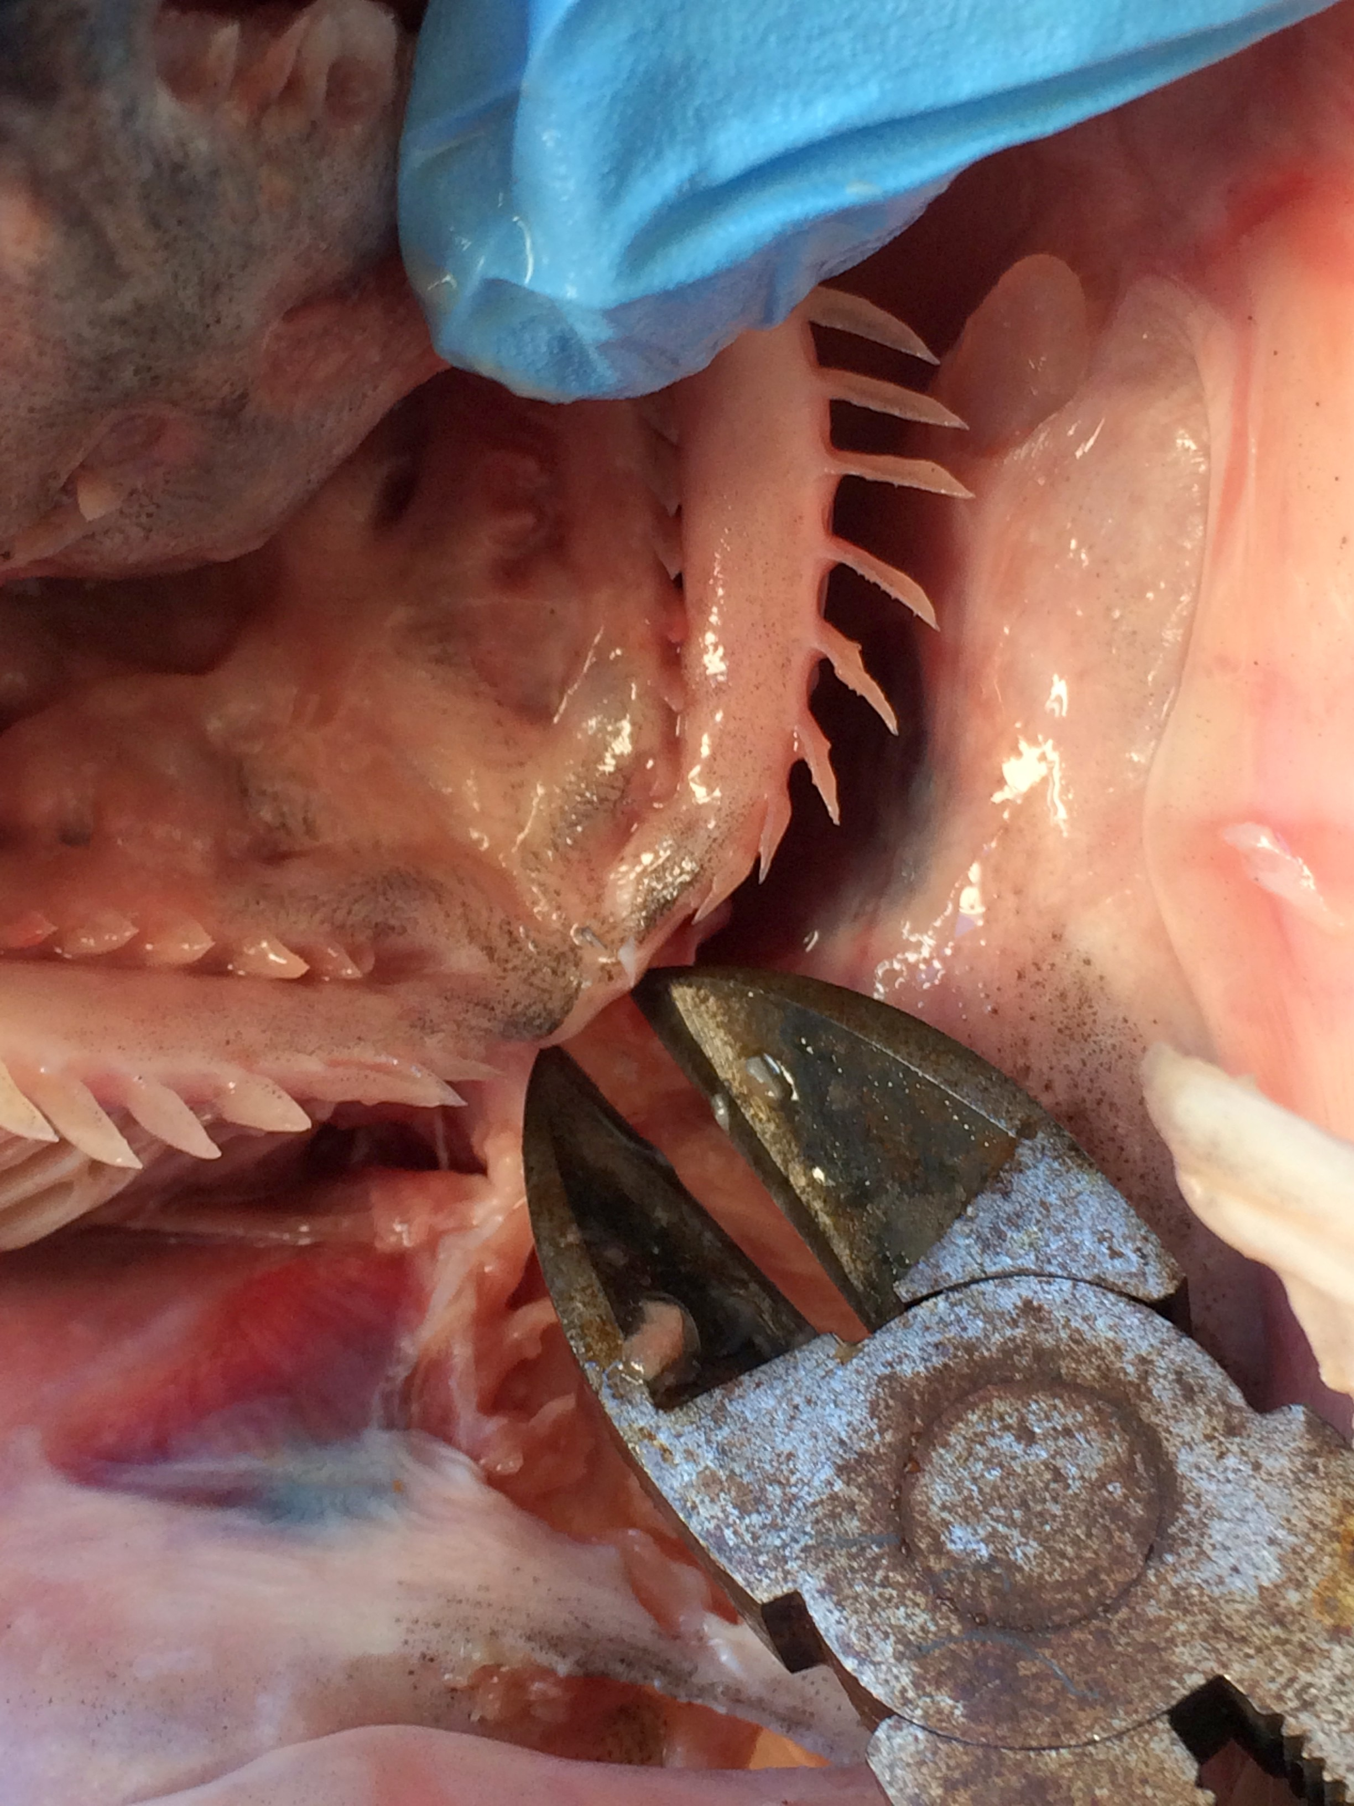
What does it mean to ‘dissect’?
Notes:
Discussion question 2.
What is a dissection?
It means to take apart to look at in smaller pieces to find something out. We will be dissecting a fish to find things out about it. The best way to learn is by doing hands-on science. The students will learn about the gills, eyes, brain, otolith etc. by actually cutting into the head of a fish – rather than by looking at a diagram.
The teacher should introduce the lab activity (fish head dissection) here. Go over some of the basic about what they will be doing (from the ‘Fish head dissection instructions’ sheet).
It would be prudent to remind students about lab safety here.
Dissection Objectives for student: Create a dynamic hand-on experience to assist in understanding the internal organs and system functions of a salmon head.

Slide 6
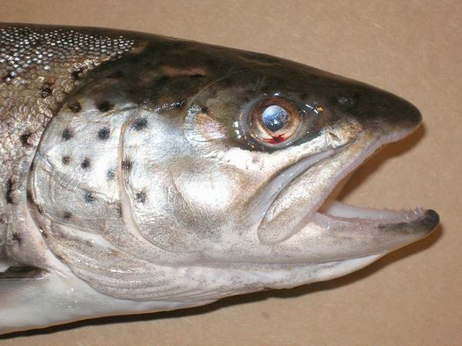
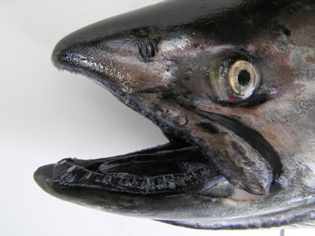
Identify Your Fish Head
Atlantic Salmon – Farmed
Black spots on head, interior of he mouth is entirely white.
Chinook (King) Salmon – Wild Caught
Gums are black.
Notes:
Students will also have to identify their fish head. They must determine whether it is farmed atlantic or wild caught chinook salmon.
Additional info about identifying salmon
http://www.chefs-resources.com/Salmon-Facts-Identifying-Types-of-Salmon#ixzz2yEk1B4FP
: http://www.chefs-resources.com/Salmon-Facts-Identifying-Types-of-Salmon#ixzz2yEkUflbm
Atlantic Salmon Identification - The interior of the mouth of an Atlantic salmon is entirely white. Adult Atlantic salmon are graceful fish, deepening rearward from a small pointed head to the deepest point under the dorsal fin, then tapering to a slender caudal peduncle which supports a spreading and slightly emarginate caudal fin. Adults have black spots predominantly above the lateral line, although its caudal fin is usually unspotted. Atlantic salmon are distinguished from the Coho salmon because they have fewer than 13 rays in the anal fin. While they mature they take on a silver blue sheen. (see the Atlantic salmon fish cam)
Chinook (King) Identification - Best identifying characteristic is teeth set in black gums. The base of the tail flares like the handle of a canoe paddle, offering the angler a grip sufficient to lift the fish. Like the coho, the interior of the mouth will also be gray or black. Tail spots are usually restricted to the top half of the tail, but may also appear on the lower half. The anal fin usually has 15 to 17 rays. Chinook Salmon do not jump and roll as much as coho, but have tremendous power and make long reel-screaming runs.

Slide 7
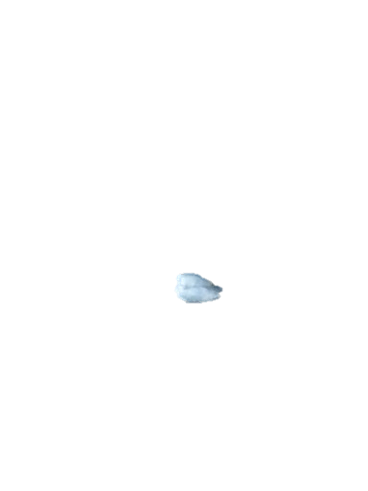
What is an otolith?
Otoliths or ”ear bones.”
Calcium carbonate
balance, orientation, and sound detection
Notes:
Otoliths are commonly referred to as "earstones" or "fish ear bones." They are hard, calcium carbonate structures located directly behind the brain of teleost (bony) fish. Otoliths help with balance, orientation, and sound detection-much like the inner ear of mammals. They are not attached to the skull, but "float" beneath the brain inside the soft, transparent inner ear canals.
Otoliths have a very distinct shape, which is characteristic of the species of fish. That is, different fish species have differently shaped otoliths. Indeed, the shape is so distinctive that biologists can use the otoliths recovered from seal and bird stomachs and droppings to determine the type of fish they ate.

Slide 8
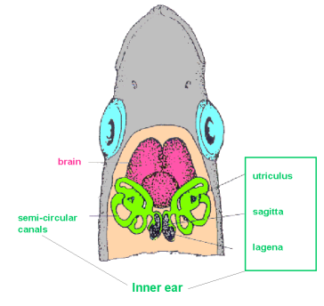
Fish Ears!
Tell Scientists:
Growth
Age
Size
Notes:
This diagram shows the location of the inner ear structure within the head of a fish. The otoliths are behind the brain and semi-circular canals. One of the objections of today’s dissection will be to remove the fish otolith. It is HIGHLY recommended to watch a couple of youtube videos and practice removing the otoliths form the salmon heads before doing it with the class (see the first slide notes in this presentation for youtube links). It takes a little bit of practice, but once you do one or two successfully, it becomes easier.

Slide 9
Lab Instructions
Groups of 4 – one head per group.
Read through “Fish Head Dissection Instruction” entirely before beginning!
Answer the associated questions during the dissection.
Otolith Removal / Measuring
Notes:
The class will be divided into groups of 4. Each group will dissect one fish head following the instructions laid out on the “Fish Head Dissection Instruction”. They will examine/dissect the gills, eye, nostrils, mouth, brain, and otoliths. During the dissection, students will answer the questions on the “Fish Head Dissection Worksheet”.
The otolith dissection will be the most difficult task!

Slide 10
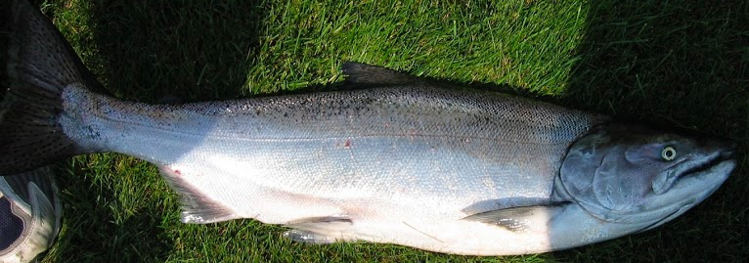
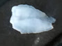
Part 2. Exploring Salmon Otolith Data
Otolith Length to Fish Body Length relationship
Notes:
Day two. The following slides are ment to be shown to students on the second day of the lesson – after the fish head dissection is complete.
Picture on the right is a chinook salmon, on the left a chinook salmon otolith.
There is a direct relationship between otolith growth and fish growth. In fact, this relationship can be used to estimate the size of a fish if you only know the size of the otolith. This is exactly what the students are going to do in today’s lesson. First they will investigate this relationship by creating a scatterplot of the otolith length vs. salmon body length. Note:
Students will measure the width and length of the otolith and use that to reconstruct the reconstruct the original size of the fish. In their worksheet, they will compare the size distribution of two groups of Chinook salmon caught using two different fishing methods; Lake Michigan salmon caught by recreational fisherman using pole and line and Alaskan salmon caught by commercial fisherman with nets. The first step will be to plot the otolith vs. body length data for the Lake Michigan salmon and describe the relationship. Next they will use this relationship to estimate the size of the Alaskan salmon based on the length of the otoliths they removed in the previous less. Finally, they will make a histogram (also called a bar graph), which will allow them to compare the size distribution of the two groups of fish.

Slide 11
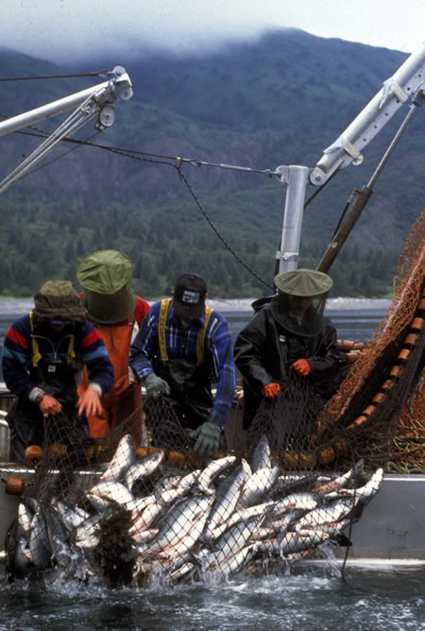
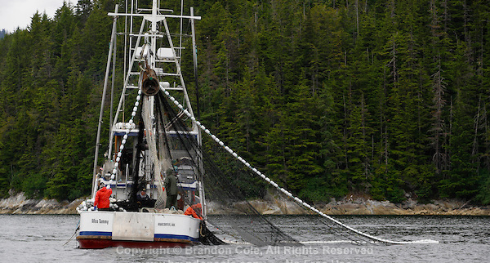
Commercial Chinook Salmon Fishery – Pacific/Alaska
Notes:
Describing the slide:
The commercial salmon fishery in the pacific / Alaska uses nets to capture salmon. The salmon come back to the home rivers in great schools – this is where fisherman often target them with nets. Ask the class: “Are fish a school generally similar sizes – or all different sizes?” (answer should be similar sizes). Question 2: “Do you think that the fisherman are catching fish of similar sizes or all different sizes?” (answer should be similar sizes). Tell the class that they will test this hypothesis by looking at the relationship between the otolith size and the body size of the fish they dissected in the previous lesson.

Slide 12
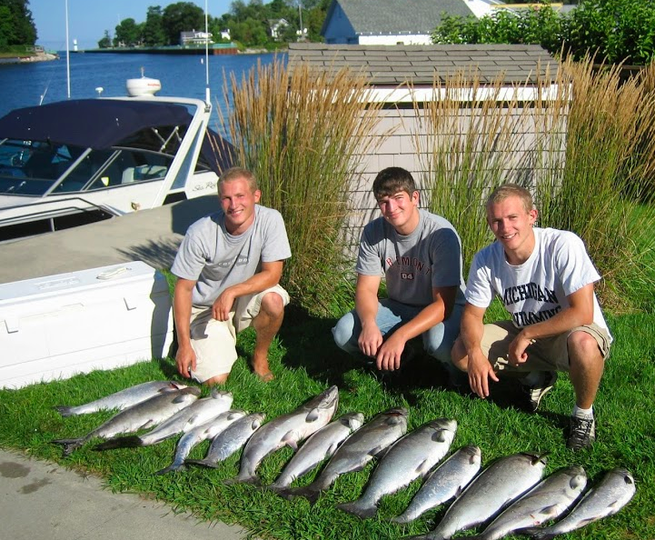
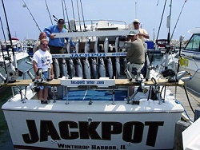
Lake Michigan Salmon
Notes:
It turns out our batch of fish from Catalina offshore products were all commercially caught wild Chinook Salmon. There were not any farmed Atlantic salmon, even though they told us there would be. Therefore, we will be comparing our salmon to a batch of salmon caught from Lake Michigan. The Chinook salmon in the great lakes are caught in a recreational fishery with pole and line. Question: “How many of you <students> have used a fishing pole to catch fish?”. Question 2: “Where all the fish similar sizes, or many different sizes?”, Question 3: “Do you think the salmon from Lake Michigan will be similar sizes, or all different sizes?” We will test this hypothesis today.

Slide 13
Instructions: Exploring Otolith Data Worksheet
Step 1. Plot the Lake Michigan Salmon Otolith Length vs. Body Length in a scatter plot and draw a line to describe the trend.
Step 2. Use the formula provided to calculate the Alaskan Chinook body sizes.
Step 3. Make a frequency table and make a histogram/bar graph of the data.
Step 4: compare on contrast the Alaskan vs. Michigan Salmon data.
Notes:
Students will measure the width and length of the otolith and use that to reconstruct the reconstruct the original size of the fish. In their worksheet, they will compare the size distribution of two groups of Chinook salmon caught using two different fishing methods; Lake Michigan salmon caught by recreational fisherman using pole and line and Alaskan salmon caught by commercial fisherman with nets. The first step will be to plot the otolith vs. body length data for the Lake Michigan salmon and describe the relationship. Next they will use this relationship to estimate the size of the Alaskan salmon based on the length of the otoliths they removed in the previous less. They will then make a histogram (also called a bar graph), which will allow them to compare the size distribution of the two groups of fish. The final step is analyzing or interpreting the results. This is perhaps the most important step where the teacher can check the understanding of the students. They must be able to explain the graphs to someone who has never seen the graph before (and doesn’t have the graph in front of them). The next two slides help to explain the graphs to the teacher.

Slide 14
End slide show for students
Notes:
This slide is simply to mark the end of the slide show for the students. The remaining two slides are for the teacher. They help explain the graphs that the students have to create.

Slide 15
TEACHER SLIDE: Otolith Length vs. Body Length Scatterplot Answer
Notes:
Teacher slide: Otolith Length vs. Body Length Scatterplot
Make sure students know how to describe the graph to someone who has never seen the graph and cannot see the graph (so the student will have to describe what is on each axis!)
Example answer: The relationship is a positive linear relationship. As the otolith length increases, the body length increases. The relationship appears relatively strong.
The formula on the graph is the linear equation that relates the otolith length to the body length. This equation is calculated from the Lake Michigan salmon data in table 1 in the Exploring Otolith Data worksheet. As you can see from your first scatter plot above, the relationship is not perfect. There is a considerable amount of ‘scatter’. Why are the data points not all on the line? Answer: Each fish is an individual! Not all the students in the class are the same shape/size – even though most are similar ages. Similarly, not all fish come in the same shape/size. Some may be shorter and fatter, while others long and lean. Body length does not tell the entire story. Similarly, different things can impact otolith growth including stresses such as disease or nutrition deficiency or natural variables like temperature. These factors can result in individuals having a slightly different relationship between otolith growth and body growth.
One way to quantify the strength of the relationship is by calculating the R² value of the data in relation to the equation. The R² value indicates how well the data fit the equation. If the data form a perfect straight line, the R² value would be 1. If the data are scattered randomly with no clear relationship, the R2 would be 0. If the R² value is positive, the relationship is positive (and vice versa for negative). In our case, the R2 value for the otolith length vs. body length is 0.577. This means that the relationship is moderately strong and positive. When you use the formula to calculate the body length of the Alaskan salmon we are making a rough estimation. In reality the actual fish body length may be slightly larger or smaller.

Slide 16
TEACHER SLIDE: Salmon Body Length Histogram Answer
Notes:
Teacher slide - Salmon Body Length Histogram Answer. Make sure the students understand how to describe the data using the axis labels in their answer (e.g., “the lake Michigan salmon have a wide distribution of body lengths from about 40 to 90 cm with a general peak in the middle of the distribution <roughly normally distributed>, while the Alaskan salmon have a very narrow range of body sizes from 50-60cm”. This makes sense because of how the fish a caught. Nets are largely size selective because they catch school of fish that are all roughly the same size. Pole and line fishing is less size selective because it doesn’t target large school).
General graph description: The Alaskan salmon are all similar sizes while the Lake Michigan Salmon are roughly normally distributed with a wide range.
Fisherman using nets target large schools of salmon. Since fish tend to school with other fish that are similar size, the fish being caught are generally the same size. This is nicely reflected in the graph were all the Alaskan salmon are between 50 and 60cm. In Lake Michigan, fisherman use pole and line to pull out a couple of random individuals from the entire population. We would expect that the size of fish would very greatly because the fishing technique allows for a relatively equal chance of catching a large or small fish. Again, this is nicely reflected in the graph as the Lake Michigan salmon ranged in size from~40 to ~90 cm, a much larger range than the Alaskan caught salmon.

