Slide 1
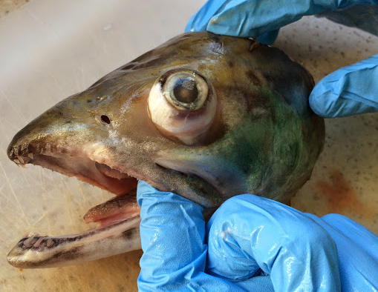
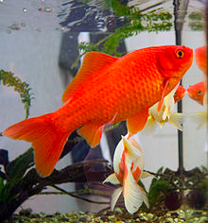
Fish Growth Lesson
Notes:
Fish Growth Lesson 4
William Jones and Steve Walters
WHY
The growth of an organism is influenced by a variety of biotic and abiotic environmental variables. Through direct and indirect alteration of these environmental variables, human actions are perturbing the natural growth patterns of many organisms worldwide. Through an analysis of the otolith growth rings, students will begin to learn how natural climate variability and human actions can influence growth fish. Students will then design and test their own hypotheses about fish growth by altering the environmental variables of a goldfish tank and observing the impact these alterations have on goldfish growth.
SUMMARY
In this lesson, students gain a better understanding of how the environment influences the growth of organisms. First, students will count growth rings on photographs of otolith cross-sections to determine the age of a fish. They will then design and set-up their own scientific experiment to test their own hypotheses of what impacts the growth of goldfish.
PICTURE/GRAPHICS CREDITS.:
Images in this PPT all from W. Jones unless otherwise noted. Red drum otolith photographs from Shannon Davis-Foust.
WEBSITES/RESOURCES USED IN THIS PRESENTATION
Red drum otolith photographs from Shannon Davis-Foust.
ADDITIONAL READING:
CONTEXT FOR USE:
This is meant for a 9th grade marine science / introductory biology classroom, but could easily be adopted for advanced biology. This lesson is designed for 90min periods. The lesson is divided into two main activities. The first activity is looking at otolith cross-sections and the second activity is the goldfish growth experiments.
First activity in lesson 4: Fish Growth
On day one, students will initially be given a brief lecture reviewing what an otolith is and introducing the concept of otolith growth rings. The students should have already learned the basics about otoliths in previous lessons. Students will then be handed a photograph of a red drum otolith cross-section (a thin slide of an otolith – much like a tree-trunk ‘cookie’ which is used to count tree rings) and asked to count the annual rings to determine the age and birth date of the fish. They will then brainstorm environmental variables that impact fish growth. Finally, students will be asked to bring concepts together and design an experiment to determine what influences the growth of goldfish/guppies. Each class will then decide on one variable to change (light, food, temp, pH, etc) and set up the experiment. There should be a control fish tank with normal conditions. The weight / length of the fish will be measured weekly for the duration of ~6 week study to determine what influence the changed variable had on the fish growth (vs. a control). Students will monitor the tanks daily, recording everything from water quality to how much food was given to the fish in a log sheet (see “Goldfish Growth Experiment” document for more details).
Both activities in this lesson can likely be done in one 90-minute class period. However, additional days will be needed to set up and monitor the goldfish growth experiments. Additionally ~2 days will likely be needed for the final project. In the final project students will present on one aspect of either the goldfish experiments or the white seabass in the classroom experiment.
See “Gold Fish Growth Experiment” document for information about setting up and monitoring the goldfish experiments.
Also see “Water Quality Parameters” in the white seabass lesson under “additional resources” for tips on what water parameters to measure during the goldfish experiments or for ideas on what could be changed in the goldfish tank. Students could, for example, alter the salinity or pH of the goldfish tanks.
Fisheries Science Unit - Final Presentations (this is from lesson one “Seabass in the Classroom Guide”).
Student Projects Topics
Toward the end of the year, students will wrap up the seabass unit by doing a poster project on one aspect of the seabass project or goldfish growth experiments. Students can analyze and graph the data recorded (fish/water measurements) or focus one particular aspect of the project (e.g. tank). A list of potential ideas is described below. Teachers/students are encouraged to come up with other projects centered on the seabass unit or goldfish experiments. The number of possible topics is limitless. Students should be broken up into groups of 2-3 students per group and either assigned a research topic or given the freedom to choose a topic (this may depend on how advanced the students are). Students should get at least 2 full class periods to work on their poster, depending on how often and efficient they are with making posters/presentations. The first day should be primarily analyzing the data or system (like the tank), while day two should be constructing the poster. Presentations should be ~3-5min long on the third day.
Example data from 2014 is provided in the “Seabass in the Classroom Guide” from lesson 1.
Feeding assimilation: How much of the food that was given to the fish was actually assimilated into biomass? Students will know the beginning weight of each of the fish, their final weight, as well as the total amount of food that was fed to the fish. For the goldfish experiments, observing the change in growth will be how they test their hypothesis about the impact of different variables on growth.
Diet Analysis: What is in the seabass fish food and why? Students can investigate what is in the fish food pellets provided by HSWRI and why each component is important to the fish. This would involve talking with HSWRI researchers. Students can also investigate what juvenile seabass would traditionally eat in the wild.
Growth rates: Measuring the fish every 3-4 weeks (for the seabass, or every week for the goldfish) would allow the students to monitor the growth rates over time. Students can also investigate if all the fish grow at the same rate - or if their hypothesis about different variables influencing goldfish growth holds up.
Length vs. Weight: Students can investigate how the length vs. weight relationship changes over time (example graphs at the bottom of this document)
Chemistry: Water quality measurements – temperature, pH, nitrogen gas, oxygen, nitrates, salinity (example data and graphs at the bottom of this document). Students can focus on one parameter or investigate if there is any relationship between parameters. Students can also research the effect of changing one of the parameters on the fish (what would happen to the fish if salinity or temperature were changed for example?).
Nutrient cycling: Explain the nitrogen cycle within the tank system (including important components such as fish food, fish fecal matter, bio-balls, etc).
Engineering: Diagraming the fish tank (either the goldfish or seabass tanks) and the function of each main component.
Life cycle: Diagram, in fine detail, the life cycle of the white seabass.
MISCONCEPTIONS:
- Only tree have growth rings
- The impact of human activity on animal growth is too small to measure
- Only food and/or temperature controls goldfish growth
- Human actions in the context of “global change” always negatively influences animals
EVALUATION TIPS:
Students are evaluated on the “Fish Growth” worksheet, goldfish experimental design sheet, participation in setting up/monitoring the goldfish experiments, and the final presentation after the experiments are done.
TEACHING NOTES:
- Read entire activity and review all background materials and resources
- Determine amount of time you would like to dedicate to this activity.
- Determine the best assessment strategy for your class based on suggestions provided (worksheet, poster, poster presentation).
- Determine of your school has the resources to raise goldfish in the classroom (it involves a lot of space and money). This lesson can be taught without actually doing the goldfish experiment – the students can just design the experiment.

Slide 2
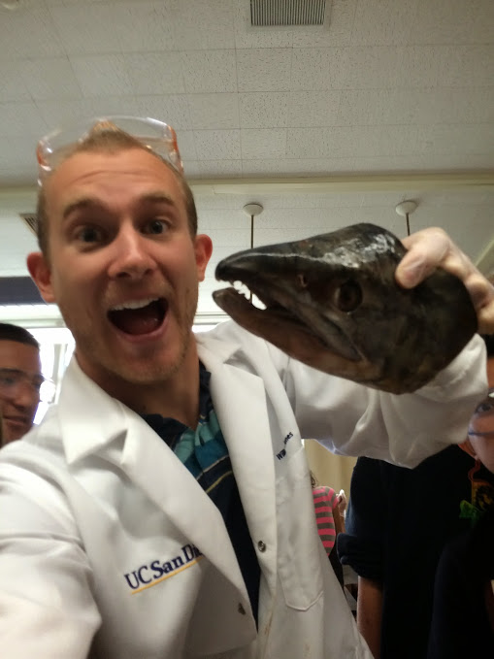
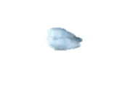
Otolith Review
Notes:
Insert some picture of the kids dissecting out the otoliths from the previous lesson. Ask them a few review questions, such as; What is an otolith? What is its function in the fish? How do scientists use otoliths?
The point is to review some of the main points they have learned previously:
Otoliths are commonly referred to as "earstones" or "fish ear bones." They are hard, calcium carbonate structures located directly behind the brain of teleost (bony) fish. Otoliths help with balance, orientation, and sound detection-much like the inner ear of mammals. They are not attached to the skull, but "float" beneath the brain inside the soft, transparent inner ear canals.
Otoliths have a very distinct shape, which is characteristic of the species of fish. That is, different fish species have differently shaped otoliths. Indeed, the shape is so distinctive that biologists can use the otoliths recovered from seal and bird stomachs and droppings to determine the type of fish they ate.
They can tell scientists about the age and growth of the fish.

Slide 3
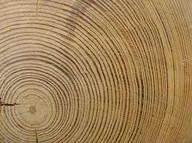
Part 2. “Dating” a fish
Notes:
Activity: Engage the students! The objective of this slide is to get the students thinking about what causes variability in tree ring growth.
The teacher can either show this slide or show the students a real tree ring ‘cookie’ (thinly sliced section of a tree trunk).
Questions to ask the students about the tree trunk cookie:
What do you see on this slide?
(expected student answers: tree stump, rings, circles, lines…). Keep leading the students on.
Where do the lines come from? (the teacher is looking for the answer: “they form as the tree grows”)
What do the lines represent? (the teacher is looking for the answer: “each complete ring is one year of growth”)
How do the lines from? (looking for: slow growth in winter = dark band, fast growth in summer = light band)
What causes variation in the lines? / Are all the rings the same size? Reminder; The objective of this slide is to get the students thinking about what causes variability in tree ring growth
-Have them consider all of the following:
-effects of competition or predators (biotic)
-effects of site factors (pollutants, solid quality, nutrients)
-effects of climate, temperature, food (abiotic)

Slide 4
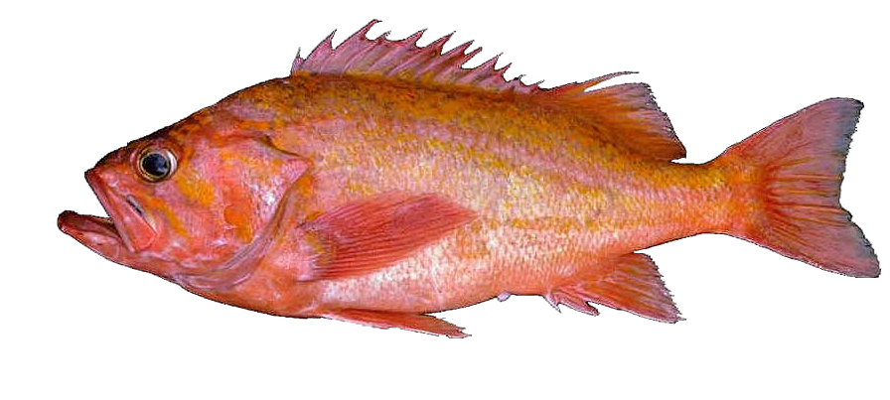
Growth Rings in other Organisms
Many organisms form annual increments
-mollusks, corals, sponges, bones
and… FISH
In fish, growth increments formed in:
-vertebrae, various bones
-fin rays
-scales
-otoliths
Notes:
The purpose of this slide is to illustrate that more than just trees have growth rings. In fact, a lots of other organisms have growth rings!
Growth rings can be found in mollusk shells, coral, sponges, bones and in fish.
In fish, growth rings are present in more than one structure – they can be found in various bones (fin rays, vertebra), as well as scales and otolith.

Slide 5
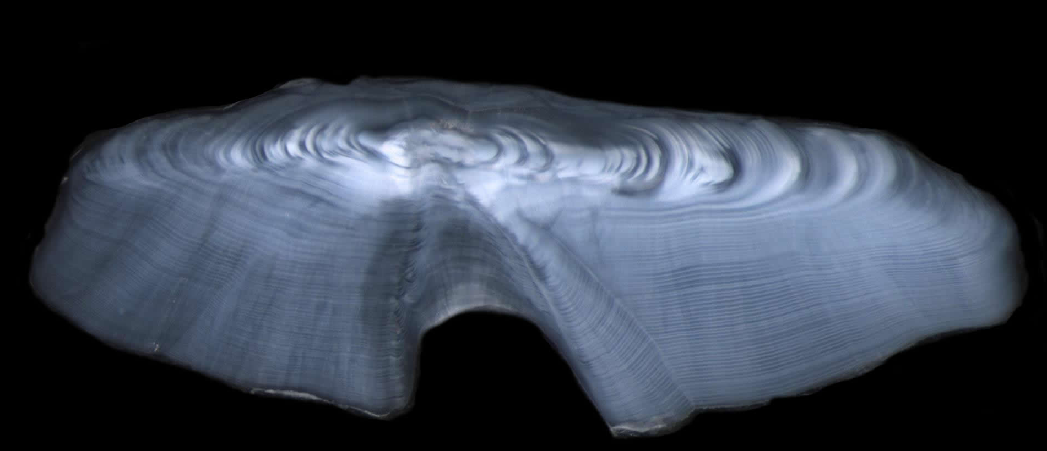
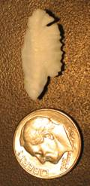
Resolving otolith increments
cut here
Notes:
Many otoliths must be sectioned or cut to read the rings. This is similar to a tree – you can not read the rings of a tree by just looking at the tree trunk. You must cut it.
What can otoliths tell us about age?
Scales, bones, fin rays and otoliths have all been used to determine the age of fish, since these and other bony parts of fish often form yearly rings (annuli) like those of a tree. However, otoliths generally provide the most accurate ages, particularly in old fish.
The easiest way to "read" an otolith is to take a slice, or cross section, out of the otolith with a special saw and then count the rings under a microscope. If the otolith is thin enough, it may be possible to count the annuli without having to slice it. If you can see alternating light and dark zones, you're probably looking at annuli. They probably won't be as clear as those in a cross section, but they should look roughly similar.
Thin sections of an otolith reveal bands of opaque and translucent material, sort of like the rings on a tree trunk. The growth of otoliths is a one-way process: new material (protein and calcium carbonate) is added to the exposed surface of the otolith over time, but existing material cannot be removed. The one-way growth process explains why otoliths can form and retain such delicate structures as daily rings, while bones cannot.
As we saw in the previous lesson, the growth of these rings is related to the growth of the fish. They can be yearly growth rings, but also seasonal, lunar, or even daily!

Slide 6
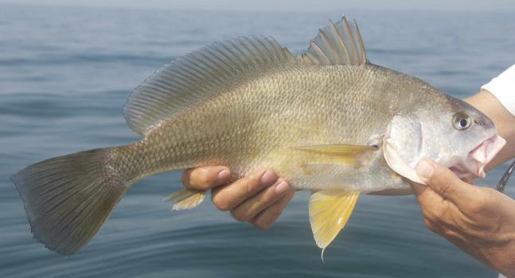
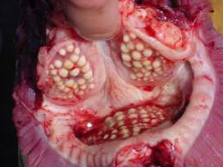
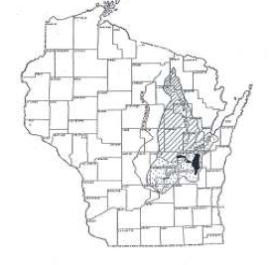
Freshwater Drum
Diet: mussels
Can live 70 years
Freshwater lakes: including Lake Winnebago, WI
Notes:
Teacher Notes: This slide shows the freshwater drum. The bottom left picture shows molars inside the fish’s jaw which it uses to crush mussel shells. The right picture is lake Winnebago, Wisconsin. This is where the otoliths the students will be looking at came from. The top picture is of the Red drum itself. They can live up to 70 years, although 25 years is much more common.

Slide 7
Task 1 Instructions
Age and Birth estimates
Calculate the age of your fish by counting the growth rings in the otolith.
Estimate the year of birth by subtracting the age from the year the fish was caught.
Notes:
Students should be handed a photograph of a red drum otolith cross-section (a thin slide of an otolith – much like a tree-trunk ‘cookie’ which is used to count tree rings) and asked to count the annual rings to determine the age and birth date of the fish. The red drum images are in the folder labeled “Drum_Otolith_images”. There should be 17 images. Each image has the date the fish was caught in the image name as well as the fish ID number. For example, the file name of first image is: FD-031-2006 20x(1). The fish ID number is 31 and the fish was caught in 2006. When the teacher prints the images, it would be helpful to write the catch date on the image somewhere. In this case, 2006 corresponds to the date of the outer most ring. Students will use this information to ultimately calculate the birth date of the fish.

Slide 8
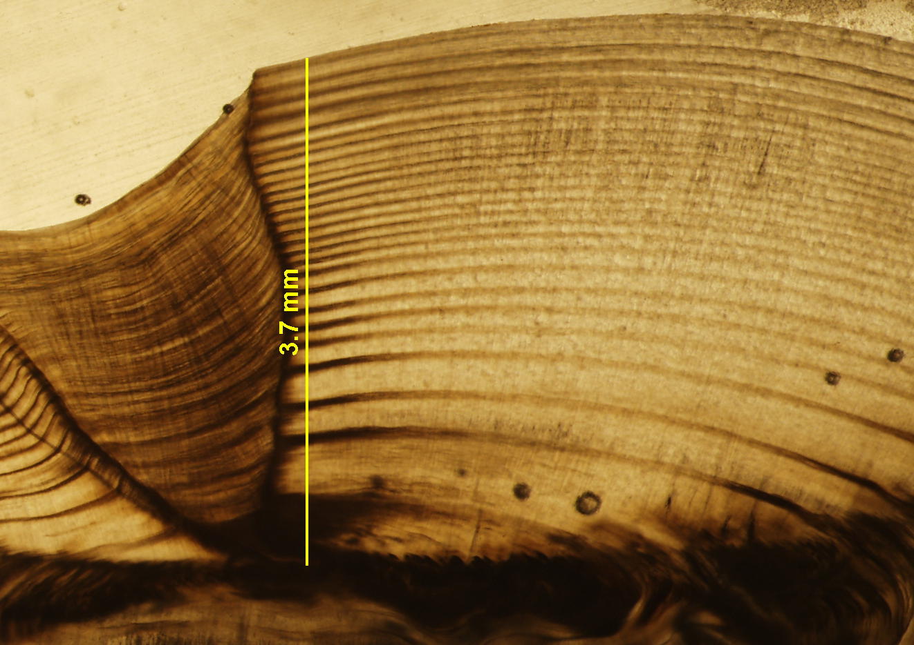
Catch Date:
2012
2012
Direction of Growth
Year 3
Year 2
Year of Birth (year 1)
Notes:
(otolith #70).
This is a sectioned red drum otolith. Note the direction of growth (from center / bottom of the otolith out), year of capture, and birth year. Students will be given one of these images and will count the rings to determine age and estimate the birth year. Note the first year of growth often does not have a very good distinct dark band. For the zebra mussel questions, be sure to tell them that the introduction happened recently (within the last ~15 years), not near the birth date of the fish(es).
The rings appear to get thinner (in general) as you move away from the birth year. This is because, in general, the amount of otolith material that is laid down around the center is the same every year. Thus, as the radius of the otolith increases, the thickness of the ring must decrease if the amount of material laid down is roughly equal every year. This is known as the ‘growth effect’. In the photograph above, the growth effect is very obvious from the year of birth (year 1) through about the first 10 years. Many students will want to say that the mussels were introduced at birth, since the rings are largest there. However, this is NOT true because what they are observing is simply the growth effect.

Slide 9
Synchronous growth
Matching growth “bar codes” (Crossdating)
Trees cored in year 2000
most recent increment
(formed in 2000)
Tree 1
to tree center
1980
1985
1990
1995
2000
Tree 2
1985
1995
2000
1980
1990
Tree 3
Notes:
The physical environment affects otolith ring width, which induces a synchronous growth pattern. “bar codes” should match among otoliths. In tree ring analysis (Dendrochronology) the technique if cross-matching growth rings with a synchronous pattern of growth is called: crossdating
The technique of ‘cross-dating’ helps to establish the correct dates to tree-ring increments by matching up the ‘bar-code’ pattern. This also can be done in fish. This is possible because of the idea of synchronous growth.
This slide shows the ‘bar’ code or growth rings of 3 different trees. The outer most ring of each tree matches (year 2000). As you move to older rings, certain years show a similar growth signal in all three trees. For exampe, year 1985 was very small in all three, while the year 1995 was relatively large. This is a ‘synchronous’ pattern of growth and can be used to increase your confidence when trying to assign dates to the rings.

Slide 10
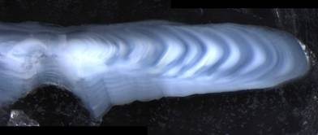
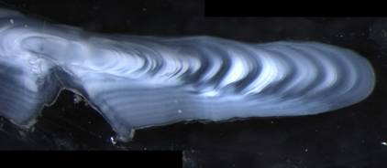
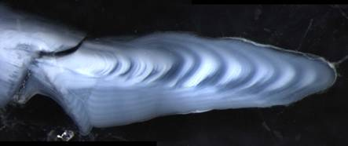
Crossdating in Fish
1983
Notes:
Just like tree rings, otolith rings can be cross dated. The 1983 year was a slow-growth year in these three otoliths.
Teacher Note: Have the student complete the “Fish Growth” worksheet before continuing onto the next slides (up to question 6).

Slide 11
Fast Growth
Slow Growth
Notes:
Use this slide if the students are having trouble with the zebra mussel questions. Not all of the otoliths show a response to the zebra mussels. This could simple be because that individual fish didn’t start eating zebra mussels, even though they were introduced. All of these fish are individuals – so it is possible not all of them switched their diet to zebra mussels. Be sure to tell the students

Slide 12
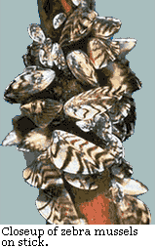
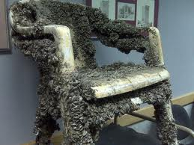
Faster Growth corresponds
To the introduction of
Zebra mussels
Zebra Mussels
Notes:
This slide illustrates to the students roughly when the mussels were introduced. Pictures of zebra mussels are on the right. The introduction of zebra mussels into lake Winnebago and the Great Lakes may have benefited the red drum by increasing its growth, but harmed most other things. They were introduced by ballast water discharge and their populations exploded because they have few natural predators in the area and are fast reproducing. They cover everything on the bottom of lakes and rivers – destroying the natural habitat. You can no longer walk barefoot because the shells are razor shape!
Images from wikipedia.

Slide 13
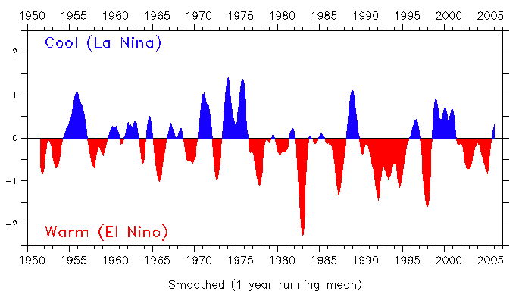
1983
1987-88
1973
Notes:
La Nina: 1964, 1970, 1973, 1988-89, 1995, 1998
El nino:1957-58, 65-66,69-70, 1972-73, 76-77, 1982-83, 86-87, 91-92, 94-95,1997-98, 02-03,
The bottom graph shows the El Nino (warm) vs. La Nina Years (cold).
What is plotted on the top graph is the (detrended) ring increment width vs. increment year for all the red drum otolith images. The increment width was measured using a computer program. Ring increment width is a proxy for the growth of the fish (if a fish grows faster in a particular year, the ring will be larger – same idea behind tree rings). The graph shows synchronous growth between the fish!
The red drum are responding to El Nino condition as well as a recent increase in growth from the introduction of zebras in the mid 1990s.
“Synchronous growth” means that the drum are responding to climate in the same way. El Nino is considered a “warm” condition. All of the yellow arrows above are El Nino events – as one can see, the response of the fish during these years is an increase in growth (not all the fish respond exactly the same because they are living individual lives, that is why the graph is not perfect). A general uptrend toward the end of the graph can also be seen (from ~the early 1990s to present). This corresponds to the introduction of zebra mussels into the lake system. Since red drum eat zebra mussels, the response of the fish is an increase in growth.

Slide 14
Conclusions - Freshwater Drum growth is influenced by…
- Environmental Impacts on growth (El Nino)
Human Impacts (invasive zebra mussels)
What else? (question 5 in handout)
Notes:
The main conclusions for this part of the lesson is that just like tree rings, we can study rings in fish otoliths to gain an understanding of how environment influences fish growth. In this example, we saw that red drum from Wisconsin have increased growth during El Nino (warm) years. They also responded to the introduction of non-native zebra mussels into the lake system with increased growth. These two case studies are examples of animals responding to natural climate variability and a human induced impact. These examples are not the only thing that influence fish (or animal’s) growth. The students should have brainstorm other things that may influence fish growth in their handout (this should largely be a review from the beginning of the lesson) – have the students once again share out their ideas.

Slide 15
Goldfish Growth Experiments: Instructions
Experimental Design
Design an experiment to test the how certain variables influence the growth of a goldfish
Consider your 5 senses, biotic, abiotic, environmental, and human impacts
Notes:
Their worksheet activity on the goldfish experiment is designed to bring everything they’ve learned today together. It can be homework. They have to bring storm more ideas of how they could alter the natural environment (fish tank) of a goldfish to see if there is an affect on its growth. Be creative!
A few possible answers;
Sound: noisy kids in the classroom! Tapping the glass.
Touch: ph, water chemicals, temperature.
Smell: predatory animal extract, smell of food but no actual food,
Taste: altering food/diet.
Sight: Light levels - complete black vs. 24hr sun.
Each class will alter one variable. The kids or the teacher can decide on the variable. Remember to have a control! If there is only one class, you could divide the class into groups. NOTE: this lesson can be taught with out actually setting up the full goldfish growth experiments. Even if they will not set up an actual experiment, it is a good thought exercise!
The next class period can be designated to setting up the aquarium and the monitoring system. See the ‘Goldfish Experiment Setup’ document.

Slide 16
TEACHER SLIDE: Freshwater Drum Answers
A –31, 2006, 24 measurements Years old: 25 Date of Birth: 1982
B – 33, 2006, 38 meas. Years old: 39 Date of Birth: 1968
C – 41, 2006, 25 meas. Years old: 26 Date of Birth: 1981
D – 46, 2006, 22 meas. Years old: 23 Date of Birth: 1984
E – 47,1986, 32 meas. Years old: 34 Date of Birth: 1953
F – 70, 1986, 33 meas. Years old: 35 Date of Birth: 1952
G – 75, 2006, 50 meas. Years old: 52 Date of Birth: 1955
H – 103, 2004, 20 meas. Years old: 22 Date of Birth: 1983
I – 104, 2004, 20 meas. Years old: 22 Date of Birth: 1983
J – 105, 2004, 20 meas. Years old: 22 Date of Birth: 1983
K – 119, 1986, 36 meas. Years olc: 40 Date of Birth: 1947
L – 157, 1986, 32 meas. Years old: 35 Date of Birth: 1952
M – 209, 2006, 45 meas. Years old: 48 Date of Birth: 1959
N – 1273,2007, 22 meas. Years old: 25 Date of Birth: 1983
O – 1339,2007, 22 meas. Years old: 25 Date of Birth: 1983
P – 1340, 2007, 14 meas. Years old : 17 Date of Birth: 1991
Q – 1351, 2007, 16 meas. Years old: 20 Date of Birth: 1988
Notes:
Teacher slide –red drump otolith ages and birth years. These are the answers for the red drum otolith images – all fish ID, catch dates, ages, and birth years.

