Slide 1
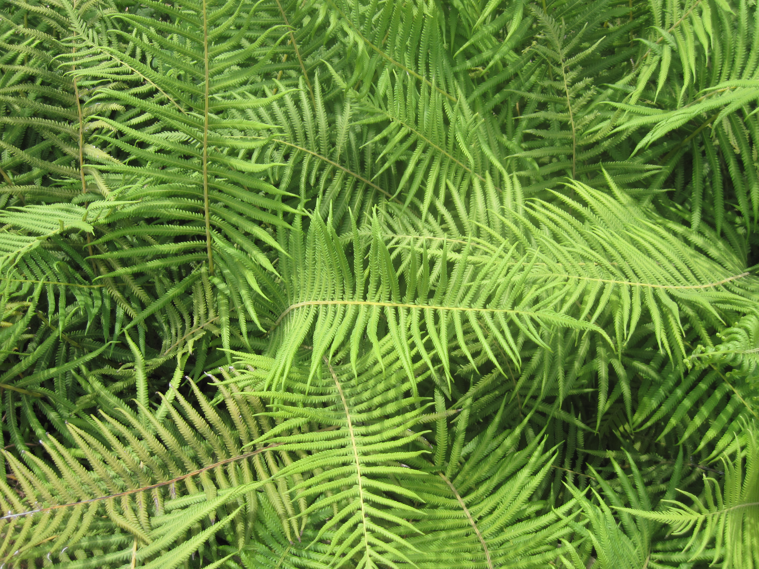
Introduction to Hypotheses
Notes:
Authors: Lynn Waterhouse, Scripps Institution of Oceanography; Joanne “JJ” Johnson, Kearny SCT, San Diego Unified District.
Why:
The basic principle behind all scientific work is the scientific method. The scientific method enables scientists to move beyond observations into using a rigorous, repeatable procedure in order to test and draw conclusions about the world we live in. This is the essence of how science is done.
As human beings we are constantly making observations about the world around us. These observations help us in our daily lives. For instance, each of you made decisions on what to wear today. If it had been raining or snowing you may have chosen something different. Or if it was 100 degrees Fahrenheit outdoors you may have chosen something else. So, you made an observation about the weather when you woke up (or based it on yesterday’s weather) and then got dressed based on your hypothesis about what today’s weather would be like. Similarly, when you go home tonight the decisions you make about when to start your homework are also based on hypotheses about how long everything you need to complete tonight will take.
Before one can learn any statistical tests, one must first understand hypotheses.
Summary:
This first PowerPoint introduces the concepts of hypotheses. Understanding hypotheses are essential for using the scientific method. Hypotheses enable one to go from observation to inference and provide a framework to test our inferences. Students will become familiar with the process of making observations and inferences. Students will become familiar with framing hypotheses and also framing statistical hypotheses. Students will become familiar with null hypotheses and alternative hypotheses and how the two relate to one another. After this lesson students will better understand the process behind the scientific method and be prepared to at least outline the steps of a basic scientific study with a statistical hypothesis.
Take-Home Messages:
Statistical hypotheses have a rigorous structure to them.
Typically the hypotheses that represents what we, as scientists, are interested in is the alternative hypotheses.
Photo Credits this slide:
Ferns, Santa Barbara Botanical Garden. Lynn Waterhouse, 2014.
Context for Use:
This curriculum was designed for use in both a 10th grade Advanced Biology and 11th grade AP Biology classroom in San Diego, CA, but can also be used in AP Environmental Science classes in the same district.
Misconceptions:
Students may confuse hypotheses with observations. Typically observations are made on a sample and then the hypotheses extract those observations to say something at a much larger scale. For example, you may observe that more people in the class are wearing sweaters than short-sleeved shirts on a given day. The hypothesis could involve reasons as to why more people have on sweaters or one could hypothesis about the amount of people wearing sweaters on that day in their entire school, city, or even state.
Evaluation Tips:
Students will be formatively assessed using inquiry-based discussions throughout the lesson and worksheets.
There is one assigned lab, the M&M basic lab. The M&M advanced lab builds upon the basic lab and introduces the chi-square goodness of fit test (which is beyond the AP Biology exam requirements). It is up to the teacher to assign any formal lab notebook.
There are addition handouts (census, birds in wetlands, dizziness, and Zebrafish). It is up to the teacher to assign these handouts and to decide if they will be used as an in class activity, for homework, or as a quiz. The zebrafish handout requires some familiarity with genetics (phenotype and genotype) so this handout may be appropriate when covering genetics and heredity. The birds in wetlands handout could fit nicely into an ecology section or when habitat, breeding grounds, or migrations are discussed. The census handout and dizziness handout can be used at any time.
Teaching Notes:
Teacher will introduce hypotheses to the students.
Students can review PowerPoint beforehand, or any appropriate textbook reading (if provided by the teacher).
Teacher will ask students to formulate hypotheses for a variety of situations.
Following this PowerPoint the Introduction to Chi-square PowerPoint should be taught. These two mini-lessons (PowerPoints) are necessary prior to doing the M&M basic and advanced lab as well as any of the handouts.

Slide 2
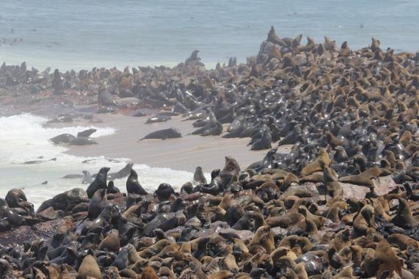
How do we learn about our world?
Observation/Description
Inference
Notes:
Main Points:
Two main ways to learn about the world.
1. Observation and description.
2. Inference – testable statements (theories) –all based on hypotheses!
Main point from photo:
Teacher: Ask students what do they observe in this photo?
Example:
More seals on beach than in water.
Teacher: Ask students to make inference from photo, based on one observation previously give.
Example:
Using observation that more seals are on the beach than in the water.
The water is cold and the seals are on the beach to stay warm.
There are sharks in the water and the seals are on the beach to avoid being eaten.
Teacher explain that by making inferences, one is formulating the basis hypothesis.
Photo Credits this slide:
Cape fur seal colony of Cape Cross near Swakopmund in Namibia, Lyn Hancock, http://lynhancock.blogspot.com/2012/11/memories-of-sam-cape-fur-seal-colony-of.html

Slide 3
Basic Structure of Hypotheses
Based on observations
Testable
Repeatable
Notes:
Main Points:
Hypotheses are generated by first making observations on the world around us and then drawing an inference based on our observations.
Hypotheses must be testable to qualify as a scientific hypothesis.
The test to evaluate a hypothesis must be repeatable.

Slide 4
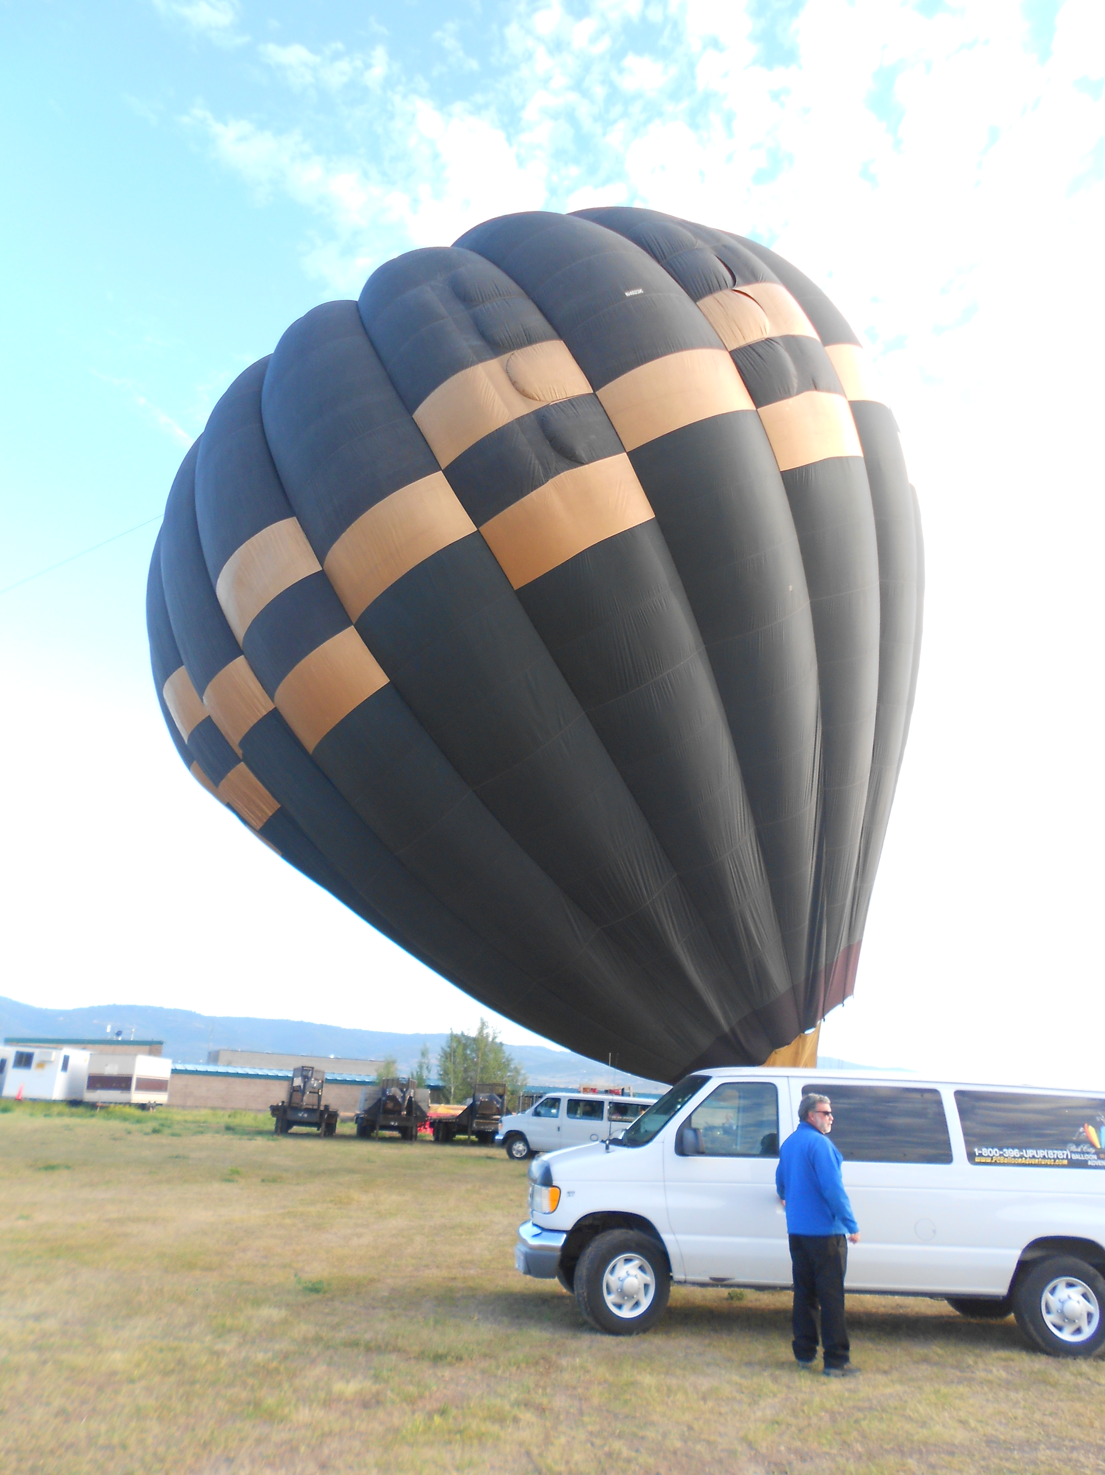
Practice Making Hypotheses
Observation/Description
Inference
Hypotheses
Notes:
Main Points:
Practice making observation, inference, hypothesis. Example answers are given in brackets.
Ask students what they observe in the photo. [A hot air balloon inflating]
Ask students to make an inference from the photo. [The balloon is about to rise]
Ask students to formulate a hypothesis from their inference. [When enough hot air is added to the balloon it will rise]
Photo Credits this slide:
Hot air balloon inflating. Lynn Waterhouse.

Slide 5
Statistical Hypotheses
Statistical hypotheses are hypotheses which can be evaluated by conducting a statistical test.
What you are interested in becomes the alternate hypothesis.
The opposite statement is the null hypothesis.
Notes:
Teaching notes:
Statistical hypotheses are hypotheses which can be evaluated by conducting a statistical test. The form of the hypotheses will in part be determined by the statistical test you will be using.
In general on first makes an observation, draws some inference, comes up with a hypothesis of interests, selects an appropriate statistical test for that hypothesis, reframes the hypothesis as a set of statistical hypotheses and then conducts the test.
There are two types of statistical hypotheses:
Null hypothesis
Alternative hypothesis
The specifics of the wording for the null and alternative hypotheses are framed by the type of statistical test being used. In general, the alternative hypothesis is the hypothesis you are interested in and the null hypothesis is the opposite of it. The following examples should help explain this in more detail.
Teaching Example (go through this with the class)
Return to the example based on this photograph:
We observed that we see more seals on the beach than in the water.
We inferred that maybe there was a predator in the water.
We could hypothesize that there are in fact more seals on the beach than in the water. If we were to use the chi-squared test for equality (which will be taught in the next lesson, Introduction to Chi-square), the null hypothesis would be that there are the same amount of seals in the water and on the beach and the alternative would be that there are not the same amount of seals in the water and on the beach.
We could hypothesize that there are predators in the water. To test this we would simply need to establish that there are predators in the water. So we could first do a survey to look for predators and then determine if the predators eat the seals (which could be done in a variety of ways including through stomach content analysis, fecal pellet analysis, or observing an act of predation to name a few). If we wanted to frame this into a null and alternative hypothesis we could look at the mortality rates (which include predation and natural causes) for seals on land and in the water. The null hypothesis would be that the mortality rates are the same in the water and on the beach. The alternative hypothesis would be that the mortality rates are not the same (actually we would want to test if the mortality rate in the water is greater than the rate in the ocean, but this requires a test more sophisticated than the chi-square test of equality).
Reiterate difference between Null and Alternative hypothesis
Null hypothesis- The specifics of this will be determined by the type of statistical test you use, but in general this is the opposite of the statement that is the alternative hypothesis.
Alternative hypothesis- Again, the specifics of this are determined by the type of statistical test being used. The Alternative hypothesis is where the hypothesis of interest typically resides.
Photo Credits this slide:
Cape fur seal colony of Cape Cross near Swakopmund in Namibia, Lyn Hancock, http://lynhancock.blogspot.com/2012/11/memories-of-sam-cape-fur-seal-colony-of.html

Slide 6
Statistical Hypotheses
We are interested in why seals are on the beach. We think it may have to do with sharks.
Alternate hypothesis? Null hypothesis?
Notes:
Main Points
We are interested as two why so many seals are on the beach. We think it is due to sharks.
Ask students to formulate a null and alternative hypothesis.
Alternative: There are more seals on the beach to avoid the sharks in the water.
Null: The reason there are more seals on the beach has nothing to do with sharks.
The type of statistical test that would be used here is complicated, so we are being a bit lose in the formulation of the null and alternative, but there are still strict rules that must be followed.
The reason the statistical test would be so complicated here is that we are talking about causation, and causation is one of the hardest things to prove (especially using live, wild animals).
Common mistakes in framing the statistical hypothesis:
Alternative: There is a shark in the water. ← this statement tells us nothing about the seals
Alternative: The shark wants to eat the seals. ← this statement focuses on the sharks, not the seals.
Alternative: The seals are on the beach because there is a shark in the water.
Null: There is no shark in the water. ← This null hypothesis does not complement the alternative. The null should describe all other possibilities not explained by the alternative.
General Rules for Null and Alternative
Null and alternative hypothesis follow this simple pattern.
Alternative: A is true.
Null: A is not true.
Photo Credits this slide:
Cape fur seal colony of Cape Cross near Swakopmund in Namibia, Lyn Hancock, http://lynhancock.blogspot.com/2012/11/memories-of-sam-cape-fur-seal-colony-of.html

Slide 7
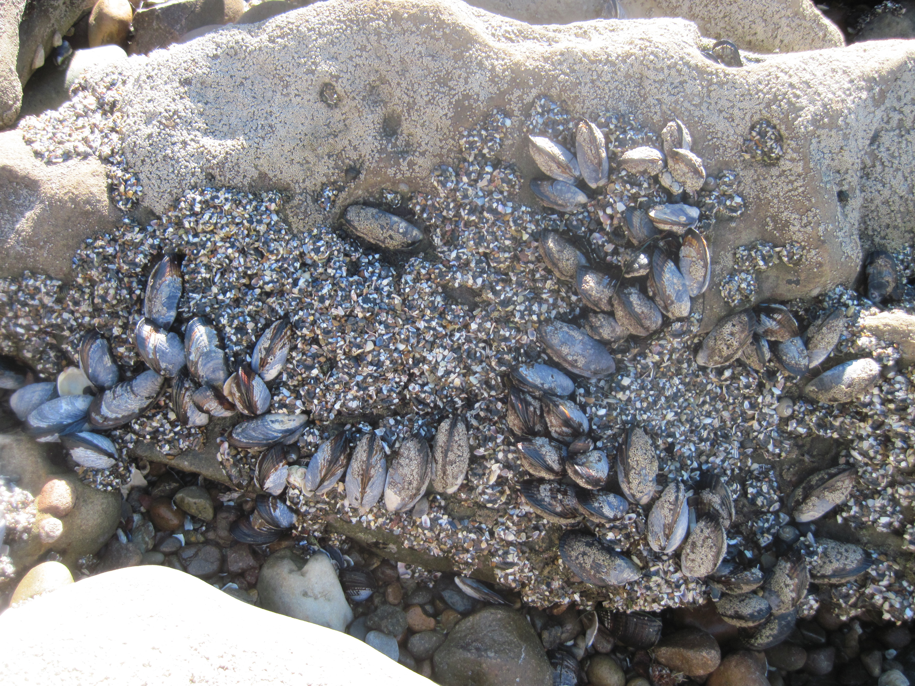
Statistical Hypotheses
This is the rocky intertidal.
Observations? Inference?
Alternate hypothesis? Null hypothesis?
Notes:
Main Points
This is an additional photo for making observations, inference, and hypotheses with the class. This is an optional slide.
Example of observation, inference, and hypotheses:
Observation: The organisms growing on the rock only grow up to a certain height.
Inference: Maybe water has something to do with it.
Alternative Hypothesis: Organisms can only live so high on a rock or they run out of water.
Null Hypothesis: Where organisms live on a rock does not have to do with water limitations.
Note: there are multiple answers to this question.
Try and keep in mind that
The hypothesis of interest becomes the alternative hypothesis.
The null hypothesis is generally the opposite of the alternative.
Alternative: A is true.
Null: A is not true.
Photo Credits this slide:
Rock intertidal. La Jolla Shores, La Jolla, California. Lynn Waterhouse.

Slide 8
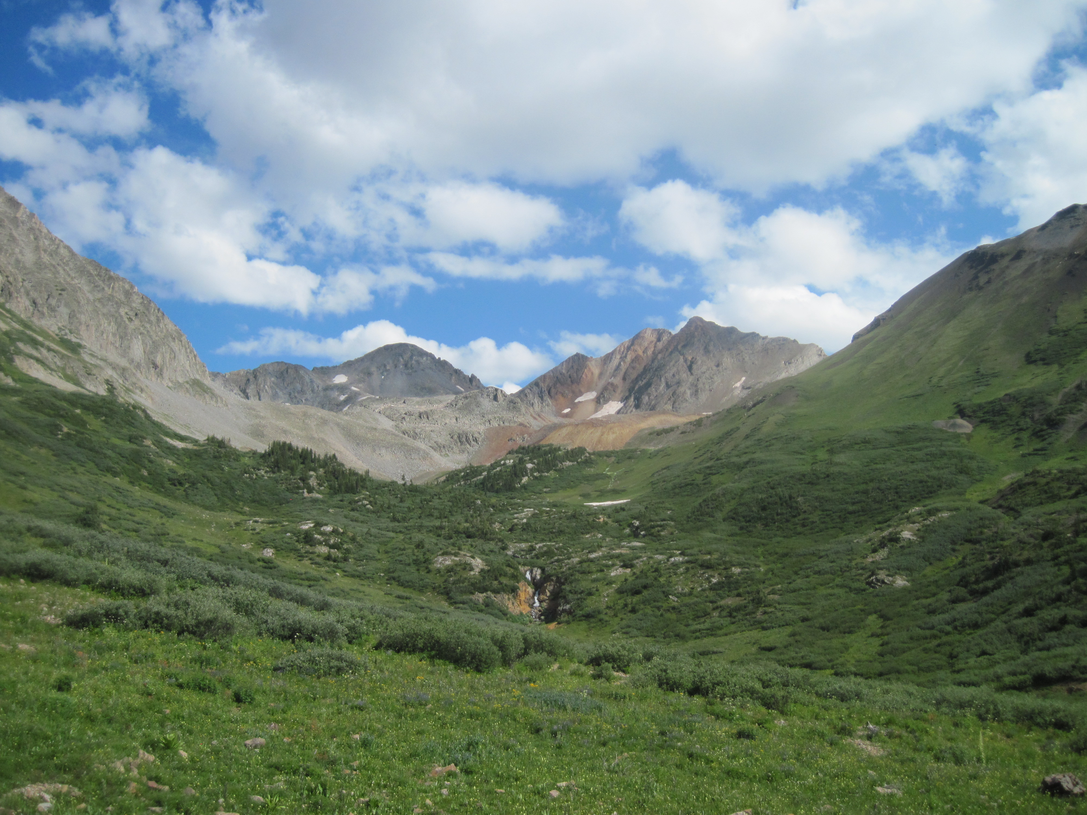
Statistical Hypotheses
This is part of the Rocky Mountains.
Observations? Inference?
Alternate hypothesis? Null hypothesis?
Notes:
Main Points
This is an additional photo for making observations, inference, and hypotheses with the class. This is an optional slide.
Example of observation, inference, and hypotheses:
Observation: The vegetation stops being green at a certain altitude on the mountain.
Inference: Maybe altitude limits where certain vegetation can grow.
Alternative hypothesis: Altitude limits where the green vegetation can grow.
Null hypothesis: Altitude does not effect where the green vegetation can grow.
Note: there are multiple answers to this question.
Try and keep in mind that
The hypothesis of interest becomes the alternative hypothesis.
The null hypothesis is generally the opposite of the alternative.
Alternative: A is true.
Null: A is not true.
Photo Credits this slide:
Crested Butte, Colorado. Dan Popa.

Slide 9
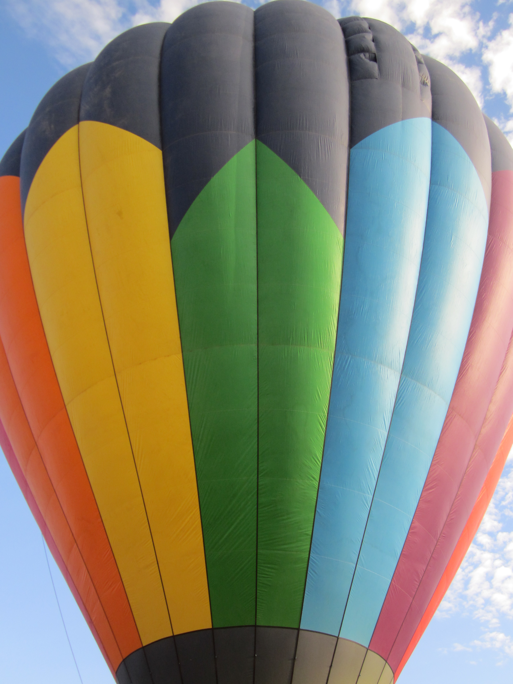
Conclusions
The scientific process involves the steps of making observations, formulating hypotheses, turning those hypotheses into statistical ones and then testing them.
Notes:
Conclusions
Students understand that the scientific method is a simple extension of the process of making observations and inference. The scientific method has specific structure and steps involved.
Students should now be familiar with the process of making observations and drawing inference from the world around them.
Students should understand that statistical hypotheses have two types: null and alternative. The alternative hypothesis is generally the one the scientist really cares about (relates to the original inference). The null hypothesis is typically the opposite of the alternative. The specifics of the exact form that the null and alternative hypotheses take will be determined by the type of statistical test used. The null and the alternative hypotheses must describe all possibilities.
Students now better understand the process behind the scientific method and are prepared to outline the steps of a basic scientific study with a statistical hypothesis.
This PowerPoint should be followed with the PowerPoint on Introduction to Chi-square.
Photo credit this slide:
Hot air balloon. Lynn Waterhouse.

