Slide 1
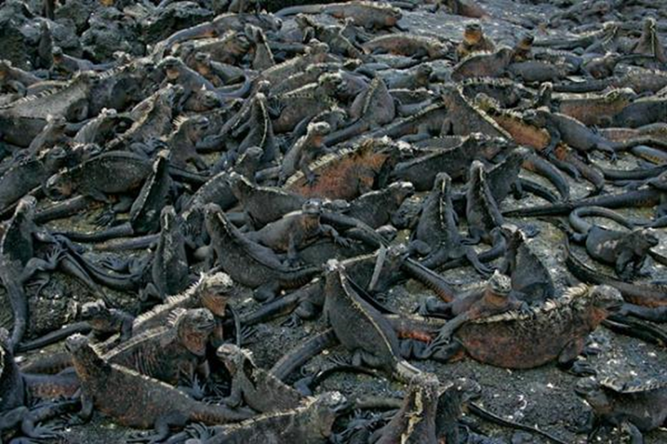
Introduction to Chi-Square Analysis
Notes:
Authors: Lynn Waterhouse, Scripps Institution of Oceanography; Joanne “JJ” Johnson, Kearny SCT, San Diego Unified District.
Teaching Note:
This PowerPoint is meant to go after the PowerPoint on “Introduction to Hypotheses”.
Why:
If we are curious if objects are distributed into categories evenly (randomly) rather than by some cause other than randomness we will use a Chi-square test for equality.
Specifically we are evaluating if the number of objects in each category is statistically equal. The phrase statistically equal does not mean literally equal. It means that some deviations (differences) from complete equality are allowed, but that these deviations (differences) are small, and therefor due to random chance alone. This allows us to determine if objects are distributed evenly into categories, meaning there is a random distribution, or if some cause other than randomness is at play. If the distribution is random we expect statistically equal number of objects per category.
Some examples of chi-square tests for equality
Forest biologists may be interested in if one plant type is dominant to another, they could use chi-square to determine if the plants occur in equal abundance in a category (meaning occurrence of plant type is random) or if one or multiple plants are more dominant (suggesting some factor causes certain plants to achieve greater success in the habitat than others).
A baseball coach may want to evaluate the success of his players when they are at bat against a certain pitcher. The coach can use the chi-square test for equality to determine if all players perform the same, or if some are better than others. This could affect the batting line up against that pitcher.
County governments will want to know how they should allocate spending across school districts. Chi-square test for equality can be used to determine if the school populations are statistically equal or if some school districts are larger than others. This can affect how counties allocate their tax dollars.
Summary:
This first PowerPoint introduces the chi-square test for equality. The chi-square test for equality is used to determine if the number of objects in each category is statistically equal. If the number of objects is statistically equal, we say any differences are due to random chance alone.
Students should already be familiar with hypotheses and here they will be introduced to the specific hypotheses that go along with the chi-square test for equality. The null hypothesis will take a form similar to “the number of objects in each category is statistically equal, any difference is due to random chance alone” and the alternative hypothesis will be “the number of objects in each category is not statistically equal, any differences are due to some cause other than random chance”.
Student will become familiar with the equations for calculating expected value, degrees of freedom, chi-square, and sum of chi-square. Students will also become familiar with how to use a chi-square table to find the critical value given the degrees of freedom and a level of significance (or alpha value).
Students will become familiar with using their calculated sum of chi-squares value and the critical value to determine if they reject or accept the null hypothesis. An easy way to remember this is that the sum of chi-squares provides a metric on how different are our observed values from being statistically equal. The critical value provides the maximum sum of chi-squares value that is an allowable “difference metric” given our level of significance (alpha value) and degrees of freedom. If our calculated sum of chi-squares is larger than the critical value then we reject the null hypothesis because our observed data has greater differences than allowed under randomness and statistical equality. If our calculated sum of chi-squares is smaller than the critical value than we accept (fail to reject) the null hypothesis and determine that the differences we observed are due to random chance alone.
Students are also familiar with taking the statistical result of the test and translating it into a statement relevant to their problem. If they reject the null hypothesis in favor of the alternative then students should be able to hypothesize a reason other than randomness that is causing the difference. Students should be able to think of ways that they could evaluate if their hypotheses for causes other than randomness are correct (note: this is an extension skill and doesn’t have any correct answers, we just want the students to be thinking of how they can test their hypotheses and to get used to the way in which the scientific method works).
Students will also become familiar with identifying cases when the chi-square test for equality is applicable. Students should be able to create their own chis-square example (polling the class for their favorite color, superhero, sport, etc. are great examples) and do the analysis.
Later activities include conducting chi-square analysis in a variety of situations.
The lab activity using bags of M&M’s (king size work best) is suggested for the follow up activity.
There is an advanced M&M activity in which students are introduced to the chi-square goodness of fit test. The chi-square goodness of fit test differs from the chi-square test for equality in that rather than saying objects are in different categories in statistically equal numbers, the objects are now in categories based on a specific proportions and you test how well your observed data fits those specified proportions.
There are a variety of handouts that students can do as in class assignments, homework problems, or for quizzes. They are on birds and wetlands (uses ecology knowledge), census data, dizziness example, and the zebrafish example (uses some genetic knowledge).
Vocabulary used
Random(at random) – without any definite cause, purpose, or aim
Statistically Equal – Things are statistically equal if the differences are smaller than a critical statistical value
Critical Value- The largest statistic value allowed under the null hypothesis. In the case of chi-square test for equality, the critical value is the largest allowable sum of chi-squares value that one would observe for a given degrees of freedom and a specific level of significance (alpha value) is the objects were found in statistically equal numbers per category and any difference was due to random chance alone.
Level of significance- This is commonly referred to as the alpha level. This is the proportion of times we are willing to incorrectly find a significant differences (the proportion of times we will incorrectly reject the null).
Test statistic- The calculated sum of chi-squares.
Null hypothesis- The number of objects in each category is statistically equal, any differences are due to random chance alone.
Alternative hypothesis- The number of objects in each category is not statistically equal, the differences are due to some cause other than random chance.
Accepting the null (fail to reject the null) – the calculated sum of chi-squares is smaller than the critical value, so we accept the null. This means the number of objects in each category is statistically equal and any difference is due to random chance alone.
Rejecting the null (accept the alternative)- the calculated sum of chi-squares is larger than the critical value, so we reject the null in favor of the alternative. The means the number of objects in each category is not statistically equal and the difference is due to some cause other than random chance.
Chi-square test for equality- A statistically test which enables us to examine if objects are distributed equally among categories with only random chance operating to cause the differences.
Degrees of freedom- The number of categories minus one.
Expected value- The total number of objects divided by the number of categories. This is how many objects we would expect to see in each category under equality.
Observed value – The objects we observe (or measure) in each category. These are the data we collect or observe.
Photo Credits this slide:
Marine iguana sitting on a rock in the Galapagos Islands, from World Wildlife Fund (WWF), http://worldwildlife.org/species/marine-iguana
Colony of marine iguanas from Galapagos Islands, image copyright 2005, Arthur Morris/BIRDS AS ART, http://www.birdsasart.com/bn180.htm
Websites Used:
Context for Use:
This curriculum was designed for use in both a 10th grade Advanced Biology and 11th grade AP Biology classroom in San Diego, CA, but can also be used in AP Environmental Science classes in the same district.
Misconceptions:
Students may be slightly confused by the term statistically equal. Using statistical equality the statement 2=1 can be true if they error structure allows for it.
Randomness can also cause some confusion. For chi-square analysis randomness implies that the objects are found in statistically equal numbers in each category.
Students may be unaware of the broad applications of statistics. Take the time to reinforce the broad applications of statistics and the wide variety of careers that rely on statistics. Statistical knowledge can take you a long way. However, the media often incorrectly portrays statistics, so encourage students to question statistics as reports by the media, especially the conclusions drawn from those statistics.
Evaluation Tips:
Students will be formatively assessed using inquiry-based discussions throughout the lesson. It is up to the teacher to assign any lab notebooks or lab reports.
Teaching Notes:
Prior to this lesson students have reviewed the PowerPoint on hypotheses.
Following this lesson students can complete the M&M basic lab activity and advanced lab activity. The advanced lab activity uses the chi-square goodness of fit, something not covered in this lesson. The chi-square goodness of fit is a simple modification to the chi-square test for equality in that instead of assuming statistically equal distribution of objects across categories, the percentage of objects in each category is now given and this is the distribution the test evaluates the goodness of fit against.
Optional handouts are available for follow up evaluation. The zebrafish activity would go best during discussion of genetics and phylogeny. The birds and wetland handout would go best in an ecology segment that discusses habitat, migration, and breeding grounds. The census and dizziness handouts could be used at any time.

Slide 2










Applications of Chi-Square
Notes:
Cases in which Chi-Square analyses (and other types of statistical tests) may be used:
Baseball and other professional sports and sports related companies employ statisticians for a variety of reasons. ESPN employs statisticians to come up with player, team, and game day stats. Sports betting companies employ statisticians to run the odds. Sports gear companies like Nike and Adidas employ statisticians to evaluate which players are worth sponsoring, and what gear to produce to meet market demand. Many sports teams now decide who they will draft or hire based on complex statistical models that enable them to build a better team overall. If anyone has seen the movie “Moneyball” staring Brad Pitt and Jonas Hill, which was based on a true story, this is what was happening there.
Wall street stock investors use complex statistical algorithms to determine which stocks to invest in and which ones to sell. Present day stock models are very complex, but they may use a form of chi-square analysis to choose among multiple models.
Casinos hire many statisticians. These statisticians evaluate the odds of winning for every game a casino runs to ensure the casino always makes a profit. The statisticians may also look for customers who are cheating (for example, counting cards in blackjack). Statistical models are also used to help determine how many of each type of game to place on the floor, and even what type of ambiance the casino should offer.
Retailers determine how much of each item to stock based on statistical analyses.
Scientists analyze genetic data to determine taxonomy and determine new species using advanced statistical methods.
Grocery stores determine how much of each product to stock and the manufacturers have to determine how much of each product to make and where to distribute it.
The amount of money spent on producing Hollywood blockbuster movies may also come from statistical analysis. The movie production companies evaluate which genres, directors, actors, etc. they should spend the most money on.
The US government does a census (a complete survey of the US population) every 10 years, this is used to determine funding allocations for various government programs and school districts. Surveys can also be used to evaluate how programs are doing.
Advertisers rely heavily on statistical models to evaluate how much they should spend on advertising, and where and when they should advertise.
Architects and construction firms also use statistics, civil engineers make use of models and limits on construction materials to evaluate the safety of structures and plan new projects.
Class Interaction
You can ask the class if they know of any other uses of statistics. You can also ask if they know of any specific uses of chi-square (this is unlikely at this point, but if any of the students have taken biology already or statistics they should have an answer to this question). We will return to this question at the end of this lesson.
Picture credits
All images on this slide are from Microsoft Office online image search.

Slide 3

Chi-Square???
Greek letter Chi
pronounced “kai”—Latin or “chee” – Greek
Chi-squared test for equality
Notes:
Main Points:
Correct pronunciation of chi-square (background knowledge on origin of word chi)
Greek letters are often used in mathematical and statistical applications as the Greeks were the pivotal to the fields of mathematics and statistics.
General usage of chi-square test
We will be learning the Chi-squared test for equality
There are other versions of the chi-squared test including goodness of fit and the basis for the likelihood ratio test (this statement is optional, if you feel it will confuse the students, just reinforce that other versions exist, but we are just learning the test for equality)
Misconceptions
Some students may be confused with the term equality. We are not looking for strict equality, rather we are speaking about statistical equality. Statistical equality means that two numbers can be equal if one is equal to the other plus or minus some error.

Slide 4
Chi-Square Test for Equality
Want to know if the items are distributed equally across groups.
Equality statistical equality
Notes:
Main Points:
Test for equality. We are looking to evaluate if the distribution of objects in categories is random. Imagine raindrops falling on the ground onto two pieces of sidewalk next to one another. If the raindrops are random, we would expect an equal number of raindrops to fall on each piece of concrete. The exact number may be different, but if we counted the number of raindrops again and again and again (effectively repeating this experiment) we would expect the average number of raindrops falling on each piece of concrete to be equal. This is what we mean by statistical equality and randomness.
Equality refers to statistical equality
-allows for random deviation from being equal
Imagine that the pink and yellow boxes represent two experimental agriculture plots, one with weed killer and one without. The green circles represent weeds. We want to know if the application of weed killer reduces the number of weeds.
Ask the students if the number of green dots in the pink box and tan box are equal?
Answer: they are not strictly equal
But are they statistically equal??
Chi-square analysis test for equality (chi-square analysis) can be used to determine this answer.

Slide 5
Chi-Square ( χ² ) Test
Used to determine if there is a significant difference between the expected and observed data
Two Versions of Null hypothesis:
There is NO statistically significant difference between expected & observed data. Any differences are due to RANDOM CHANCE alone.
  The number of objects in each category is statistically equal, any difference is due to random chance.
Notes:
Main Points
The chi-square test for equality enables one to determine if there is a significant difference between the expected and observed data. Specifically the chi-square test for equality evaluates if objects are found in different categories in equal numbers.
The chi-square test for equality has a specific null and alternative hypothesis that goes along with it. Here we introduce the null hypothesis.
The null hypothesis is:
There is no statistically significant difference between expected and observed data. Any differences are due to random chance alone.
Or
The number of objects in each category is statistically equal, any difference is due to random chance.
Vocabulary used
Significant difference = statistical difference (this is an important point to make, statistics classes and the AP biology exam tend to use different terminology)
Observed data – what is counted
Expected data – the count that is expected under all categories having a statistical equal number of items

Slide 6
Chi-Square ( χ² ) Test
Two Versions of ALTERNATIVE hypothesis:
There is NO statistically significant difference between expected & observed data. Any differences are due to RANDOM CHANCE alone.
  The number of objects in each category is statistically equal, any difference is due to random chance.
Notes:
Main Points
Remember from the PowerPoint on hypotheses, the alternative hypothesis will be the opposite of the null hypothesis.
Here are two examples of what the alternative hypothesis will be for the chi-square test for equality.
Alternative:
There is a statistically significant difference between the observed and expected data. The differences are due to something other than random chance alone.
Or
The number of objects in each category is not statistically equal, the differences are due to some reason other than random chance.
How the chi-square test works
Under the null hypothesis we expect an equal number of objects per category. We can calculate how many objects we would expect in each category under equality, and then compare this to our actual observations. We then use a metric which uses the difference between the expected number and the observed number to determine essentially how different our observed data is from equality. Since we are talking about statistical equality based on randomness, we expect a certain amount of difference to exist. However if that difference is really large, then we have evidence that the objects do not occur in numbers that are statistically equal in each category and then we reject the null hypothesis. Essentially we are evaluating how different our observation from equality.
Further Extension
Reason other than random chance could be a biological factor. In the previous example with the green dots being in the pink or tan square, imagine the green dots are birds and the pink and tan square represent different patches of forest. Ask students to come up with a reason other than random chance why the birds would be found in different numbers in the two different patches of forest. Some example answers: better habitat in one patch of forest; more food in one patch of forest; less predators in one patch of forest; and higher rate of reproduction in one patch of forest.

Slide 7
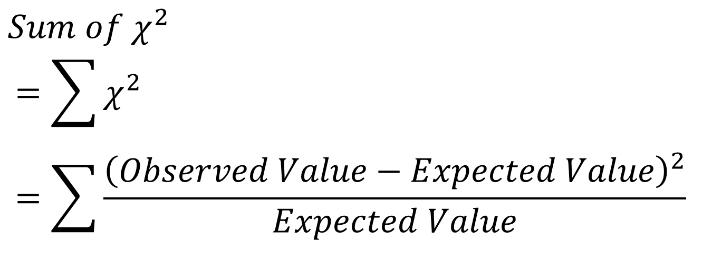
Chi-Square ( χ² ) Formula
Notes:
Main Points
Here we will go over the equation for the sum of chi-squares.
The symbol that looks a bit like a giant E is the mathematical symbol for addition (the summation sign). It means you should add all the stuff to the right up. In this case it means we need to calculate the chi-square value for each category and then add them all together.
You should go over order of operations. The acronym for the order of operations is PEMDAS. It stands for "Parentheses, Exponents, Multiplication and Division, and Addition and Subtraction". People often remember it by the pneumonic "Please Excuse My Dear Aunt Sally". It means first we do the parentheses, then the exponents, then multiply and divide, and then addition and subtraction come last.
The order of operations mean that in the equation for the chi-square statistic we first do observed value minus expected value. Then take the square of this quantity. Finally divide this quantity by the expected value, and this is the chi square value for one category. Then do this for all categories and add them together.
Reassure students that we will work through an example coming up. The important thing here is to understand the symbols and the order of things.
Things to keep in mind:
We are interested in the sum of chi-square.
There will be one chi-square value for each category and then these values are summed to get the overall sum of chi-square for the problem.
Make sure students understand the summation sign.

Slide 8
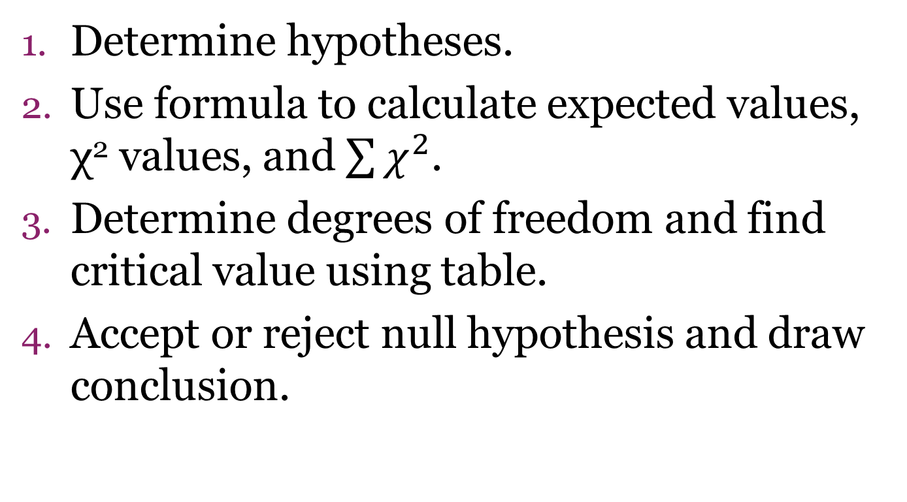
How to use the Chi-Square Test
Notes:
Main Points
Go over steps in doing a chi-square analysis.
We will go over each of these steps in greater detail in the following slides.

Slide 9
How to use the Chi-Square Test
Determine hypotheses
Null: The number of items founds in each category is statistically equal. Any difference is due to random chance alone.
Alternative: The number of items in each category is not statistically equal. The difference is due to some other cause than random chance.
***Modify to be more specific for your study***
Notes:
Main Points
Step 1 is determining the hypotheses.
They follow these basic patterns.
You will need to modify them to match your study.
In the plots of experiments land with weed killer applied or not and growth of weeds examples we briefly discussed before the null and alternative would be:
Null: The number of weeds growing in the plot with weed killer and the one without are statistically equal, any difference is due to random chance alone.
Alternative: The number of weeds growing in the plot with weed killer and the one without are not statistically equal, any difference is due to some other cause than random chance.

Slide 10
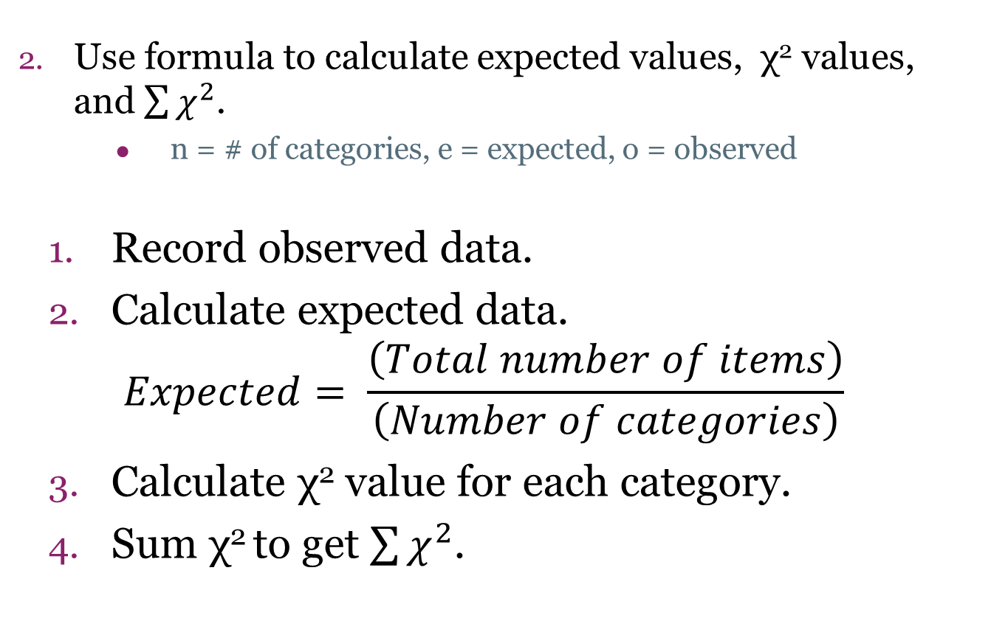
How to use the Chi-Square Test
Notes:
Main Points
Step 2: calculating the sum of chi-squares
Record the observed data for each category
Calculate the expected number for each category.
Remember: the expected number is how many items one would expect in each category assuming equal distribution among categories.
Using the chi-squared test for equality the expected number in each category will be identical. You may want to emphasize this to students a few times.
Calculate the chi-square value for each category.
Chi-square is (observed-expected)^2/expected
May be easier for students to do this step by step
(Observed – Expected)
(Observed – Expected)^2
(Observed – Expected) ^2 / Expected
Sum the chi-square values
Common mistakes:
The expected number of items in each category does not need to be a whole number. In fact it will rarely ever be a whole number.
Do not round until the final step. Retain all decimals until the very end. Prematurely rounding can lead to the wrong answer.
The expected number for each category will be identical.
Chi-square values and sum of chi-square values will always be positive numbers. If you calculate a negative number something is wrong.
Helpful Hints
The chi-square value for each category will always be positive. Why? Because the equation for the chi-square value is (observed-expected)^2/expected. So we have a positive number divided by a positive number, and the result will be a positive number. The sum of chi-squares will also be a positive number since

Slide 11
How to use the Chi-Square Test
3. Determine degrees of freedom and level of significance to find critical value using the chi-square table.
Degrees of Freedom = Number of Categories – 1
Notes:
Main Points
Step 3 is to find the critical value for your test. The critical value for the chi-square test for equality is the largest possible value for the sum of chi-squares, given the degrees of freedom and level significance, one could find if in fact the number of objects in each category were statistically equal, and any difference was due to random chance alone. We compare the critical value to our calculated sum of chi-squares to determine if we accept or reject the null hypothesis.
To find the critical value it requires using a chi-square table. Before you can use a chi-square table you first need to understand two concepts, the degrees of freedom (explained here) and the level of significance (or alpha), which is explained on the next slide.
Degrees of freedom are equal to the number of categories minus one. This can be thought of as the free number of categories, which is the number of categories minus the parameters that have to be estimated (which is 1). The parameter that has to be estimated is the expected number per category. Another way to thing of this is the degrees of freedom is how many values are free to vary. If I told you that an average of 3 numbers was equal to 5 and that the first two numbers were 4 and 6, you would know exactly what the third number is. Numerically this is 5 = (4+6+X)/3 and we want to know what X is (it has to be 5). Since the expected number of objects per category is the average number per category, and for any given average for n objects, there are n-1 free values and the final value (the nth) value is determined by the n-1 values before it.
Note: if more variables have to be estimate the degrees of freedom will change. For the chi-square test for equality we only have to estimate 1 parameter (the expected value) so we have n-1 degrees of freedom.

Slide 12
How to use the Chi-Square Test
3. Determine degrees of freedom and level of significance to find critical value using the chi-square table.
Level of significance = α = 0.05
Probability of finding a significant difference when there is none is 0.05. That is we will incorrectly reject the null hypothesis 5 out of 100 times.
Notes:
Main Points
Step 3 is to find the critical value.
The level of significance is the probability of finding a significant difference when there is none. In other words, it is the probability of rejecting the null hypothesis when we should in fact be accepting it.
When we set the level of significance equal to 0.05 (an alpha of 0.05) it means if we repeated a study 100 times when the number of items in each category is in fact equal, we will reject the null hypothesis 5 out of 100 times and come to the incorrect conclusion that the number of items in each category is not equal.
The level of significance may be set to a different value depending on the situation. For instance, if we are think of a statistical analysis used by pharmaceutical companies to evaluate if a certain drug has the negative effect of causing people to go into seizures, then we may use a level of significance of 0.01 or even 0.00001 (0.001%) . If we are discussing the level of significance used by a investor in the stock market, they may choose something higher, say 0.20, if they are willing to accept a bigger risk for a larger payoff.
Note: understanding what the level of significance means is not required by the AP Biology class and it actually requires knowledge of probability theory. A level of significance of 0.05 will always be used in biology classes and for the AP Biology exam unless explicitly stated otherwise.

Slide 13
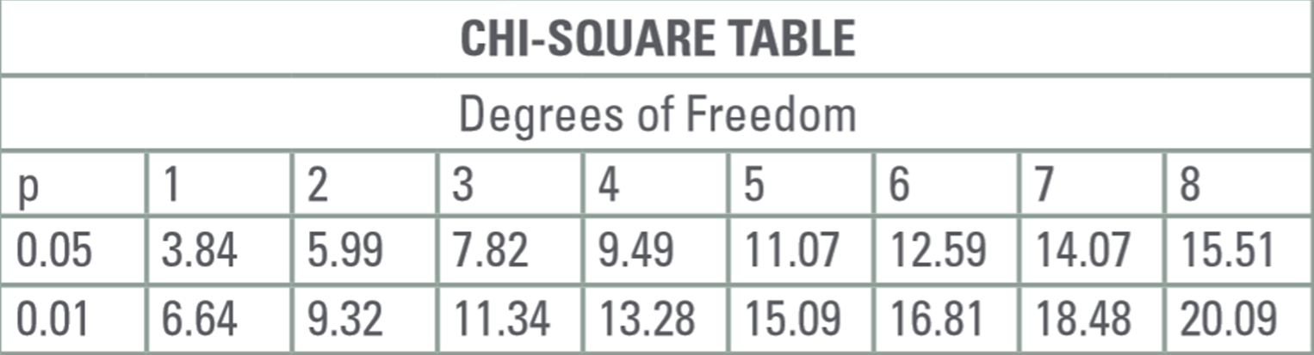
Notes:
Main Points
This is a chi-square table.
It is used for finding the critical value for chi-square analysis. The critical value is the value we use to compare to our sum of chi-squares to determine if we are going to reject or accept the null hypothesis.
In order to find the critical value, you must know the degrees of freedom and the level of significance.
In this table the level of significance is given in the 1st column, with row 2 being alpha=0.05 and row 3 is alpha=0.01. The columns 2-9 detail the degrees of freedom.
To find the critical value, typically use the level of significance p = 0.05 (2nd row) and then find the column with the appropriate degrees of freedom.
Photo Credit
AP College Board. Handout for AP Biology exam. Downloaded from: http://media.collegeboard.com/digitalServices/pdf/ap/bio-manual/CB_Bio_TM_APPENDIX_A_WEB.pdf

Slide 14
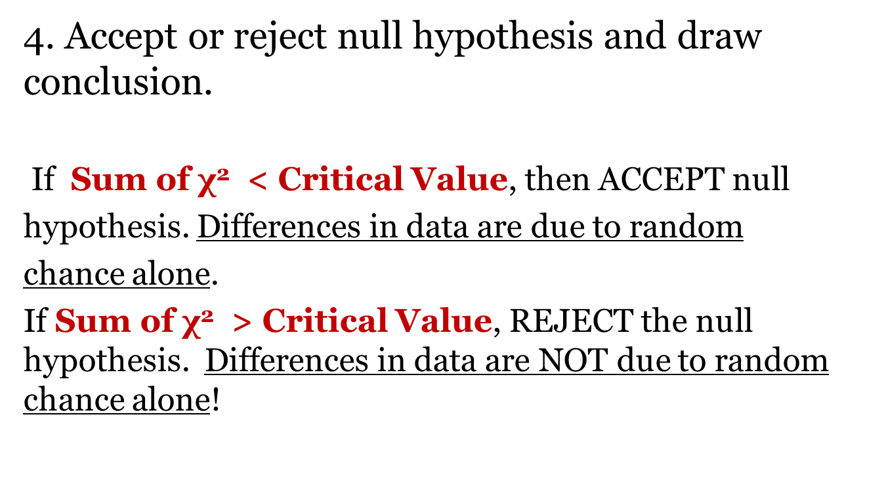
How to use the Chi-Square Test
Notes:
Main Points
Step 4- determine the result of your test.
Compare your sum of squares to the critical value from the chi-square table.
This is when we decide if the distribution is random, meaning statistically equal numbers in each category, or not random, meaning some other factor is influencing the distribution.
If your sum of chi-squares is smaller than the critical value, you accept the null hypothesis. Conclude the items are distributed among categories statistically equal and any differences are due to random chance alone.
If your sum of chi-squares is larger than the critical value, you reject the null hypothesis. Conclude the items are not distributed statistically equally and that any differences are due to some other cause than random chance alone.

Slide 15
How to use the Chi-Square Test
4. Accept or reject null hypothesis and draw conclusion.
Make a conclusion statement tying the statistical result back to the study. If applicable, make a new hypothesis as to why you rejected the null hypothesis.
Notes:
Main Points
Step 4- determine the result of your test.
Compare your sum of squares to the critical value from the chi-square table.
Students should always be able to translate rejecting or accepting the null hypothesis into a statistical statement and a conclusion statement relating back to the main purpose of the study. Students should also be able to generate a new hypothesis if the result of the test is to reject the null hypothesis, that is, use their background knowledge on the topic to come up with a probably reason as to why the test was rejected.
Back to our example with the plots of land and the weed killer and weeds. If we rejected the null, we would say that the number of weeds is not statistically equal in the plot without weed killer and the plot with weed killer and we conclude this difference is due to some other cause than random chance. We may hypothesize that in fact the weed killer did it’s job and killed some weeds, which is why the plots had different numbers of weeds in them.
NOW, let’s work through a real example (starting next slide)

Slide 16



Simple Chi-Square Example
Determine null hypothesis
Notes:
Main Points
Now everyone will work together to go through a chi-square example step by step, it involves silver and gold Hershey kisses in a paper bag.
Problem set up
We have a bag filled with silver (regular) and gold (almond) Hershey Kisses.
Ask the students what the null hypothesis is.
Helpful Hints
If the students are missing the mark, tell them we are interested in the number of kisses in the bag.
If they still don’t get it, remind them chi-square tests equality of objects in categories. Ask what the categories are (gold vs. silver kisses).
Photo credits this slide:
Silver Hershey Kiss: http://onekit.enr-corp.com/1002116/images.html
Gold Hershey Kiss: http://www.polyvore.com/gold_hershey_kiss/thing?id=644797

Slide 17
Simple Chi-Square Example
Determine null hypothesis
There is no significant difference in the number of gold and silver wrapped Hershey kisses in the bag. Any difference is due to random chance alone.
Notes:
Main Point
The null hypothesis is that there is no significant difference in the number of gold and silver Hershey kisses in the bag. Any difference is due to random chance alone.
Photo credits this slide:
Silver Hershey Kiss: http://onekit.enr-corp.com/1002116/images.html
Gold Hershey Kiss: http://www.polyvore.com/gold_hershey_kiss/thing?id=6447977

Slide 18
Simple Chi-Square Example
2. Use formula to calculate χ² value:
 | Observed | Expected | (Obs-Exp) | (Obs-Exp)² | (Obs-Exp)²/ Exp
Silver Kisses
Gold Kisses
Total
To calculate expected need total population, divided by total possibilities
Notes:
Main point
Here is the data table. Remember step 2 is to calculate the chi-square values.
First we will need our observed data.
Statement:
Σχ² means sum of chi-squares

Slide 19
Simple Chi-Square Example
2. Use formula to calculate χ² value:
 | Observed | Expected | (Obs-Exp) | (Obs-Exp)² | (Obs-Exp)²/ Exp
Silver Kisses | 17
Gold Kisses | 3
Total | 20
If there are 20 kisses in total, what is the expected number of kisses?
Notes:
Main Point
If the observed data is 17 silver kisses and 3 gold kisses, this gives a total of 20 kisses.
What is the expected amount per category?
Statement:
Σχ² means sum of chi-squares

Slide 20
Simple Chi-Square Example
2. Use formula to calculate χ² value:
 | Observed | Expected | (Obs-Exp) | (Obs-Exp)² | (Obs-Exp)²/ Exp
Silver Kisses | 17 | 10
Gold Kisses | 3 | 10
Total | 20 | 20
Now we need to calculate the chi-square values for each category.
Notes:
Main Points
The expected value is 10 per category. This is found from 20/2 = 10
Note the expected value is the same for each category.
Now we need to calculate the chi-square values. It is laid out step by step in this table to make things simpler.

Slide 21
Simple Chi-Square Example
2. Use formula to calculate χ² value:
 | Observed | Expected | (Obs-Exp) | (Obs-Exp)² | (Obs-Exp)²/ Exp
Silver Kisses | 17 | 10 | 7 | 49 | 4.9
Gold Kisses | 3 | 10 | -7 | 49 | 4.9
Total | 20 | 20
What is the sum of chi-squares?
Notes:
Main Point
This is what the data table looks like filled out.
First we did observed-expected.
Then (observed-expected)^2
The (observed-expected)^2/expected

Slide 22
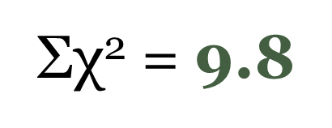
Simple Chi-Square Example
2. Use formula to calculate χ² value:
 | Observed | Expected | (Obs-Exp) | (Obs-Exp)² | (Obs-Exp)²/ Exp
Silver Kisses | 17 | 10 | 7 | 49 | 4.9
Gold Kisses | 3 | 10 | -7 | 49 | 4.9
Total | 20 | 20
What is the sum of chi-squares?
Notes:
Main Point
Sum of chi-squares is 9.8
Statement:
Σχ² means sum of chi-squares

Slide 23
Simple Chi-Square Example
Find critical value using table (use p=0.05).
Degrees of freedom
=number of possibilities - 1
= 2 – 1 = 1
Notes:
Main Point:
What is the critical value?
We need degrees of freedom.
Number of categories = 2, Hershey kisses are either silver or gold
Degrees of freedom = number of categories – 1 = 1
Use 0.05 as the level of significance
Ask students what critical value is.
Critical value is 3.84
Photo Credit
AP College Board. Handout for AP Biology exam. Downloaded from: http://media.collegeboard.com/digitalServices/pdf/ap/bio-manual/CB_Bio_TM_APPENDIX_A_WEB.pdf

Slide 24
Simple Chi-Square Example
Find critical value using table (use p=0.05).
Degrees of freedom
=number of possibilities - 1
= 2 – 1 = 1
Notes:
Main Point:
Shows the critical value.
From previous slide:
What is the critical value?
We need degrees of freedom.
Number of categories = 2, Hershey kisses are either silver or gold
Degrees of freedom = number of categories – 1 = 1
Use 0.05 as the level of significance
Ask students what critical value is.
Critical value is 3.84
Photo Credit
AP College Board. Handout for AP Biology exam. Downloaded from: http://media.collegeboard.com/digitalServices/pdf/ap/bio-manual/CB_Bio_TM_APPENDIX_A_WEB.pdf

Slide 25
Simple Chi-Square Example
4. Critical value is 3.84, our calculated Sum of χ² value is 9.8
If χ² < Critical Value, then ACCEPT null hypothesis.
  Differences in data are due to random chance alone.
If χ² > Critical Value, REJECT the null hypothesis.
  Differences in data are NOT due to random chance alone!
Notes:
Main Points
What is the result of the test?
The critical value is 3.84 and our sum of Chi-square values is 9.8

Slide 26
Simple Chi-Square Example
4. Critical value is 3.84, our calculated Sum of χ² value is 9.8
If χ² < Critical Value, then ACCEPT null hypothesis.
  Differences in data are due to random chance alone.
If χ² > Critical Value, REJECT the null hypothesis.
  Differences in data are NOT due to random chance alone!
We reject the null hypothesis. Differences in the number of gold and silver Hershey kisses in the bag are not due to random chance alone.
Notes:
Main Points
What is the result of the test?
The critical value is 3.84 and our sum of Chi-square values is 9.8
Since the Chi-square value is greater than the critical value we reject the null hypothesis. The number of gold and Hershey kisses in the bag are not statistically equal, and the differences are due to something other than random chance alone.
Ask the class to come up with some reasons other than randomness?
Examples of answers:
You purposely put more silver kisses into the bag.
Silver kisses are cheaper, so you had more of them.
You like gold kisses more, so you ate more of them, so fewer could go into the bag.

Slide 27

Summary
Chi-square test for equality
When to use it
Null & alternative hypotheses
Calculate expected value, degrees of freedom, critical value, & sum of chi-squares
Determining result of test & interpretation
Notes:
Summary:
This power point introduced us to the chi-square test for equality. The chi-square test for equality is used to determine if the number of objects in each category is statistically equal. If the number of objects is statistically equal, we say any differences are due to random chance alone.
We have reviewed the steps for conducting a chi-square test of equality.
Determine the hypothesis
Calculate the sum of chi-square value
Determine the critical value
Determine if we accept/reject the null hypothesis and interpret the results.
Students now know the specific hypotheses that go along with the chi-square test for equality. The null hypothesis will take a form similar to “the number of objects in each category is statistically equal, any difference is due to random chance alone” and the alternative hypothesis will be “the number of objects in each category is not statistically equal, any differences are due to some cause other than random chance”.
Students should remember that the expected value of items per category will not necessarily be a whole number. The expected number if the chi-square test for equality is the total number of objects divided by the total number of categories.
Remember in the chi-square test for equality the expected number is the same for each category.
Remember that we try not to round or lose digits until the final step of the chi-square test for equality.
Students know that the degrees of freedom is the number of categories minus one.
Student are familiar with the equations for calculating expected value, degrees of freedom, chi-square, and sum of chi-square.
Students are familiar with how to use a chi-square table to find the critical value given the degrees of freedom and a level of significance (or alpha value).
Students are familiar with calculating the sum of chi-squares value and the critical value to determine if they reject or accept the null hypothesis. An easy way to remember this is that the sum of chi-squares provides a metric on how different are our observed values from being statistically equal. The critical value provides the maximum sum of chi-squares value that is an allowable “difference metric” given our level of significance (alpha value) and degrees of freedom. If our calculated sum of chi-squares is larger than the critical value then we reject the null hypothesis because our observed data has greater differences than allowed under randomness and statistical equality. If our calculated sum of chi-squares is smaller than the critical value than we accept (fail to reject) the null hypothesis and determine that the differences we observed are due to random chance alone.
Students are also familiar with taking the statistical result of the test and translating it into a statement relevant to their problem. If they reject the null hypothesis in favor of the alternative then students should be able to hypothesize a reason other than randomness that is causing the difference. Students should be able to think of ways that they could evaluate if their hypotheses for causes other than randomness are correct (note: this is an extension skill and doesn’t have any correct answers, we just want the students to be thinking of how they can test their hypotheses and to get used to the way in which the scientific method works).
Students are familiar with identifying cases when the chi-square test for equality is applicable. Students should be able to create their own chis-square example (polling the class for their favorite color, superhero, sport, etc. are great examples) and do the analysis.
Vocabulary used
Random(at random) – without any definite cause, purpose, or aim
Statistically Equal – Things are statistically equal if the differences are smaller than a critical statistical value
Critical Value- The largest statistic value allowed under the null hypothesis. In the case of chi-square test for equality, the critical value is the largest allowable sum of chi-squares value that one would observe for a given degrees of freedom and a specific level of significance (alpha value) is the objects were found in statistically equal numbers per category and any difference was due to random chance alone.
Level of significance- This is commonly referred to as the alpha level. This is the proportion of times we are willing to incorrectly find a significant differences (the proportion of times we will incorrectly reject the null).
Test statistic- The calculated sum of chi-squares.
Null hypothesis- The number of objects in each category is statistically equal, any differences are due to random chance alone.
Alternative hypothesis- The number of objects in each category is not statistically equal, the differences are due to some cause other than random chance.
Accepting the null (fail to reject the null) – the calculated sum of chi-squares is smaller than the critical value, so we accept the null. This means the number of objects in each category is statistically equal and any difference is due to random chance alone.
Rejecting the null (accept the alternative)- the calculated sum of chi-squares is larger than the critical value, so we reject the null in favor of the alternative. The means the number of objects in each category is not statistically equal and the difference is due to some cause other than random chance.
Chi-square test for equality- A statistically test which enables us to examine if objects are distributed equally among categories with only random chance operating to cause the differences.
Degrees of freedom- The number of categories minus one.
Expected value- The total number of objects divided by the number of categories. This is how many objects we would expect to see in each category under equality.
Observed value – The objects we observe (or measure) in each category. These are the data we collect or observe.
Extension Questions
This is a good time to ask if the students have any questions about chi-square analysis and then review those portions.
This is also a good time to ask the students if they can think of any applications of the chi-square test for equality. You can relate it to something currently happening. If it’s October, elections are coming up or Halloween candy types from trick or treating. If it’s march there is march madness and number of games won by the various teams. If it’s January or December there are college football playoffs and number of games won by each team. If it’s spring there are flowers blooming and types of flowers and plants coming out.
Next the students will conduct a chi-square analysis on their own for the M&M Lab activity.
Follow-up Activities
Later activities include conducting chi-square analysis in a variety of situations.
The lab activity using bags of M&M’s (king size work best) is suggested for the follow up activity.
There is an advanced M&M activity in which students are introduced to the chi-square goodness of fit test. The chi-square goodness of fit test differs from the chi-square test for equality in that rather than saying objects are in different categories in statistically equal numbers, the objects are now in categories based on a specific proportions and you test how well your observed data fits those specified proportions.
There are a variety of handouts that students can do as in class assignments, homework problems, or for quizzes. They are on birds and wetlands (uses ecology knowledge), census data, dizziness example, and the zebrafish example (uses some genetic knowledge).

