Slide 1
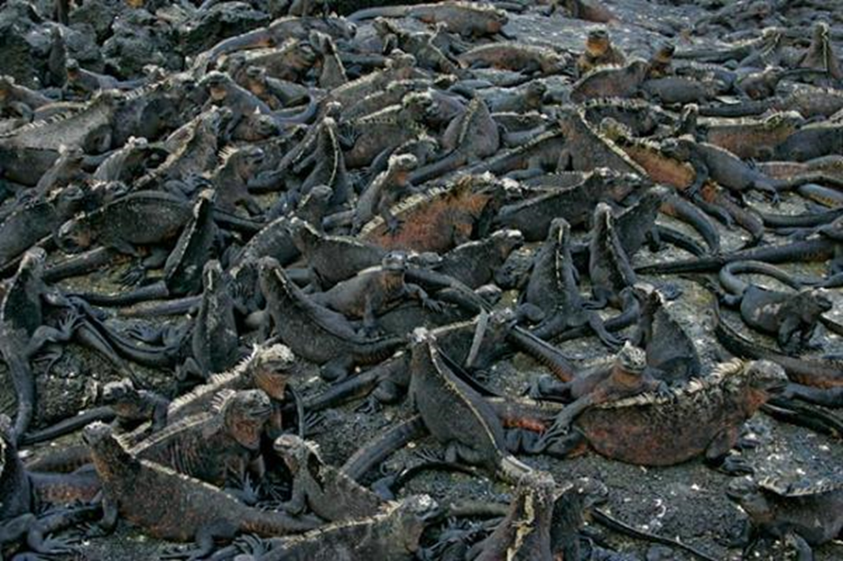
Introduction to Sampling
Notes:
Authors: Lynn Waterhouse, Scripps Institution of Oceanography; Joanne “JJ” Johnson, Kearny SCT, San Diego Unified District.
Why:
If one wishes to quantify a feature of a population or habitat, there are two methods of counting that can be used: census and sampling. In a census every individual is counted to quantify the feature or interest, whereas in a sample only a representative subset of the population is tabulated and used to estimate the total. If a sample is used it is important that the sample is representative of the population of interest. If a sample is representative we call it unbiased. Understanding how and why sampling is done lays a foundation for understanding how science is done.
Summary:
This first PowerPoint introduces the concepts of census, sampling, random sampling, and convenience sampling. Here we will also go over the use of quadrat sampling for estimating density and total abundance.
Students will be introduced to censuses and samples. They will learn that a census is when every individual is counted. They will become familiar with limitations of doing a census (expensive, time consuming, difficult with highly mobile species, difficult with cryptic species, etc.). Students will learn that in order for a sample to be useful it needs to be representative of the population of interest. A powerful type of sampling is random sampling, in which every individual in the population has an equal probability of being sampled. Students will be introduced to quadrat sampling, a method of producing a random sample in which quadrats are placed randomly throughout the habitat and then the objects falling within the quadrat are counted. Students will learn how to calculate density, abundance, mean, and standard deviation. Students should be familiar with how to calculate areas before this lesson.
Take-Home Messages:
A census is when every individual of the population is counted.
A sample is when a representative subset of the population is used to get an estimate at the population level.
A convenience sample is a sample in which the selection criterion is not random. The results from a convenience sample can be biased.
Random sample is a sample that is selected at random from the entire population, such that every object in the population has an equal chance of being selected. This means the random sample will be representative of the entire population.
Quadrat sampling is a method of sampling in which defined shapes are used to sample the entire population. Typically a quadrat is a square shape, which is placed at random into the area of interest.
Population abundance is the total number of individuals in the population.
Population density is the number of individuals per unit of area for the entire area spanned by a population.
Photo Credits this slide:
Colony of marine iguanas from Galapagos Islands, image copyright 2005, Arthur Morris/BIRDS AS ART, http://www.birdsasart.com/bn180.htm
Websites Used:
Context for Use:
This curriculum was designed for use in both a 10th grade Advanced Biology and 11th grade AP Biology classroom in San Diego, CA, but can also be used in AP Environmental Science classes in the same district.
Misconceptions:
Data that comes from samples has no meaningful theory and reasoning behind it.
Random and chaotic are the same thing.
All sampling methods will lead to the same result.
One does not need to spend time planning a sampling design.
Evaluation Tips:
Students will be formatively assessed using inquiry-based discussions throughout the lesson and the quadrat sampling activity. It is up to the teacher to assign a formal lab notebook. This lesson can also be tied in with the chi-square testing and a chi-square analysis can be done on the results. This is also up to the discretion of the teacher.
Teaching Notes:
Prior to lesson students have reviewed a PowerPoints that discuss concepts of hypotheses and chi-square test for equality.
The mini activity (step02) can be done after this entire PowerPoint is taught, or after slide 5, when random samples and convenience samples have been covered..
After this PowerPoint the quadrat sampling activity can be done and the advanced quadrat sampling activity.
As a class each group shares their results from the quadrat sampling and chi-square activity (optional).
Teacher will present a future sampling question and each student will think of their ideal design. The students will share their design with their groups. Each student will share out with the entire class something that they find important for the ideal design, making sure to not repeat a previously suggested idea.
(Optional) Hands on (advanced) quadrat sampling activity can be completed if time and space permits. This also requires more materials and prep time.
Materials for mini activity sampling design
Folder: Step02_MiniActivity Sampling Design
Print out teaching materials
Cutout of enough animal cards for 1 per student
Data sheet (1 per person)
Calculator (1 per person)
Materials for quadrat sampling activity (students work in groups)
Folder: Step03_Quadrat Sampling Activity
Rulers (1 per group)
Calculator (1 per person)
Prints of “quadrat sampling base sheets” (3 habitats) – 1 set per group
Mini quadrats – 3 per group (can be made with coffee stirrers, popsicle sticks, or cut from paper)
Printout of sheet (1 per person)
Printouts of chi-square extension, this is optional (1 per person)
Materials for advanced quadrat sampling (students work in groups)
Folder: Step04_Optional_Advanced Quadrat Sampling
Large quadrats (3 will enable you to have 1 group go at a time)
Can be made out of PVC
Can use paint stirrer sticks
Can use rulers taped together
Animal printouts (seal in water, seal on land, iguana in water, and iguana on land- need at least 15-20 of each, exact number depends on space)
These can be laminated to be reusable
Suggest adding some weight to the laminated ones so they don’t blow away in the wind or breeze
Means to mark out three areas representing sunny beach, shady beach, and water
Different color tarps work well
Bedsheets from goodwill also work well (you can fold them to take up less space)
Can use cones/stakes and string to mark out areas
Calculators (1 per person)
Measuring tape
Printouts of reading materials (or access online to them) (1 per person)
Student data sheet (1 per person)
Student chi square sheet (if you are doing the extension) (1 per person)

Slide 2
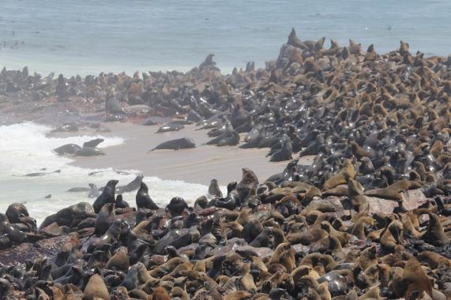
Why do we sample….
Census count every individual
Sample uses a representative subset to estimate total
Notes:
Main Points:
Examples of censuses:
US 10-year census of citizens
California condor studies (every animal is known)
Grades for this classroom
Coaches poll for ranking football teams.
Examples of samples:
Gallup poll (used to predict winners of elections)
Survey responses published in magazines (Cosmo, ESPN, Shape, Seventeen)
Nielsen TV ratings (they have boxes in select homes that record what shows are watched and this is extrapolated to represent the entire US population)
The number of calories in a bag of M&M’s. They have calculated it based on selected some bags and measuring it, but they don’t calculate the calories in every single bag ever sold.
Weather report in USA Today. USA Today typically only gives the forecast of a few cities within the USA, not ever city.
Voting for “most popular”. The voting in American Idol doesn’t mean every American votes, rather a select few vote and their favorites are the winners.
Why is it that we don’t always do a census?
Cost
Difficulty in reaching 100% of the population. The census in the USA always has difficulty reaching undocumented immigrants and people with disabilities (they may not be able to read the Census mail flyer or be reach via telephone). For populations with rapid growth rate, it is hard to guarantee your census is accurate since the population changes so frequently. For populations with large spatial coverage it is also hard to guarantee a complete sample. For populations that move frequently it is hard to guarantee that you (1) count every individuals and (2) don’t count individuals twice. For underwater populations doing a census can be very difficult, as they can be hard to reach. These are just a few reasons why it may be difficult to do a census.
Ask the students for other reasons.
Main point from photo:
Imagine how difficult it would be to count every seal in this colony. This is why we use sampling.
Teacher: Ask students what might some of the difficulties be?
Examples:
seals move, they may not stay in one place while you make your count
seals go in and out of the water
seals are laying on top of one another you may miss one
seals are wild animals, they may not want you to walk among them counting each one
It may be hard to distinguish the seals, you may wind up counting individuals twice (or more)
Photo Credits this slide:
Cape fur seal colony of Cape Cross near Swakopmund in Namibia, Lyn Hancock, http://lynhancock.blogspot.com/2012/11/memories-of-sam-cape-fur-seal-colony-of.html

Slide 3
Why a random sample???
Convenience sampling
Random sampling
Goal in design is to avoid biases
Under-representative sample
Notes:
Main Point
Go over difference between convenience sampling and random sampling
Convenience sample is when individuals have an unequal probability of being selected for the sample, example:
Take first 5 you encounter
Poll first 5 people in line
Ask only friends
Random sample- design sampling so that sample randomly selected individuals from the entire population. That is each individual has an equal probability of being selected.
For example, if I am interested in the favorite sport of students at this school, I would take a roster of all the students at the school and then, at random, select 50 of the people to ask what their favorite sport is.
We will go over these concepts in more detail on the next two slides.

Slide 4
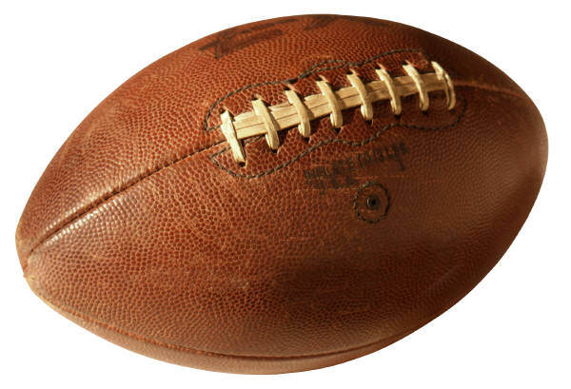


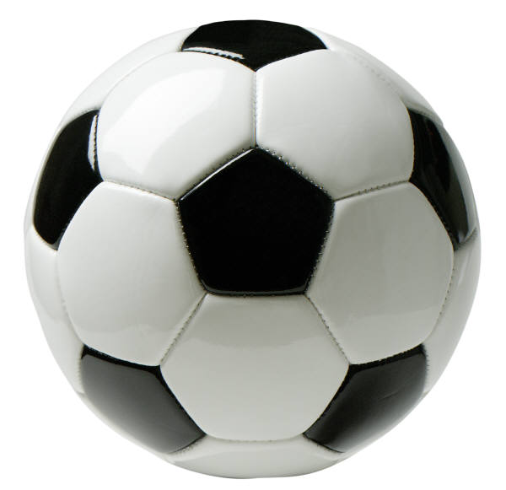

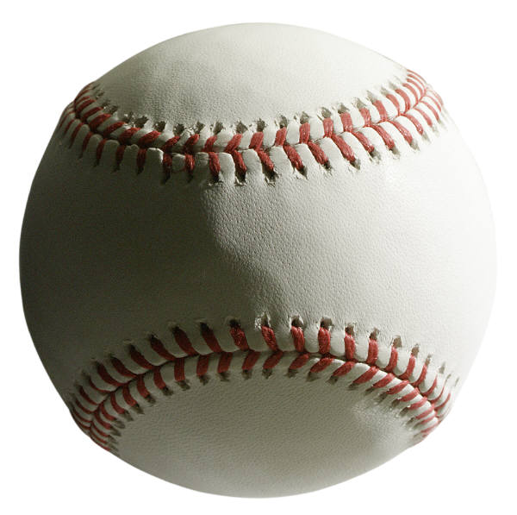
Convenience Samples
When the sample is taken based of ease of acquiring the sample, rather than rigorous design.
Notes:
Main Points
On this slide we will reiterate what a convenience sample is.
The definition of a convenience sample is a sample taken based on the ease of acquiring the sample rather than a rigorous design (so that the sample would be representative of the population). A convenience sample could wind up being representative (unbiased) but in general it is not.
Ask the students if they have examples of convenience samples, if not give them a few:
A surveyor is interested in what types of movies are most popular this summer. The surveyor polls attendees at Comic-Con in San Diego, CA. This is not a representative sample. We would expect that attendees of Comic-Con would like comic book based movies the best and this category could be unfairly favored.
A surveyor is interested in the favorite class at this school. The surveyor polls this class. This sample is not representative since this class represents a limited number of grades at the school, so it is biased towards teachers of those grades.
A surveyor is interested in the favorite sport at this school. The surveyor polls the basketball team. This sample is not representative as members of the basketball team may be more likely to like basketball the best, so the other sports may be underreported.
Terminology clarification:
Biases refers to statistical biases, not social biases or stereotypes.
Image credits
All images are from Microsoft office.

Slide 5
Random Samples
A random sample is a sample in which each unit of the population of interest has an equal chance of being sampled.
Random samples will be unbiased for the entire population on average.
Notes:
Main Points
A random sample is a sample in which each unit of the population of interest has an equal chance of being sampled.
Random samples will be unbiased for the entire population on average. This means if we make 100 random samples and average the estimates from each of those samples, that will produce an unbiased estimate of the population value.
Ask the students if they have an example of a random sample:
If I am interested in something about the population of adults in the US, I could take the US census list and randomly selecting 1,000 individuals.
If I am interested in how often high school athletes at this school are injured, I could take the roster from all the team sports and sample 100 individuals.
If I am interested in the favorite color of Team USA at the 2014 Olympics, I could take the roster from the Olympic squad and randomly select 100 individuals.
Terminology clarification:
Biases refers to statistical biases, not social biases or stereotypes.
Teaching note:
After this slide, you may want to do the mini-activity. It will give students a hands on example of random versus convenience samples. It will also review the concepts of biodiversity, evenness and species richness.

Slide 6
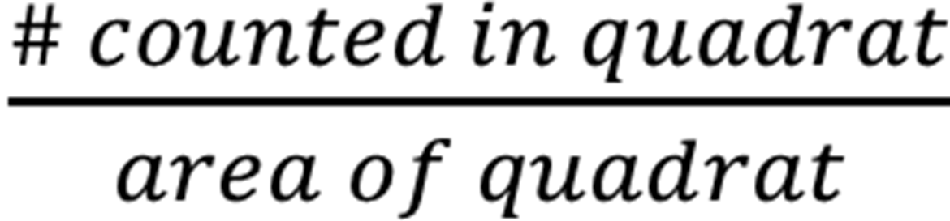

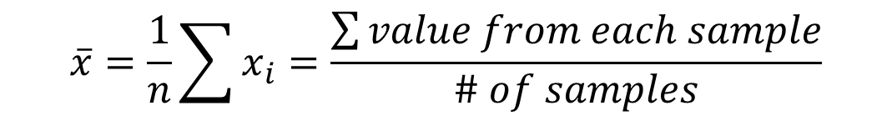
Quadrat Sampling
Count all organisms within a small, known area
Calculate density
Calculate abundance for the entire area
Mean density
Notes:
What is quadrat sampling?
First let’s explain what a quadrat is. A quadrat is typically a square frame constructed of plastic or pvc pipe, metal rod, or wood that is placed directly on top of the vegetation. Quadrats are also commonly called "plots.“ Quadrats do not have to be square but their area must be known. Other quadrat shapes commonly include circles and rectangles. The red box on this page is a quadrat. To find the area of the quadrat we would take the interior dimensions of the quadrat. The green balls inside the quadrat represent objects that we are counting. In essence, you count what is inside the quadrat.
Quadrat sampling is a method of collecting a random sample. Rather than doing a census of all the individuals in an area, we do a mini-census within randomly placed quadrats. Typically the information from a quadrat study comes in the form of counts of individuals (what we will do in the activity) or % cover (which is popular among landscape ecologists and forest ecologists).
To do quadrat sampling we count all the organisms within the quadrat. Since we know the area of the quadrat (or we can measure it) we can then calculate the density within our quadrat. The quadrat density is simply the number counted in the quadrat divided by the area of the quadrat. If we know the total area that the organisms we are interested in can occupy we can scale up from the density in our quadrat to the density in the entire area by multiplying the quadrat density by the total area. The mean density is simply the average of all the densities for each quadrat that we measure. It is important to note that density, total abundance, and mean density can all be fractions, they do not have to be whole numbers.
4 important concepts when designing your quadrat samples:
What is the distribution of the organism across the landscape (habitat) being studied?
What size quadrats should be used?
Quadrat should be much larger than the average organism size.
What shape should the quadrat be?
How many quadrats do we need to accurately estimate the density of the species?
Advanced Ideas:
What to do when an object is partially inside the quadrat? Before doing the study it needs to be decided if these will be counted or not. You can decide to count only individuals that are fully inside the quadrat, or only individuals that are 50% inside the quadrat, or all individuals with any part inside the quadrat. There are advanced statistical techniques to allow you to correct for counting portions of individuals. The decision should be made before you conduct your sampling and you need to be consistent throughout all of your samples.
External websites that provide additional information on quadrat sampling:
University of Idaho, College of Natural Resources , Principles of Vegetation Measurement & Assessment
and Ecological Monitoring & Analysis, lesson on Plot-based or Quadrat Techniques, from http://www.webpages.uidaho.edu/veg_measure/Modules/Lessons/Module%205%28Density%29/5_2_Plot-Based_Techniques.htm

Slide 7


Quadrat Sampling
Notes:
Main Point
We will now do a mini quadrat sample together.
We have a garden and we want to know how many flowers are in it. The green box represents the garden.
We also want to know about the two types of flowers in the garden. There are red and purple flowers.
Note that the flowers occur in different sizes, we have small red flowers and large red flowers. These could represent flowers of different ages. The purple flowers are all the same size.
Also note that density is not consistent across the entire green box (our garden). Why might this be?
It was planted that way
Some areas are better for growing certain types of flowers
Someone removes certain types of flowers from certain areas on purpose for aesthetics
A disease could have killed some flowers in one area, the disease may affect different flowers in different ways
We are only interested in the total number of flowers in our garden right now. We want to know how many purple flowers and how many red flowers. We also want to know the density.
Image Credits:
All images from Microsoft clip art.

Slide 8
Quadrat Sampling
Notes:
Main Point
Go over a mini quadrat sample.
We have a garden and we want to know how many flowers are in it. We also want to know about the two types of flowers. There are red and purple flowers.
We have placed four quadrats randomly into the garden. The quadrats are 0.5m squared in area. The garden is 20 square meters. (The drawing is not to scale).
We will count the flowers that have at least 50% of each flower in the quadrat.
Ask the students to count the flowers and record the data. Ask them to calculate the mean number of red and purple flowers per quadrat as well as the standard deviation. The next slide has this data in table form and the equation for mean and standard deviation.
Counts (from left to right)
1: 3 purple, 2 red
2: 2 purple, 2 red
3: 2 purple, 1 red
4: 3 purple, 1 red

Slide 9
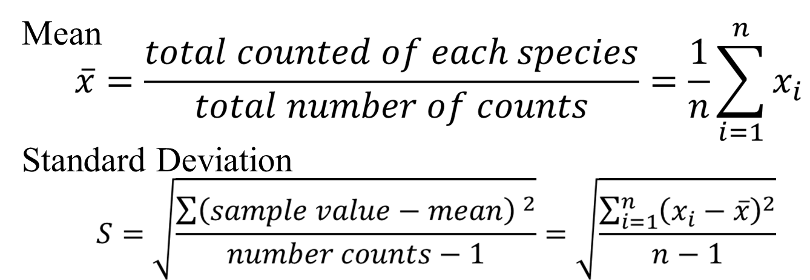
Quadrat Sampling
 | Quadrat 1 | Quadrat 2 | Quadrat 3 | Quadrat 4 | Mean | Standard Deviation
Red Flowers | 2 | 2 | 1 | 1
Purple Flowers | 3 | 2 | 2 | 3
Notes:
Main Point
Conduct a mini quadrat sampling from the garden example.
Here is the data from our counts in table form. Use the counts of each flower type (red and purple flowers) in the four quadrats to calculate the mean and standard deviation.
Equations is as you will see them for the AP Biology exam. Verbally go over the equations so that the students understand.
Calculate Mean for each color of flower
The mean is simply the sum of all our counts, divided by the number of counts we made.
Calculate standard deviation for each color of flower
For each sample find the squared difference between the sample value and the mean.
Add these squared differences up
Divide by the number of samples minus 1
Take the square root of this value

Slide 10
Quadrat Sampling
 | Quadrat 1 | Quadrat 2 | Quadrat 3 | Quadrat 4 | Mean | Standard Deviation
Red Flowers | 2 | 2 | 1 | 1 | 1.5 | 0.578
Purple Flowers | 3 | 2 | 2 | 3 | 2.5 | 0.578
Notes:
Main Point
The mean number of red flowers is 1.5 and the mean number of purple flowers is 2.5. The standard deviation for both is 0.578.
If any of the students got this wrong, ask them to show their math and try and see where they went wrong.
Note: do not round the mean, this will cause errors in the standard deviation calculations.

Slide 11
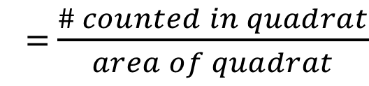
Quadrat Sampling
 | Quadrat 1 | Quadrat 2 | Quadrat 3 | Quadrat 4 | Mean | Standard Deviation
Red Flowers | 2 | 2 | 1 | 1 | 1.5 | 0.578
Purple Flowers | 3 | 2 | 2 | 3 | 2.5 | 0.578
Quadrat area is 0.5 square meters, Garden is 20 square meters.
 | Density – Q1 | Density – Q2 | Density - Q3 | Density - Q4
Red
Purple
Quadrat Density
Notes:
Main Point
Have the students calculate the density. The equation for quadrat density is shown here. They will need to use the area of the quadrat, which is stated on this slide.
The quadrats are 0.5 square meters and the garden is 20 square meters.
Calculate density in each quadrat.
Density = abundance within quadrat / area of quadrat
Units are individuals per square meter

Slide 12
Quadrat Sampling
 | Quadrat 1 | Quadrat 2 | Quadrat 3 | Quadrat 4 | Mean | Standard Deviation
Red Flowers | 2 | 2 | 1 | 1 | 1.5 | 0.578
Purple Flowers | 3 | 2 | 2 | 3 | 2.5 | 0.578
Quadrat area is 0.5 square meters, Garden is 20 square meters.
 | Density – Q1 | Density – Q2 | Density - Q3 | Density - Q4
Red | 4 | 4 | 2 | 2
Purple | 6 | 4 | 4 | 6
Notes:
Main Point
Conduct a mini quadrat sampling from the garden example.
We see the density for red and purple flowers in each of the four quadrats.
If any of the students don’t have the same answer, try and find out why.
Ask the students what the units are for quadrat density. The units are flowers per square meter. They can find the answer by remembering that the equation for quadrat density is number in the quadrat divided by quadrat area, so we are dividing units of number by area.

Slide 13
Quadrat Sampling
 | Quadrat 1 | Quadrat 2 | Quadrat 3 | Quadrat 4 | Mean | Standard Deviation
Red Flowers | 2 | 2 | 1 | 1 | 1.5 | 0.578
Purple Flowers | 3 | 2 | 2 | 3 | 2.5 | 0.578
Quadrat area is 0.5 square meters, Garden is 20 square meters.
 | Total Abundance – Q1 | Total Abundance – Q2 | Total Abundance - Q3 | Total Abundance - Q4
Red
Purple
Notes:
Main Point
Conduct a mini quadrat sampling from the garden example.
Now we will calculate the total abundance. We find the total abundance by taking the abundance within a quadrat and multiplying it by the total area, and then dividing this number by the area of the quadrat.
Calculate total abundance:
Alternative way to calculate total abundance is quadrat density X Total Area = Total Abundance units are individuals
Can do this based on the density from each of the four quadrats.
Can find the mean and standard deviation (not shown here).

Slide 14
Quadrat Sampling
 | Quadrat 1 | Quadrat 2 | Quadrat 3 | Quadrat 4 | Mean | Standard Deviation
Red Flowers | 2 | 2 | 1 | 1 | 1.5 | 0.578
Purple Flowers | 3 | 2 | 2 | 3 | 2.5 | 0.578
Quadrat area is 0.5 square meters, Garden is 20 square meters.
 | Total Abundance – Q1 | Total Abundance – Q2 | Total Abundance - Q3 | Total Abundance - Q4
Red | 80 | 80 | 40 | 40
Purple | 120 | 80 | 80 | 120
Notes:
Main Point
Here are the answers for total abundance based on each of the four quadrats for the two flower types. We see that 3 of the 4 times the purple flowers are estimated to have higher total abundance, and the 4th time purple and red flowers are estimated to have equal abundance. Does this match with what we saw when we first looked at the garden (not absolute number, since the garden drawing wasn’t to scale, but does it sound right that there are more purple flowers than red flowers? You can flash back to slide 8 if you want the students to have a second chance to look at the garden. It does appear that there are more purple flowers than red flowers in that image.

Slide 15
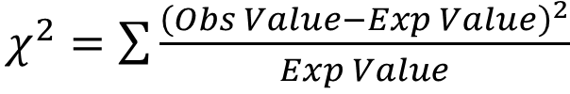
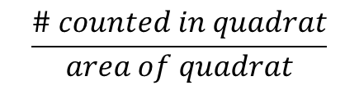
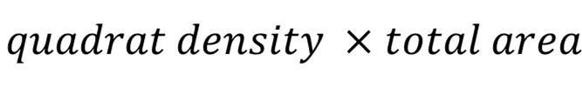

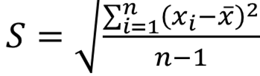

Equations for this lesson
Chi-square
Quadrat density
Abundance
Mean
Standard Deviation
Area (for a rectangle)
Notes:
Main Points
Review of equations used
Chi-Square (can be extension to data calculated from quadrat sampling) – should be familiar from the chi-square lesson
Quadrat density
Abundance
Mean
Standard deviation
Area of rectangle

Slide 16
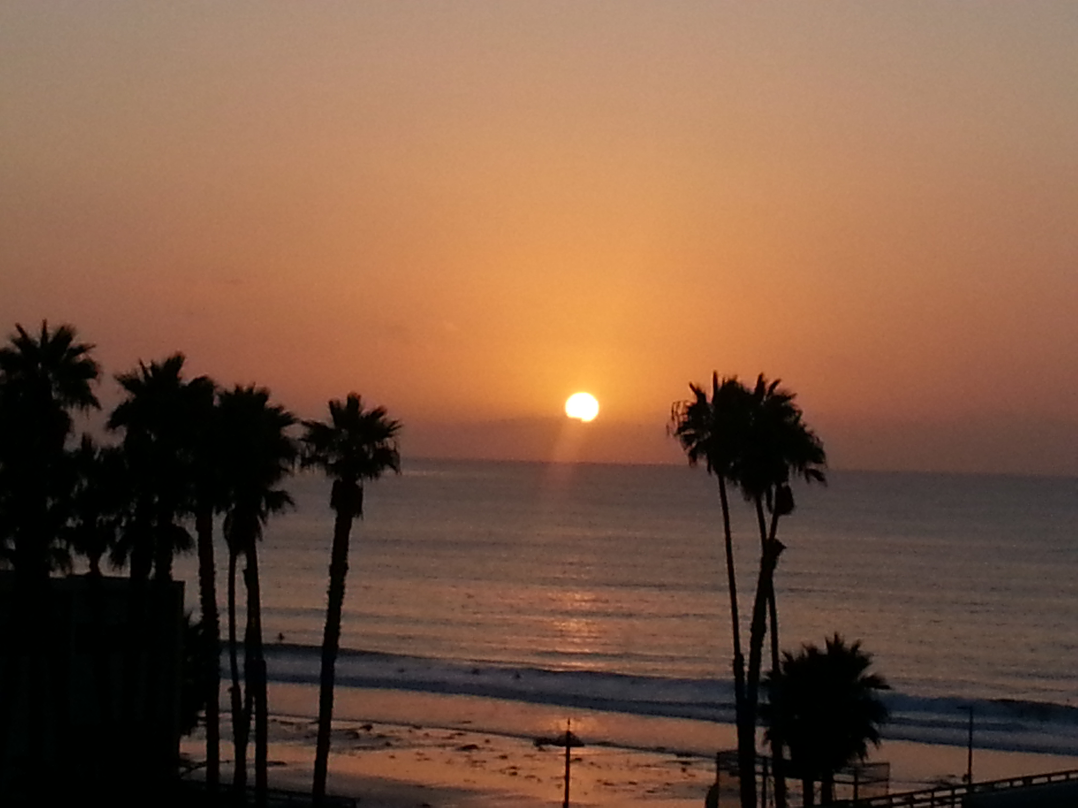
Summary
Census versus sample
Importance of representative sample
Benefits of random sample
Uses of quadrat sampling
Calculating density, total abundance, mean, and standard deviation
Notes:
Main Points:
Students should now be familiar with the difference between a sample and census. A census is when every individual in the population is counted. A sample is when a representative sample is used to estimate information about the total population.
Examples of censuses include the US census, but they are extremely expensive and time consuming. Furthermore, it is very difficult to ensure that 100% of the population is reached. This becomes more difficult if the objects being sampled move a lot, are difficult to find, or a cryptic to name some of the difficulties.
A representative sample is one that provides a good approximation of the entire population.
Students should also be familiar with convenience sampling and random sampling.
A random sample is one in which every individual has an equal probability of being selected to be in the sample.
Random sampling will produce an unbiased result compared to convenience sampling.
Quadrat sampling is a useful way to conduct random sampling. It works best on sedentary species or immobile species.
In quadrat sampling the quadrats are placed randomly across the habitat of interest and the sample is collected from within the quadrats.
Students are now familiar with the equations for calculating density, total abundance, mean and standard deviation. Students are also familiar with calculating area.
If you did the mini activity after slide 5 you can review the concepts of biodiversity, evenness, and species richness, otherwise save this point until you do that activity.
Biodiversity was covered in the mini activity. Biodiversity has two main components species richness, the number of species in the sample, and evenness, a measure of how even is the distribution of numbers of each species. Greater species richness and more evenness leads to greater biodiversity.
Next steps:
Have students complete the quadrat sampling activity. If desired have them follow up with the chi-square worksheet to practice their chi-square skills.
(Optional) Have students do the advanced quadrat sampling activity. They will get real hands on experience laying quadrats. They can also follow this up with a chi-square exercise.
Photo credit:
Sunset, Lynn Waterhouse.

