Slide 1
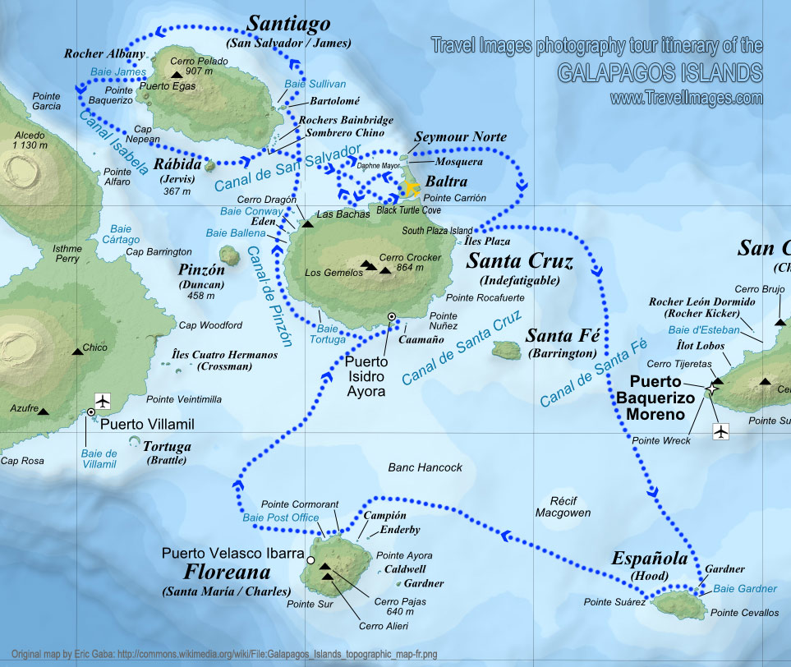
“Galapagos Island” Quadrat Sampling Activity
Notes:
Authors: Lynn Waterhouse, Scripps Institution of Oceanography; Joanne “JJ” Johnson, Kearny SCT, San Diego Unified District.
Why:
Here we will do a hands on quadrat sampling study to estimate population demographics (abundance and density) for Galapagos fur seals and Galapagos marine iguanas. This is an advanced lab, primarily because it takes a lot of space and will require a lot of focus on the students part. The teacher will set up a “Galapagos Island” complete with a water area, sunny beach area, and shady beach area. Animals will represented by photos of the creatures placed in each habitat.
Have the students imagine that the animals are real, would quadrat sampling work with the creatures?
How does using quadrat sampling on animals like Galapagos fur seals and Galapagos marine iguanas, differ from say the sea urchins and sea stars in the previous lab (the basic quadrat sampling lab)? Ask them which study area they think is more relevant to quadrat sampling.
Teacher Instructions:
We suggest using flagging tape and cones to mark out the areas, or large sheets or tarps. The animals will be represented by printouts of Galapagos fur seals (in the water and out of the water) and Galapagos marine iguanas (in the water and out of the water). If possible you may want to laminate the animals and tape them to something heavy (a penny or screw, for example) this way they can be reused in the future and won’t blow around in the wind. We suggest dividing the class into groups to do this activity. You can either assign the readings on Marine Iguanas and fur seals ahead of time or if you only have enough room for one or two groups to conduct their quadrat sampling at once, have the other groups read these handouts while they are waiting. The readings are designed to get the students thinking about differences between the two animals and potential causes for the differences in abundance and density in the various habitats.
Instructions:
This is to be used as an introduction for the advanced quadrat sampling activity. In order to do this activity you must have open space available. In addition to the open space you need to have quadrats made (suggested size is 25cm x 25cm and made out of PVC, but dowel rods would also work), animal printouts, and three different areas marked off (one will represent water, one is shady beach, and one is sunny beach – don’t tell the students this yet, just make it clear there are three areas). The photos showing the animals in the water are meant to go in the habitat that represents water. More of the marine iguana on land images should be placed in the area representing sunny beach and relatively more of the images representing Galapagos fur seals on land should go on the area representing shady beach. More of the marine iguanas on land images go on the area representing sunny beach because the marine iguanas represent
Take-Home Messages:
Quadrat sampling is a method of sampling in which defined shapes are used to sample the entire population. Typically a quadrat is a square shape, which is placed at random into the area of interest.
Quadrat sampling works best on sessile or immobile species. Other types of sampling should be used on species that move around a lot.
Quadrat sampling also works best on smaller animals, so that multiple animals can easily fit within one quadrat. Other types of sampling should be used for larger animals (for example, line transect methods).
Population abundance is the total number of individuals in the population.
Population density is the number of individuals per unit of area for the entire area spanned by a population.
Context for Use:
This curriculum was designed for use in both a 10th grade Advanced Biology and 11th grade AP Biology classroom in San Diego, CA, but can also be used in AP Environmental Science classes in the same district.
Evaluation Tips:
Students will be formatively assessed using inquiry-based discussions throughout the lesson and the quadrat sampling activity. It is up to the teacher to assign a formal lab notebook. This lesson can also be tied in with the chi-square testing and a chi-square analysis can be done on the results. This is also up to the discretion of the teacher.
Additional Teaching Notes:
Prior to lesson students have reviewed a PowerPoints that discuss concepts of hypotheses, chi-square test for equality, and the introduction to quadrat sampling.
Prior to this activity you should have done the quadrat sampling activity, although it is not necessary.
Photo credit
Image credit Stevon Gregory.

Slide 2
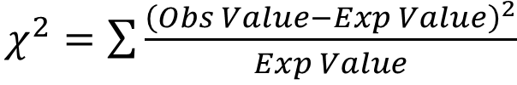
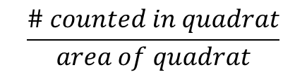
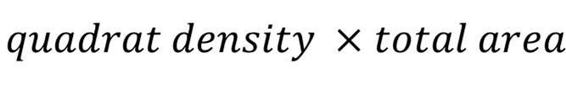

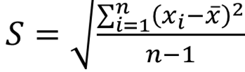

Equations for this lesson
Chi-square
Quadrat density
Abundance
Mean
Standard Deviation
Area (for a rectangle)
Notes:
Main Points
Review of equations used
Chi-Square (can be extension to data calculated from quadrat sampling) – should be familiar from the chi-square lesson
Quadrat density
Abundance
Mean
Standard deviation
Area of rectangle

Slide 3
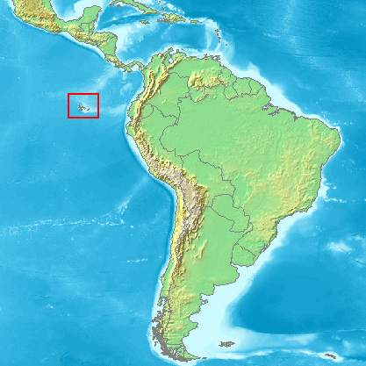
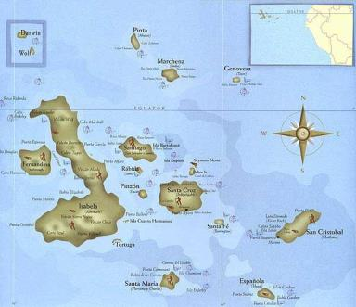
Galapagos Island Quadrat Sampling Activity
Notes:
Slide notes:
This slide is meant to introduce the Galapagos Islands to the class. The Galapagos Islands are off the coast of Ecuador. They are famous for their high biodiversity and for being a crucial stopping point in Charles Darwin’s voyage aboard the HMS Beagle.
You can briefly discuss with the class why Charles Darwin’s voyage aboard the HMS Beagle was so important. It was on this voyage that the concept of natural selection was truly cemented for him. In particular he noticed the variety of birds found in the Galapagos Island and the uniqueness of their beaks (Darwin’s finches).
Materials (found in the Advanced Quadrat Sampling Teacher Instructions folder and Seals Iguanas Readings folder):
Calculator (one per student)
Laminated animal cutouts (may be attached to foam or pennies for more weight, will want at least 15-20 of each animal photo)
3 Quadrats (minimum)- you will need to construct these from PVC, paint stirrers, or meter sticks
fabric/tarps/tape to delineate three habitat types
quadrat worksheet
chi-square worksheet
Readings on Galapagos fur seals and marine iguanas (foundin the Seals Iguanas Readings folder)
Photo credits this slide:
Map of South America with red box around Galapagos Islands near Ecuador, from Wikimedia page on Galapagos Islands, http://commons.wikimedia.org/wiki/File:Galapagos_Islands_-_Overview.PNG
Map of Galapagos Islands, from Discover Galapagos, http://www.discovergalapagos.com/map.html

Slide 4
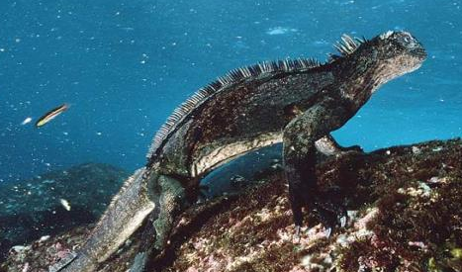
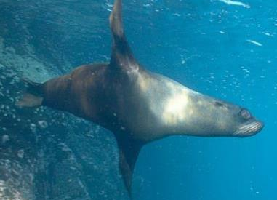
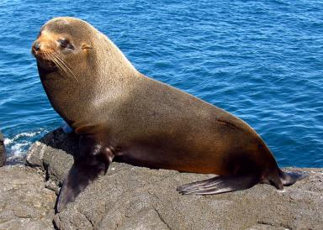
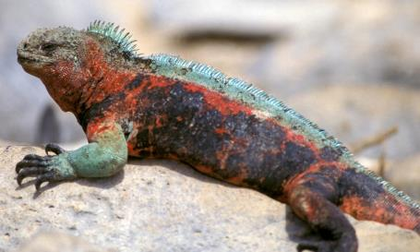
Galapagos Island Quadrat Sampling Activity
Notes:
Notes this slide:
Here are the two animals we will be studying with our quadrats today. The Galapagos marine iguana shown top left and bottom right, and the Galapagos fur seal shown top right and bottom left.
Steps for activity for student
In their groups, students complete the quadrat sampling activity sheet
Individually students calculate the densities and abundances of both species within the three habitats and for the whole island. Students will share and discuss their answers with their group.
Using their quadrat data, students will individually complete the chi-square activity sheet. Students will hare and discuss your answers with their group.
As a class discuss the quadrat activity.
As a class discuss the chi-square activity. Compare results.
Optional. Do extension design activity, where students are presented with a habitat and asked to design their own sampling schematic. Students will each come up with their own design, then discuss with their groups, and finally share out to the whole class. When sharing out to the entire class, students need to listen to make sure they do not repeat previously presented ideas.
Photo credits this slide:
Galapagos fur seal on rock, Wikimedia commons, http://commons.wikimedia.org/wiki/File:Galapagos_Fur_Seal,_Santiago_Island.jpg
Galapagos fur seal swimming in the ocean, Gordon Rocks. Gordon Rocks, Galapagos Islands, Ecuador, from http://www.oceanlight.com/spotlight.php?img=16323
Marine iguana sitting on a rock in the Galapagos Islands, from World Wildlife Fund (WWF), http://worldwildlife.org/species/marine-iguana
Marine iguana in the ocean, photograph by David Doubilet, from http://animals.nationalgeographic.com/animals/enlarge/marine-iguana-underwater_image.html

Slide 5
Galapagos Island Quadrat Sampling Activity
Galapagos Fur Seal
Notes:
Notes for this slide:
Here we see a Galapagos fur seal in and out of the water.
Ask the class to make some observations and inferences about the fur seals.
Examples:
They have a lot of fur.
They have a sleek shape when in the water.
They are true seals in that they have ears that stick on and they can walk on their foreflippers.
They might be a tasty treat for sharks (inference).
Photo credits this slide:
Galapagos fur seal on rock, Wikimedia commons, http://commons.wikimedia.org/wiki/File:Galapagos_Fur_Seal,_Santiago_Island.jpg
Galapagos fur seal swimming in the ocean, Gordon Rocks. Gordon Rocks, Galapagos Islands, Ecuador, from http://www.oceanlight.com/spotlight.php?img=16323

Slide 6
Galapagos Island Quadrat Sampling Activity
Marine Iguanas
Notes:
Notes for this slide:
Here we see a Galapagos marine iguana in and out of the water.
Ask the class to make some observations and inferences about the marine iguanas.
Examples:
They have some serious claws.
They have a variety of colorations. Perhaps this means they can change colors.
They have a spiky looking back. (Observation) This could make it hard for predators to eat them. (Inference)
Photo credits this slide:
Marine iguana sitting on a rock in the Galapagos Islands, from World Wildlife Fund (WWF), http://worldwildlife.org/species/marine-iguana
Marine iguana in the ocean, photograph by David Doubilet, from http://animals.nationalgeographic.com/animals/enlarge/marine-iguana-underwater_image.html

Slide 7
Galapagos Island Quadrat Sampling Activity
Notes:
This is a duplicate of slide 4.
You may want to leave this up while the students do the activity in case they want another look at the animals for drawing conclusions on why they found a difference (if they did) in abundance and density.
Notes this slide:
Here are the two animals we will be studying with our quadrats today. The Galapagos marine iguana shown top left and bottom right, and the Galapagos fur seal shown top right and bottom left.
Steps for activity for student
In their groups, students complete the quadrat sampling activity sheet
Individually students calculate the densities and abundances of both species within the three habitats and for the whole island. Students will share and discuss their answers with their group.
Using their quadrat data, students will individually complete the chi-square activity sheet. Students will hare and discuss your answers with their group.
As a class discuss the quadrat activity.
As a class discuss the chi-square activity. Compare results.
Optional. Do extension design activity, where students are presented with a habitat and asked to design their own sampling schematic. Students will each come up with their own design, then discuss with their groups, and finally share out to the whole class. When sharing out to the entire class, students need to listen to make sure they do not repeat previously presented ideas.
Photo credits this slide:
Galapagos fur seal on rock, Wikimedia commons, http://commons.wikimedia.org/wiki/File:Galapagos_Fur_Seal,_Santiago_Island.jpg
Galapagos fur seal swimming in the ocean, Gordon Rocks. Gordon Rocks, Galapagos Islands, Ecuador, from http://www.oceanlight.com/spotlight.php?img=16323
Marine iguana sitting on a rock in the Galapagos Islands, from World Wildlife Fund (WWF), http://worldwildlife.org/species/marine-iguana
Marine iguana in the ocean, photograph by David Doubilet, from http://animals.nationalgeographic.com/animals/enlarge/marine-iguana-underwater_image.html

