Slide 1

Taking a Closer Look at Tagging Studies
Created 2013-2014 School Year
Lynn Waterhouse, Scripps Institution of Oceanography
Jennifer Ogo, Kearny SCT, San Diego Unified School District
Joanne “JJ” Johnson, Kearny SCT, San Diego Unified School District
Notes:
Photo credit: Lynn Waterhouse (Palm trees in Santa Barbara).
WHY :
Tagging studies are one of many ways in which biologists study populations. This lesson focuses on mark-recapture tagging studies, but other types are briefly mentioned. Different types of tagging can be used for studying different questions, ranging from individual scale questions to population-level studies. This PowerPoint provides a brief background on tagging studies. It also provides a brief background on various methods of estimating total population size. The remainder of the PowerPoint focuses on mark-recapture tagging studies, specifically how they are used to estimate population sizes and the various assumptions required for such studies. This can be used as an introduction to tagging studies and also provide reference material for the accompanying in class activities, a mark-recapture lab and a lab exploring violations of the assumptions of mark-recapture studies.
SUMMARY:
Tagging is a method ecologists use to study populations of animals. Depending on what type of question is being asked, a different type of tagging can be used. Tags can be used to study individual-level behavior all the way through assessing population life history parameters such as death-rates. Mark-recapture tagging studies are one of many ways ecologists can estimate population size. In order to use mark recapture studies to estimate population size a variety of assumptions are made; when these are violated various sorts of bias are created in the estimate of population size.
This lesson has multiple parts.
Introduction to tagging studies (this PowerPoint). Here you will introduce tagging studies. We will be focusing mainly on mark-recapture, or mark-resight, surveys.
Mark recapture with beans lab. The students will use black and white beans to conduct a mark-recapture study.
(Optional) Advanced mark-recapture with beans lab. The students will use black and white beans to demonstrate why the basic model no longer works if one of the basic assumptions is violated.
(Optional) Nassau grouper “Changing Seas” video and handout. The students will watch the PBS produced video on the Nassau grouper “Changing Seas”. It is available online for free. There is a handout for the students to complete and a teacher answer key.
Nassau Grouper Tagging Study. This is a PowerPoint to introduce the research involving Nassau Grouper in the Cayman Islands.
Design a study lab. In this assignment students will design their own study to monitor some aspect of Nassau grouper.
PICTURE/GRAPHICS CREDITS:
Photo credits are given on the individual slides.
ADDITIONAL RESOURCES:
Downloadable game (may not work properly on a Mac):
Mark Recapture Game. http://sandbox.yoyogames.com/games/8651-the-mark-recapture-game
Websites:
Sampling populations. Goes through quadrat sampling and mark-recapture. http://bio150.chass.utoronto.ca/sampling/book/sampling.html
Tagging of Pacific Predators. http://topp.org/
Tagging Projects:
Semmens Lab at Scripps Institution of Oceanography Tagging Project http://semmenslab.org/research/coastal-angler-tagging-cooperative
Tagging Cooperative. http://www.cooperativefishtagging.org/
Manta Ray Tagging Project from Scripps Institution of Oceaongraphy http://www.semmenslab.org/research/manta-rays
Activity Sheets:
Mark Recapture Lab with Beans http://bhshenvsci.wikispaces.com/file/view/Mark-Recapture+Activity.pdf
Mark Recapture Activity with Household Items and Tap http://bakersbiologyclass.wikispaces.com/Mark+%26+Recapture+Activity
Mark Recapture Lab, Tagging Students http://www.google.com/url?sa=t&rct=j&q=&esrc=s&source=web&cd=6&cad=rja&ved=0CFsQFjAF&url=http%3A%2F%2Fapbioredesign.wikispaces.com%2Ffile%2Fview%2FMark-Recapture%2520Method%2520of%2520Calculating%2520School%2520Population%2520Size%2520Lab.doc%2F244483301%2FMark-Recapture%2520Method%2520of%2520Calculating%2520School%2520Population%2520Size%2520Lab.doc&ei=M0GNUsHZCYyUjAKT2IGYCg&usg=AFQjCNHYWjgUNXQMVjthLi7JyvHKb6b6mQ&sig2=qcm7MzUDDiS5ru7aInoT9A&bvm=bv.56988011,d.cGE
Mark Recapture lab with stickers http://shop.sciencetakeout.com/Documents/156/TEACHER%20ONLINE%20Mark-Recapture%202-9-11.pdf
Mark Recapture Bean Lab with Investigation of Assumptions http://www.radford.edu/jkell/mark_rec103.pdf
Mark Recapture Bean Lab http://www.life.umd.edu/grad/mlfsc/pdfs/popsize.pdf
CONTEXT FOR USE:
This activity was designed for an AP Biology, Advanced Biology, or Biology high school classroom. Students will be in 9-12th grade.
MISCONCEPTIONS:
To estimate abundances you have to capture all animals.
Tagging an animal harms the animal. The way most tags are applied are similar to getting your ears pierced.
EVALUATION TIPS:
It is up to the discretion of the teacher to assign any activity for a grade. Example answer keys have been provided for all worksheets. The individual students answers will vary from the answer key as they require experimental data for the marking beans and advanced marking beans activity.

Slide 2
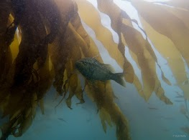
Methods for Studying Populations
Census
Sampling
  Random sampling
  Quadrat sampling
Tagging
  Mark-recapture studies
Notes:
Teaching notes:
If we are interested in studying some aspect of a population, the methods we can use are:
Census – When every individual in the population is counted.
Sampling- Using a representative subset we can answer questions about the entire population. It is important to have a representative sample so that the estimates produced are unbiased for the whole population.
Tagging- Specifically mark-recapture studies can be used to estimate population size.
Photo credit: Emily Kelley (Bass in kelp forest off La Jolla, California. Photo taken during acoustic tagging study of various bass species.)

Slide 3
Tags for Studying Populations
Type of tagging study will depend on question being asked
How many individuals are in the population?
How large of an area does an animal occupy? Home range?
How does animal behavior change with the seasons?
How does animal behavior change after a disturbance?
What are some other questions you might want to ask???
Notes:
TeachingNotes:
This slide is used to engage the students with the idea of tagging studies. The goal is to gauge the student’s familiarity with tagging studies as well as to begin a discussion about the types of questions that tagging studies can be used to address.
Additional lead in questions:
Does anyone in the class know of any local tagging studies? What species?
(For students aware of the California Condor’s population status.) Have you heard of the California Condor? Did you realize that every California condor is tagged? Why might this be?

Slide 4
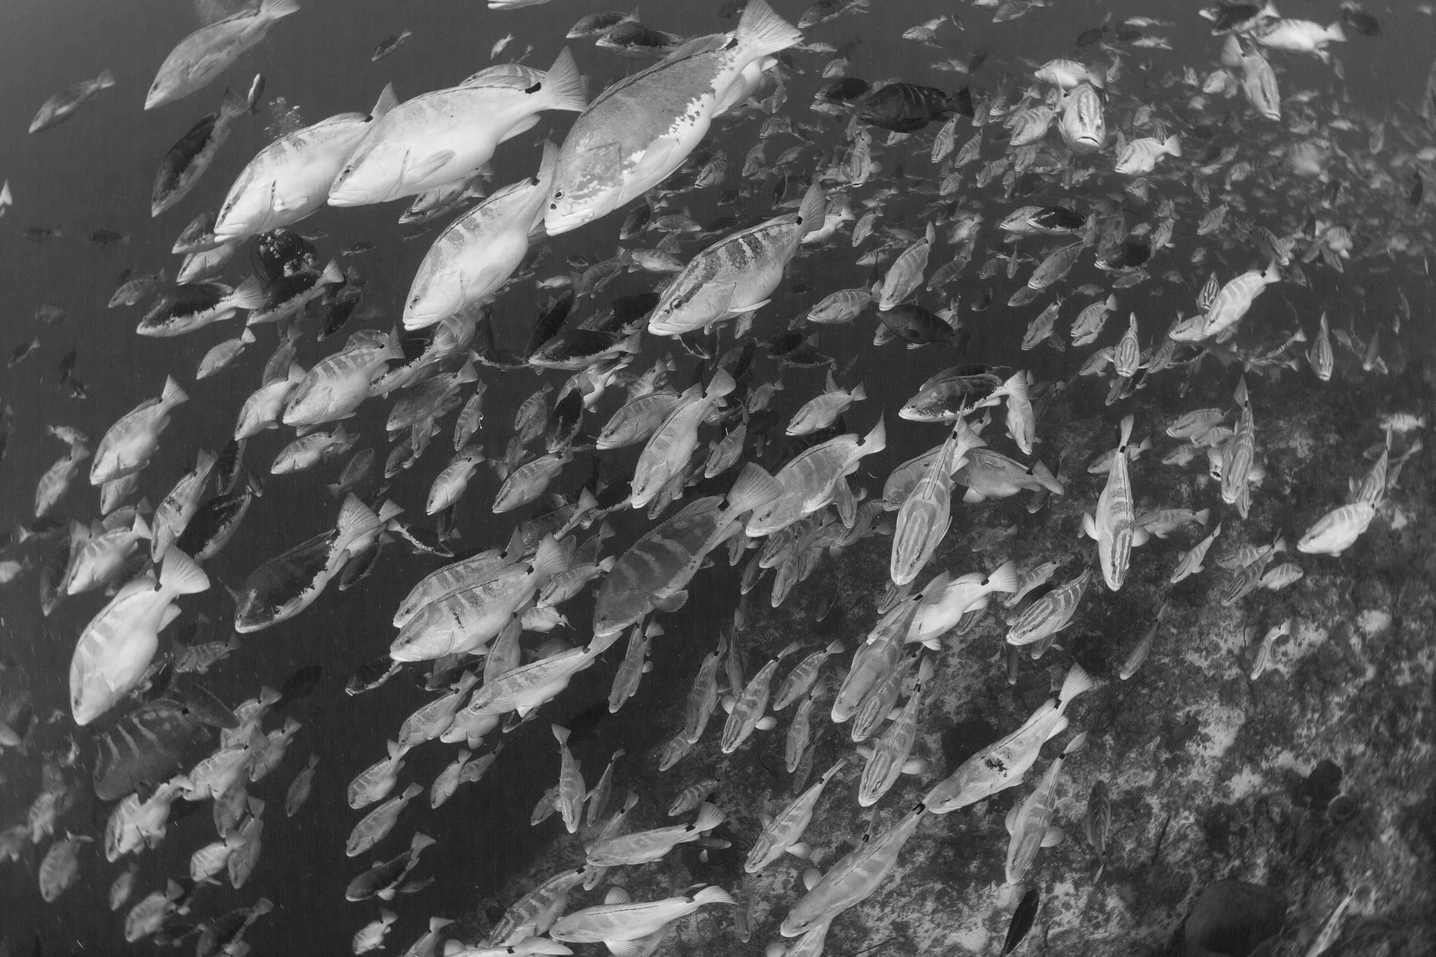
Tags for Studying Populations
Individual-based
home-range, movement, finer-scale
Population-based
total number, migrations, mortality (natural and harvest related), survival, growth
Different tags for short-term or long-term studies. Some types of tags provide information at the individual and population level.
Notes:
Teaching Notes:
In general there are two main types of tagging studies, those that focus on answering questions at the individual level and those that seek to answer questions about the population. There are many types of tagging studies. Depending on what the focus of the study is and the length of the study, different types of tags will be used.
Individual based questions may focus on an individual’s home range, their daily movement, or other finer-scale aspects of behavior (like angles at which whales forage at from accelerometer tags).
Population based questions may focus on answering questions that involve estimating the total number, mass migrations, life history parameters like natural mortality, harvest mortality, survival and growth.
The type of tag used in a tagging study depends on the question being asked. Some tags can provide information that address questions at both the individual and population level.
Photo credit: Josh Stewart (Scripps Oceanography, Manta Trust)- Photo is of spawning grouper in an aggregation from Cayman Islands.

Slide 5
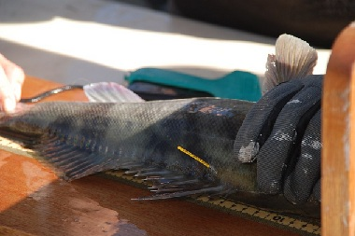
Types of Questions: Population-based
In general: less expensive, long-lasting, coarse data, unique identifiers
Streamer tags
Disc tags
Colored Elastomer tags
Bird bands
Passive Integrated
Technology (PIT tags)
Notes:
Teaching Notes:
Tags that are used to answer questions at the population level are typically:
Less expensive
Long lasting
Have a unique identifier
These types of tags provide more coarse data.
Examples of tags that can answer questions at the population level are:
Streamer tags, disc tags, and bird bands – all of these are external tags which contain a unique number for each individual.
Colored elastomer tags are typically internal tags which use a unique series of colors to identify the individual. Usually they are placed in a part of the animal’s body so that the skin is very thin and you can see the colors through their skin. In some cases it may require the use of a magnifying glass to see the colors, but this is only when the animal can be recaptured and handled safely.
Passive integrated technology (PIT) tags are internal tags which use technology similar to race-timing chips or tags used in family pets. Tags contain a unique ID for each individual and are read (detected) by receivers.
For example PIT tags will let us know when the tagged animal passes a detection array, so we can know when fish within a river pass an array. We call this coarse data because we don’t know the location of the fish all of the time, we just know when it passes the specific arrays. We have to make assumptions about what the fish does in the time between when it passes the detection arrays.
Photo Credit:
Tagged Bass from California. http://semmenslab.org/research/coastal-angler-tagging-cooperative

Slide 6
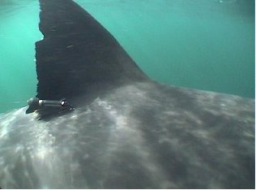
Types of Questions: Individual-based
In general: more expensive, shorter duration, finer-scale data, unique identifiers
SPOT – Smart Position or Temperature Transmitting Tag
SRDL – Satellite Relay Data Logger
Pop-up archival tags (PAT)
Critter Camera
Radio tags
Archival tags (long duration, but must be retrieved
Notes:
Teaching Notes:
Tags that are used to answer questions at the individual level are typically:
More expensive
Stay on for a shorter duration
These tags also have unique identifiers and provide finer-scale information. By finer-scale we mean that we know more about what the animal is doing. Before we talked about PIT tags which provided the coarse data in that we only know when tagged animals pass an array. If an animal is tagged with a radio tag or satellite tag, as long as we are monitoring the radio frequency (for radio tags) or get the complete satellite information we know where that animal is essentially all the time (it is not actually all the time, generally these tags are programmed to transmit every so many seconds or minutes). Finer-scale information is more complete information, so rather than giving just a snapshot of what the animal is doing, we get a more complete story.
Examples of tags that can answer questions at the population level are:
Satellite tags – provide locations of animals. (include SPOT, SRDL, PAT tags). Can last up to a year.
Critter camera- developed by National geographic. Records for ony hours.
Archival tags- record valuable information like temperature, depth, and light level (include PAT and other archival tags).
Radio tags. Require someone listening to a receiver to locate the individual.
Photo credit:
Tagged shark, Tagging of Pacific Predators program http://topp.org/about_topp

Slide 7
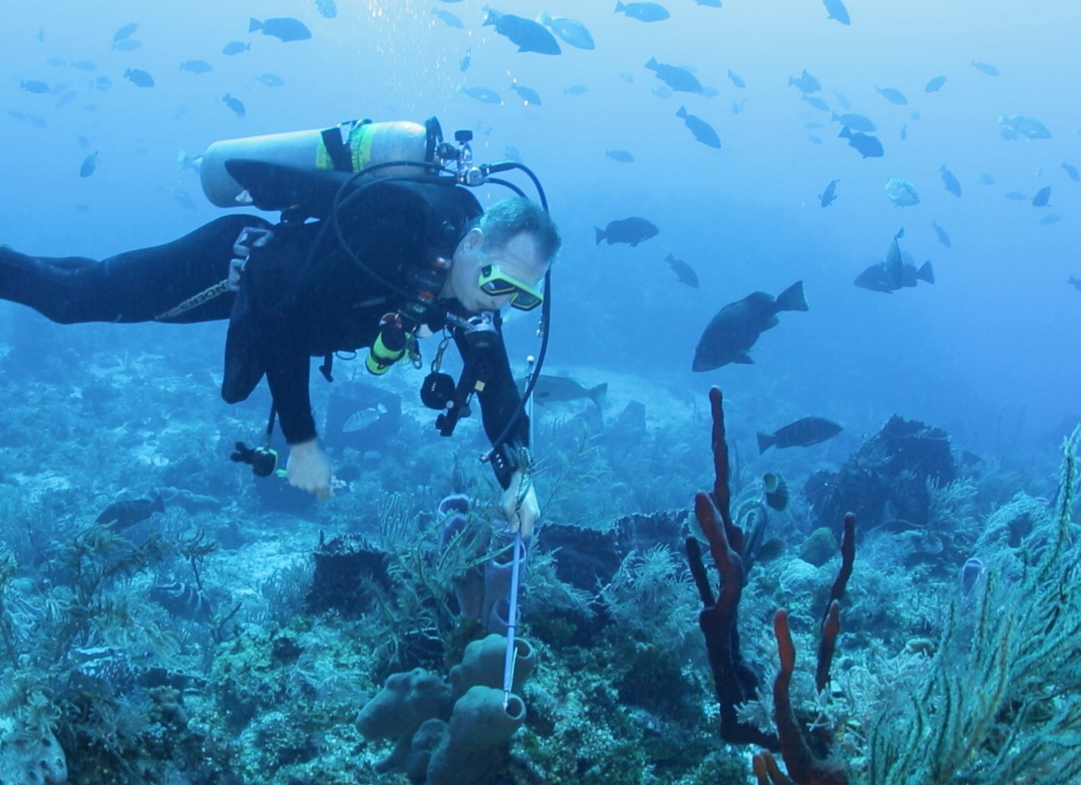
Mark-Recapture Studies
Diver holding a pole which is used for tagging Nassau grouper.
Notes:
Teaching notes:
Now we will focus on discussing mark-recapture studies. The diver in this photo is on scuba. The diver is holding a pole. This pole has a rubber band on it and a modified tip so that the diver can use it to tag fish.
Image credit:
Josh Stewart, 2014. This image shows a SCUBA diver holding a pole which is used to tag Nassau grouper with a temporary streamer tag (floy tag). The purpose of the study is to estimate total number of fish at a spawning aggregation.

Slide 8
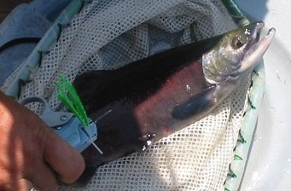
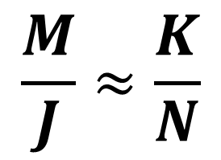
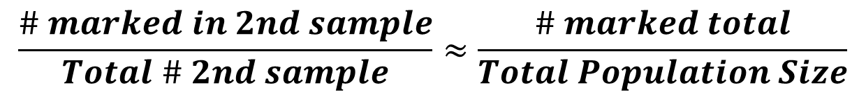
Mark Recapture Studies
Goal:
Estimate total population size (N)
Time 1: capture K individuals & mark them
Time 2: capture J individuals and see how many of them are marked (M)
Notes:
Teaching notes:
Basic Idea:
In order to estimate total population size (N) at time 1 capture K individuals and mark them. At time 2 capture J individuals and see how many of them are marked (M). The ratios of marked to total should be approximately equal for the population and sample.
Photo credit:
Tagged Metolius River Konake: http://www.critfc.org/fish-and-watersheds/fishery-science/data-resources-for-scientists/mrmix-2/

Slide 9

Mark Recapture Example
How many ducks are in the lake??
Notes:
Teacher notes:
We want to do a study to evaluate how many ducks are in a lake. The lake is very large, so we cannot do a census. Instead we are going to conduct a mark-recapture study to estimate the number of ducks in a lake.
Photo:
Clip art from Microsoft office.

Slide 10
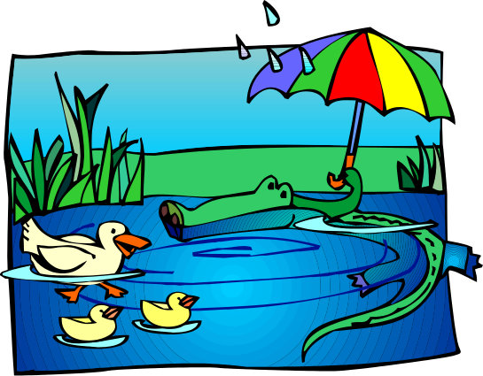
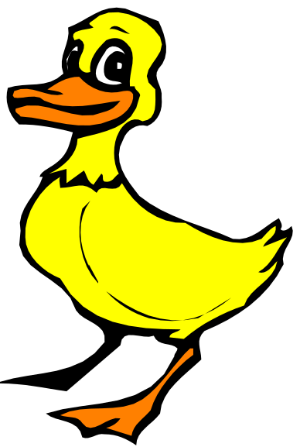

Mark Recapture Example
Capture 50 ducks.
Tag them
Notes:
Teacher notes:
We want to do a study to evaluate how many ducks are in a lake. The lake is very large, so we cannot do a census. Instead we are going to conduct a mark-recapture study to estimate the number of ducks in a lake.
At time 1 we capture 50 ducks and tag them. The ducks have ankle tags (bird bands) on. We then release these ducks back into the lake and give them a couple of days to fully mix with the other ducks.
Photo:
Clip art from Microsoft office.

Slide 11
Mark Recapture Example
Time 2.
Capture 80 ducks. 12 are tagged.
Notes:
Teacher notes:
At time 2 we capture 80 ducks and note that 12 of them are tagged.
Photo:
Clip art from Microsoft office.

Slide 12
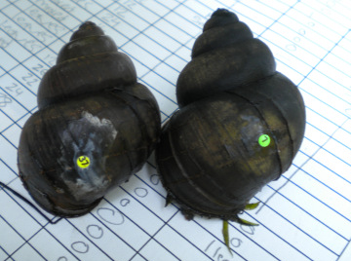
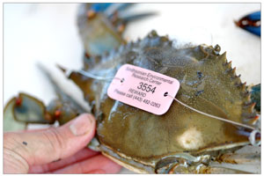
Mark Recapture Studies
Estimating population numbers
Notes:
Teacher notes:
The ≈ denotes “approximately equal to”
The basis of this equation is the hypergeometric distribution in statistics and probability. The students don’t need to know this distribution, it is just if they are curious.
We estimate the total population by multiplying the total marked by the number in the sample divided by the number that are marked in the sample.
These photos show tagged animals. The tag on the left show a blue crab which is tagged with wire around its carapace (shell) which has a disc on it with reward information. The photo on the right shows a tagged invasive freshwater gastropod, it has also been tagged with a disc glued onto its shell. These are both examples of tags that answer population level questions.
Photo credit:
Tagged blue crab: http://www.serc.si.edu/labs/fish_invert_ecology/bluecrab/Population_Size_Tagging.aspx
Tagged invasive freshwater gastropod: http://mccannecology.wordpress.com/research/

Slide 13
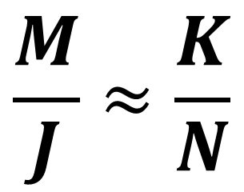
Mark Recapture Example
N = ?
K = 50
J = 80
M = 12
Notes:
Teacher notes:
Knowing that we originally released K=50 tagged ducks, we can estimate the total population size (N).
At time 2 we recaptured J=80 ducks and found that M=12 of them were tagged.
Use the data to calculate N. The equation is given. You will need to rearrange the equation to solve for N.
Ask students for the answer. The next slide shows the answer.
Photo:
Clip art from Microsoft office.

Slide 14
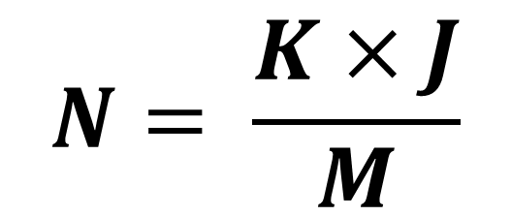
Mark Recapture Example
N = 333.33
K = 50
J = 80
M = 12
Notes:
Teacher notes:
Knowing that we originally released K=50 tagged ducks, we can estimate the total population size (N).
At time 2 we recaptured J=80 ducks and found that M=12 of them were tagged.
In order to solve for the total population size we need to compute:
(# initially tagged) x (# caught at time 2) / (# marked in sample 2)
The answer is 333.33. So we have estimated that there are 333.33 ducks in the lake. This is an estimate not an absolute number. So we have now seen how we can use a mark-recapture study to estimate total population size, rather than having to do a census.
Take the time to make sure all students understand how the answer was found. They will use this technique in the bean activities.
Photo:
Clip art from Microsoft office.

Slide 15
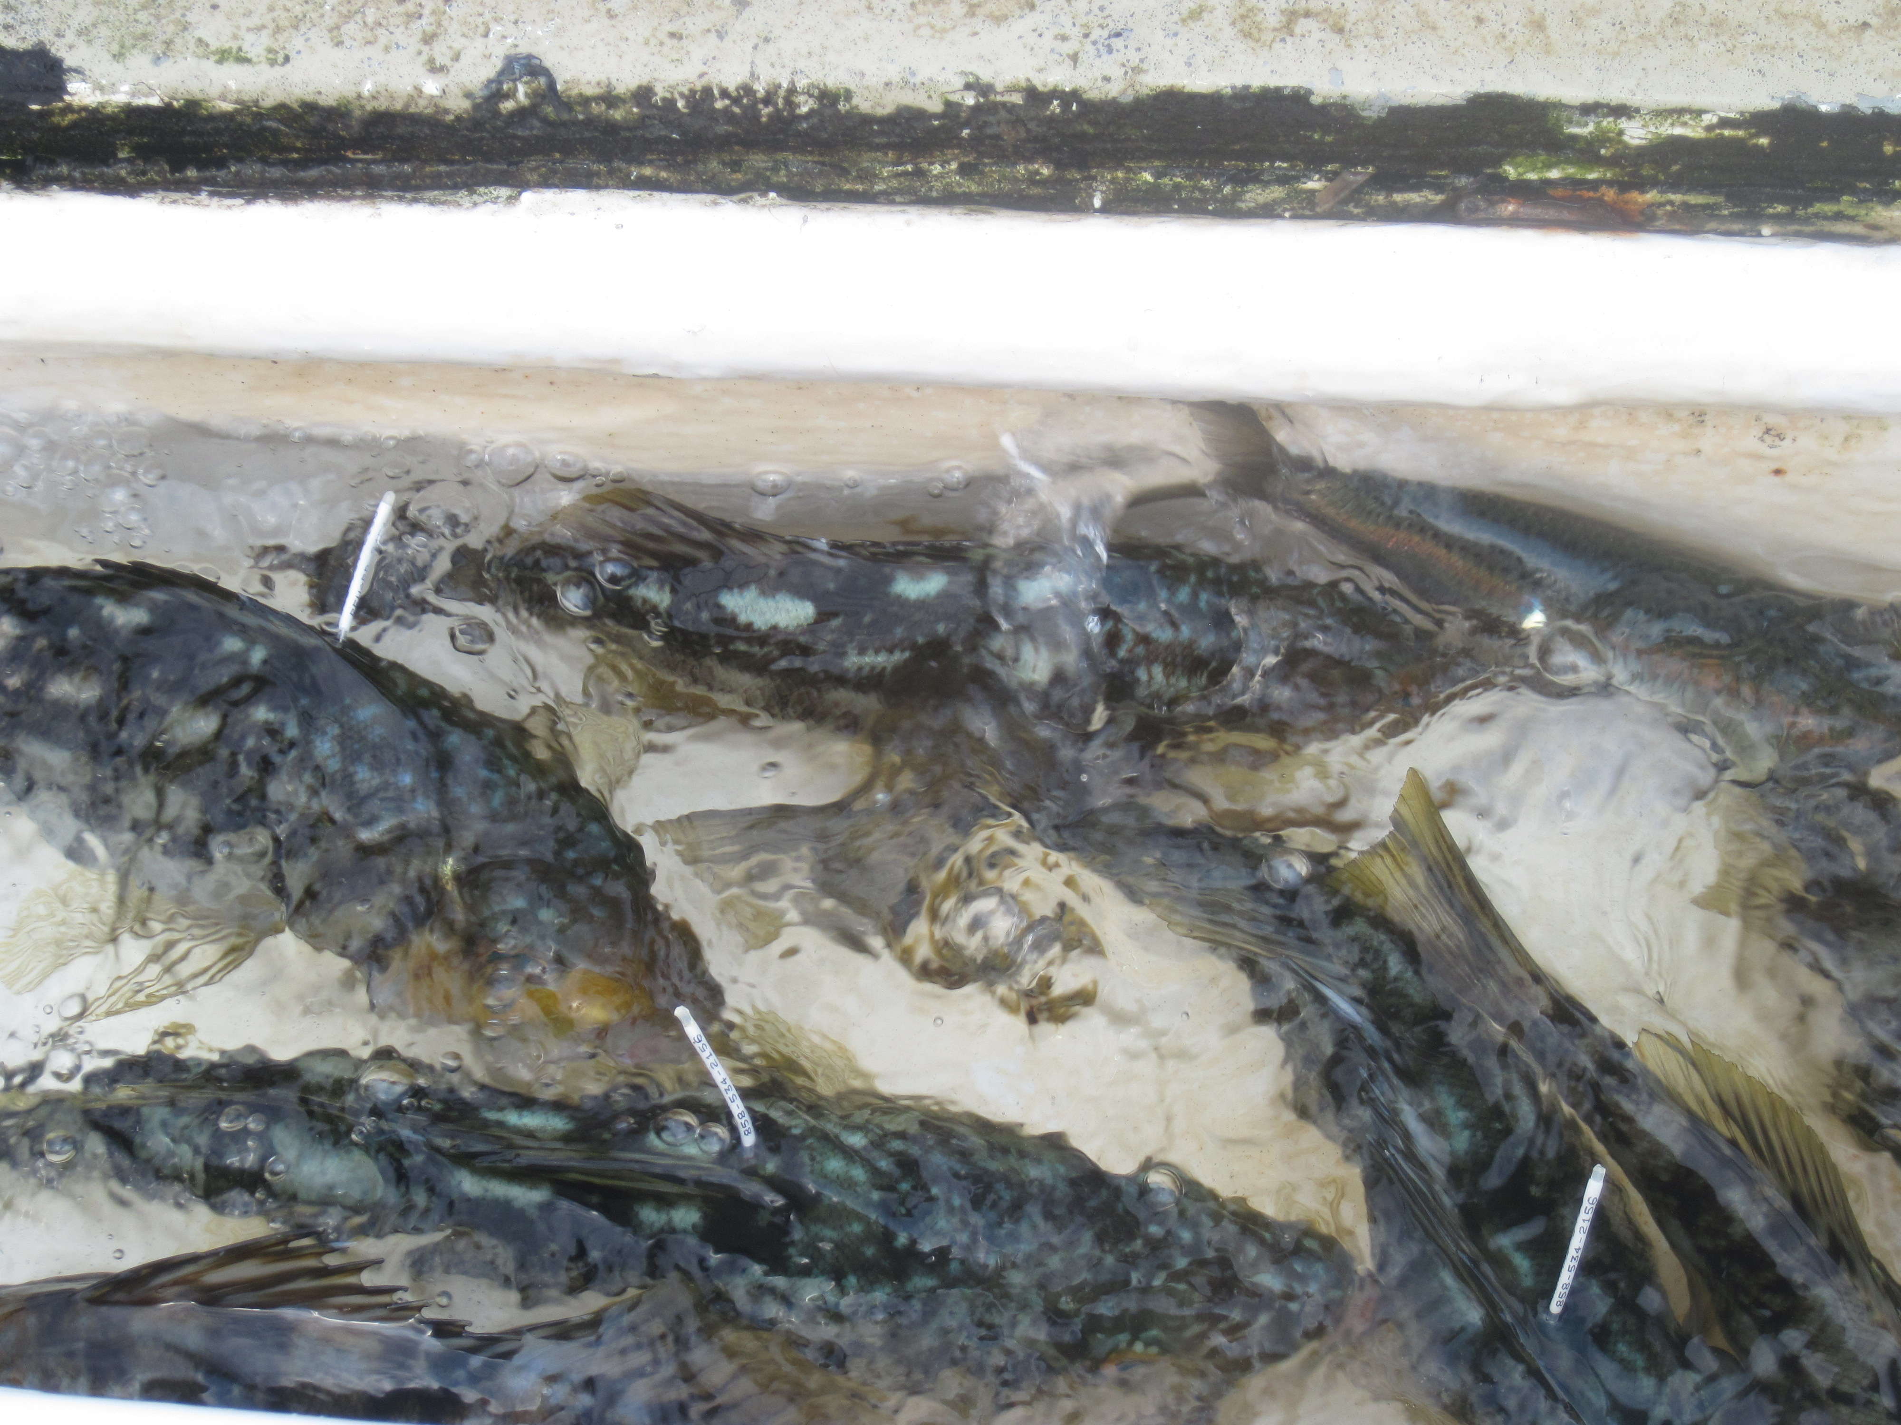
Conclusions
The question of interest determines what type of tagging study should be used.
Mark-recapture studies can be used to estimate total population size.
Notes:
Teaching Notes:
At the end of this lesson students have been introduced to tagging studies. The type of tagging study used will be determined by the question of interest. Questions typically focus on the individual or population level. PIT tags are helping scientists determine how many salmon return to various parts of rivers throughout the northwest to spawn, this helps government agencies make decisions about the status of the species (is it endangered) as well if they can allow fishing to occur. External streamer tags are used on striped seabass in the Chesapeake bay to help scientists determine estimates of mortality, both natural mortality and harvest (or fishing mortality). Estimating mortality is important because it helps management determine the status of the stock, and set the levels of fishing. Satellite tags are used on wolves in some north west states to see where the wolves roam, they can tag just one or two individuals per pack, since wolves are highly social beings. This helps scientists and conservationists study the recovery of the wolves, as well as alerting local law enforcement agencies when any wolves may wander too close to populated areas. These are just a few examples of tagging studies and the questions they answer. We can use mark-recapture studies to estimate total population size (total abundance). Mark recapture studies are used on Nassau grouper in the Cayman Islands to estimate the total abundance at a spawning aggregation site. Historically, that population was overfished, so monitoring the species recovery is extremely valuable to lawmakers, conservationists, and fishermen alike. Students should be able to use the mark-recapture equation and come up with it on their own if necessary.
Photo:
Lynn Waterhouse 2013. Tagged bass in a tank. The fish are tagged with external streamer tags.

