Slide 1
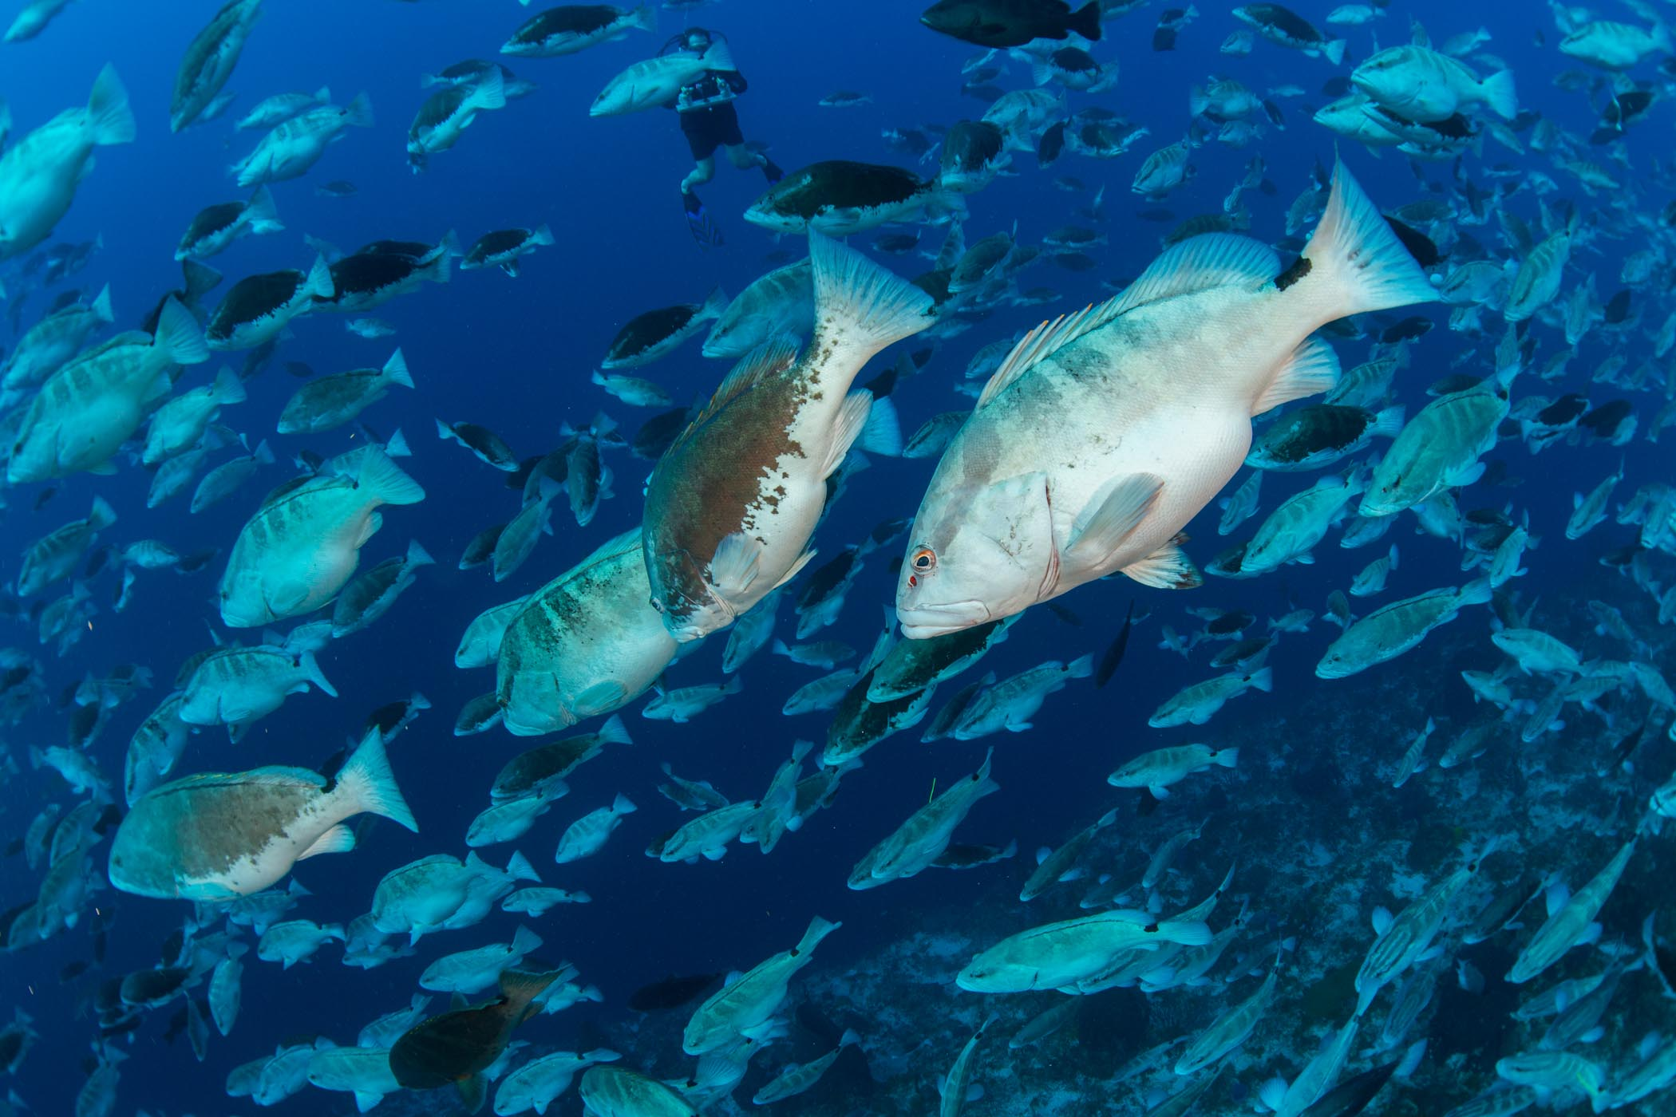
Estimating Abundance of Nassau Grouper
Notes:
Authors and Affiliations:
Lynn Waterhouse, Scripps Institution of Oceanography; Joanne “JJ” Johnson, Kearny SCT, San Diego Unified District.
WHY :
Nassau grouper are listed by the IUCN (International Union for Conservation of Nature) on their red list, marking them as an endangered species. As of September 2014 they are up for listing by the Endangered Species Act in the United States as an endangered species. In 1993 Florida banned fishing for Nassau grouper.
This PowerPoint is meant to be used to provide some basic information on Nassau grouper. Specifically this is meant to be used as example of why mark-resight (mark-recapture) studies are useful and to show an example in which estimating the population size (abundance) is not always straightforward. This is intended to be used as a motivating example for why mark-resight (a specific type of mark-recapture) studies are useful. This PowerPoint can be shown prior to the optional “Changing Seas” PBS documentary.
SUMMARY:
Nassau grouper are listed on the red list by the International Union for Conservation of Nature and are up for listing in the United States under the Endangered Species Act. In the Cayman Islands, the government has implemented protections aimed at rebuilding the Nassau grouper stocks. Here we look at video collected by scientists in the Cayman Islands in order to better understand the difficult question of how many Nassau grouper are there. This is meant to engage the student into thinking about how mark-resight studies can be used and what other type of non-invasive and non-lethal studies can be used when studying an endangered species.
Teaching Instructions
You can go over the first 5 slides of this powerpoint prior to showing the PBS video Changing Seas.
Show the PBS documentary “Changing Seas”, http://video.wpbt2.org/video/2247780078/
Have the students complete the student activity sheet
If you showed the PBS documentary, quickly review slides 1-5, otherwise cover them for the first time.
Slide 6. Show a video in which you ask the students, “How many Nassau Grouper are there?”
Grouper Moon Project – Guess How Many Fish, February 2014 Spawning Aggregation, https://www.youtube.com/watch?v=coKGz_qpJwg&list=UUUUiYJ2AaT74Yvu-Oxl7Ckg
Discuss how many fish people think are there. Discuss how you could actually answer this question if you were the scientists working on this project.
Finish this PowerPoint.
Have the students do the ‘Design A Study for Nassau Grouper Handout’
PICTURE/GRAPHICS CREDITS:
Joshua Stewart 2014. Spawning aggregation of Nassau grouper in Little Cayman Island, Cayman Islands.
WEBSITES/RESOURCES USED IN THIS PRESENTATION:
Grouper Moon Project – Guess How Many Fish, February 2014 Spawning Aggregation, https://www.youtube.com/watch?v=coKGz_qpJwg&list=UUUUiYJ2AaT74Yvu-Oxl7Ckg
Fish Base – Nassau Grouper, http://www.fishbase.org/summary/18
PBS documentary “Changing Seas”, http://video.wpbt2.org/video/2247780078/
Florida Museum of Natural History, http://www.flmnh.ufl.edu/fish/Gallery/Descript/Nassaugrouper/Nassaugrouper.html
NOAA Technical Report NMFS 146, A Technical Report of the Fishery Bulletin, FAO Fisheries Synopsis 157, Synopsis of Biological Data on the Nassau Grouper, Epinephelus striatus (Bloch, 1792), and the Jewfish, E. itajara (Lichtenstein, 1822) by Yvonne Sadovy and Anne-Marie Eklund. July 1999. http://www.sefsc.noaa.gov/sedar/download/SEDAR23_RD_15_Sadovy_Eklund_1999.pdf?id=DOCUMENT
ADDITIONAL READING:
Follow the news on listing the Nassau grouper as an Endangered Species in the United States. NOAA Fisheries Office of Protected Resources. http://www.nmfs.noaa.gov/pr/species/fish/nassaugrouper.htm
CONTEXT FOR USE:
This activity was designed for an AP Biology, Advanced Biology, or Biology high school classroom. Students will be in 9-12th grade.
MISCONCEPTIONS:
It is ok to fish for Nassau grouper. Fishing for Nassau grouper has been illegal in Florida since 1993. Even if you are just catch and release fishing it is illegal.
Nassau grouper populations are doing ok. Nassau grouper are listed by the IUCN as a red list species, this means they are endangered.
Because Nassau grouper are doing ok on Little Cayman, they are doing ok elsewhere. It also may be too early to truly say that the population of Nassau grouper on Little Cayman are truly ok. Populations throughout the Caribbean appear to be distinct, while it is a wonderful thing that the population of Nassau grouper may be recovering on Little Cayman, conservation still has a long way to go.
The only way to estimate abundance of fish populations is to kill them (this is how classical fisheries models worked). Mark-resight offers a means of studying animals without killing them.
EVALUATION TIPS:
These slides are meant to spawn discussion. There are no quizzes or homework assignments. An optional activity is to have students write up how they would conduct a study to estimate the number of fish at the spawning aggregation. There will be many answers for this and grading is left to the discretion of the instructor. The optional “Changing Seas” video has an accompanying worksheet that can be collected for a grade. An answer sheet is provided for the “Changing Seas” worksheet.
TEACHING NOTES.
The video may play best with dimmer lighting.
The “Changing Seas” video requires audio.

Slide 2
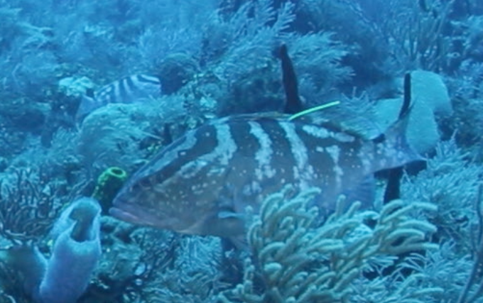
Nassau Grouper
Scientific name: Epinephelus striatus
This is a Nassau Grouper
Range: Caribbean , Western Atlantic, and some in the Gulf of Mexico
Length: 122cm (max)
Weight: 25 kg (max)
Maximum Age: 30 years
Age at sexual reproduction: 5-7 years old
Notes:
TeachingNotes:
This slide presents some information on the life history of the Nassau grouper. The following slides provide additional information.
Photographs:
Nassau grouper photo by Joshua Stewart, taken in Little Cayman, Cayman Islands 2014.
Nassau grouper in photo is most likely ~30cm long. The object coming out of its back is a tag, placed there by scientists for a mark-recapture study.
Slide Content:
Range- this is where the species is found – Nassau grouper are found in the Caribbean , Western Atlantic, and some in the Gulf of Mexico.
Length- 122 cm maximum
Weight- 25 kg maximum
Maximum Age- 30 years – maximum known of age of a Nassau grouper. Fish can be aged by reading rings in their otoliths, an ear bone. Similar to trees, fish lay down rings of calcium on their otoliths as they age.
Age at sexual reproduction- the age at when Nassau grouper are able to sexually reproduce – 5-7 years old
References for information cited here:
Fish Base – Nassau Grouper
http://www.fishbase.org/summary/18
PBS documentary “Changing Seas”
http://video.wpbt2.org/video/2247780078/
Florida Museum of Natural History
http://www.flmnh.ufl.edu/fish/Gallery/Descript/Nassaugrouper/Nassaugrouper.html

Slide 3
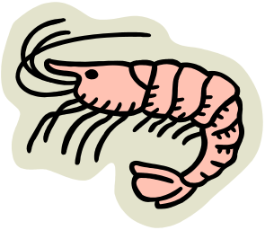
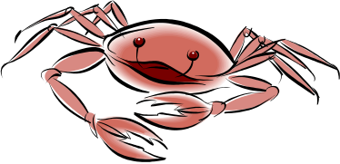


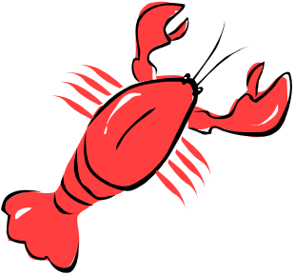
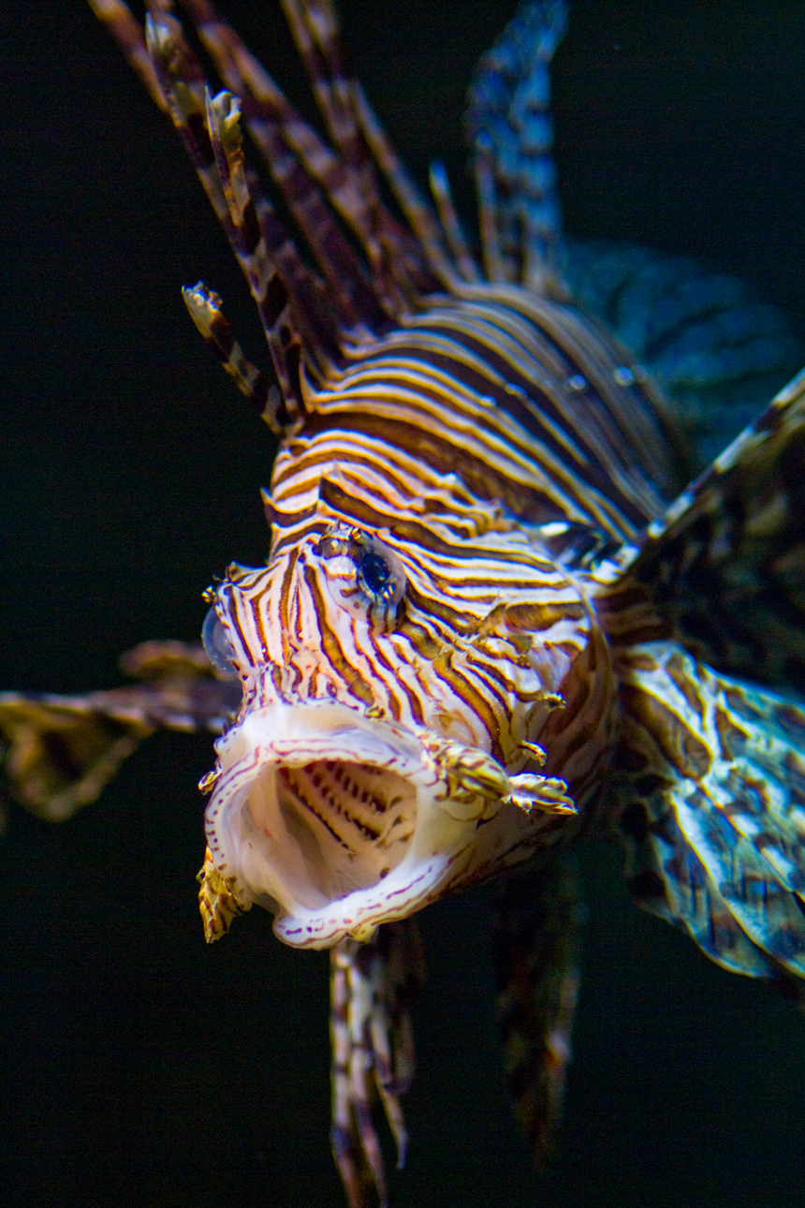



Nassau Grouper
Prey
Predators
Notes:
Teaching Notes:
This slide presents some more information on the food web of Nassau grouper, it shows what they eat and what eats them.
Scientists know what a species eats (its prey) and what eats or kills it (its predators) in a variety of ways. Ask the students how scientists know this.
Some ways in which scientists know what a species eats:
Direct observation
Gut content studies (usually requires killing the individual or finding a dead specimen and exploring what is in it’s gut)
Stable isotope analysis (use chemical markers to determine proportion of diet made up of known prey items)
Some ways in which scientists know what eats or kills a species:
Direct observation
Experiments with prey and predators
Gut content studies of predators
Predators
These are things that kill or eat Nassau grouper.
Sharks can eat Nassau grouper.
Fishermen fish for Nassau grouper and can have devastating effects on the population of Nassau grouper if they remove too many fish.
Lionfish prey on juvenile Nassau grouper. As adults, Nassau grouper can eat lionfish. Lionfish are invasive in the Caribbean.
Barracuda can also eat or kill Nassau grouper.
Prey
These are things that Nassau grouper consume.
Shrimp
Amphipods (no image for amphipods shown)
Spiny lobster
Spider crab
Octopus
Reef fish
Lionfish
Photographs:
All clip-art images from Microsoft office online clip-art.

Slide 4
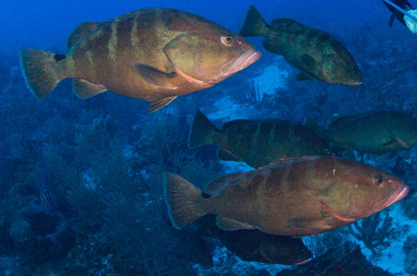
Nassau Grouper – Life Cycle
Eggs hatch 23-40 hours
Transition larvae to juvenile stage at 6-7 weeks
Sexually reproductive at 4-7 years
Typical lifespan 16 years
Maximum recorded age 29 years
Notes:
Teaching Notes:
This slide presents some information on the life cycle of Nassau grouper. The following slides provide additional information on the Nassau grouper.
Eggs hatch 23-40 hours after fertilization. Fertilization occurs during spawning when gametes join.
Transition larvae to juvenile stage at 6-7 weeks
Sexually reproductive at 4-7 years. Sexual reproduction in Nassau grouper takes place at spawning aggregations which are large gatherings of sexually mature Nassau grouper, occurring during the winter months (in low latitudes). Spawning typically takes place just after the full moon during the winter months (December to March).
Typical lifespan 16 years. This is based at the age at which Nassau grouper reach the asymptote (maximum length) from a growth curves. Growth curves are made by fitting a line to age and length data.
Maximum recorded age 29 years. Age for fish is known by counting the rings from otoliths, a fish ear bone. Otoliths are similar to trees in that they lay down growth rings.
Photographs:
Nassau groupers photo by Joshua Stewart, taken in Little Cayman, Cayman Islands 2013.
Nassau groupers in photo are most likely ~30cm long.
References
Florida Museum of Natural History
http://www.flmnh.ufl.edu/fish/Gallery/Descript/Nassaugrouper/Nassaugrouper.html
NOAA Technical Report NMFS 146, A Technical Report of the Fishery Bulletin, FAO Fisheries Synopsis 157, Synopsis of Biological Data on the Nassau Grouper, Epinephelus striatus (Bloch, 1792), and the Jewfish, E. itajara (Lichtenstein, 1822) by Yvonne Sadovy and Anne-Marie Eklund. July 1999.
http://www.sefsc.noaa.gov/sedar/download/SEDAR23_RD_15_Sadovy_Eklund_1999.pdf?id=DOCUMENT

Slide 5
Nassau Grouper – Spawning Aggregation
Notes:
Teaching Notes:
This is a photo of a spawning aggregation at Little Cayman Island, Cayman Islands in the Caribbean.
Note the high density of fish. This is because they have all gathered to spawn. When fish gather into spawning aggregations it makes them particularly vulnerable to fishing. The Nassau grouper spawn every year at the same spot following the full moon in the winter months. Since the fish gather in the same spot and at a predictable time, it makes them even more vulnerable to fishing. When it is not spawning season the Nassau grouper are much harder to find as they live spread out around the entire island, at greater depths, and tend to be hidden in holes.
Ask the students how many fish are in the photo?
(no correct answer).
Now tell them this photo was taken in approximately 80 feet of water while scuba diving. Ask them how they would find out how many fish there are.
The purpose of this slide is to set up the video which shows the spawning aggregation and to have students estimate how many fish are in the video.
Photograph credit:
Joshua Stewart 2014. Spawning aggregation of Nassau grouper in Little Cayman Island, Cayman Islands.

Slide 6
Nassau Grouper – Spawning Aggregation
Video:
Grouper Moon Project – Guess How Many Fish
February 2014 Spawning Aggregation
https://www.youtube.com/watch?v=coKGz_qpJwg&list=UUUUiYJ2AaT74Yvu-Oxl7Ckg
Notes:
Teaching Notes:
Now play the video of the spawning aggregation. The purposes is to have students guess how many fish are at the aggregation in February 2014. The answer from mark-recapture studies is approximately 3800 fish (that study did not use this video). The students will note that it is very hard to simply guess how many fish are there. The fish are moving around and the aggregation is quite large, this makes counting all the individuals very difficult. Hopefully students will realize that some other method than conducting a census is necessary to estimate the number of Nassau grouper in the spawning aggregation. If not, guide them there by asking what other ways could we estimate how many fish are there. Discuss factors that make it hard to do a census (movement, large aggregation, fish hiding behind other fish, limited dive time on scuba tank, etc.).
The video can be found here:
https://www.youtube.com/watch?v=coKGz_qpJwg&list=UUUUiYJ2AaT74Yvu-Oxl7Ckg
Or you can link to it from REEF’s Grouper Moon Page.
http://www.reef.org/groupermoonproject
The noise you hear is the scuba diver breathing through their regulator. You can hear them inhale (the hshhhhshhhh noise) and exhale (the bubbles).
The video is 2.5 minutes long. You can show all or part of it (the students should get the general idea after a minute).
Discuss with the students how many fish they think there are here (estimates from the statistical model are about 3800. The statistical model used over 200 mark-recapture counts done by 4 individuals while scuba diving. The estimate did not come from this video.).
Discuss with the students how they would conduct an experiment or study to determine how many fish are there.
Discuss how mark-resight techniques could be used to estimate abundance of Nassau grouper.

Slide 7
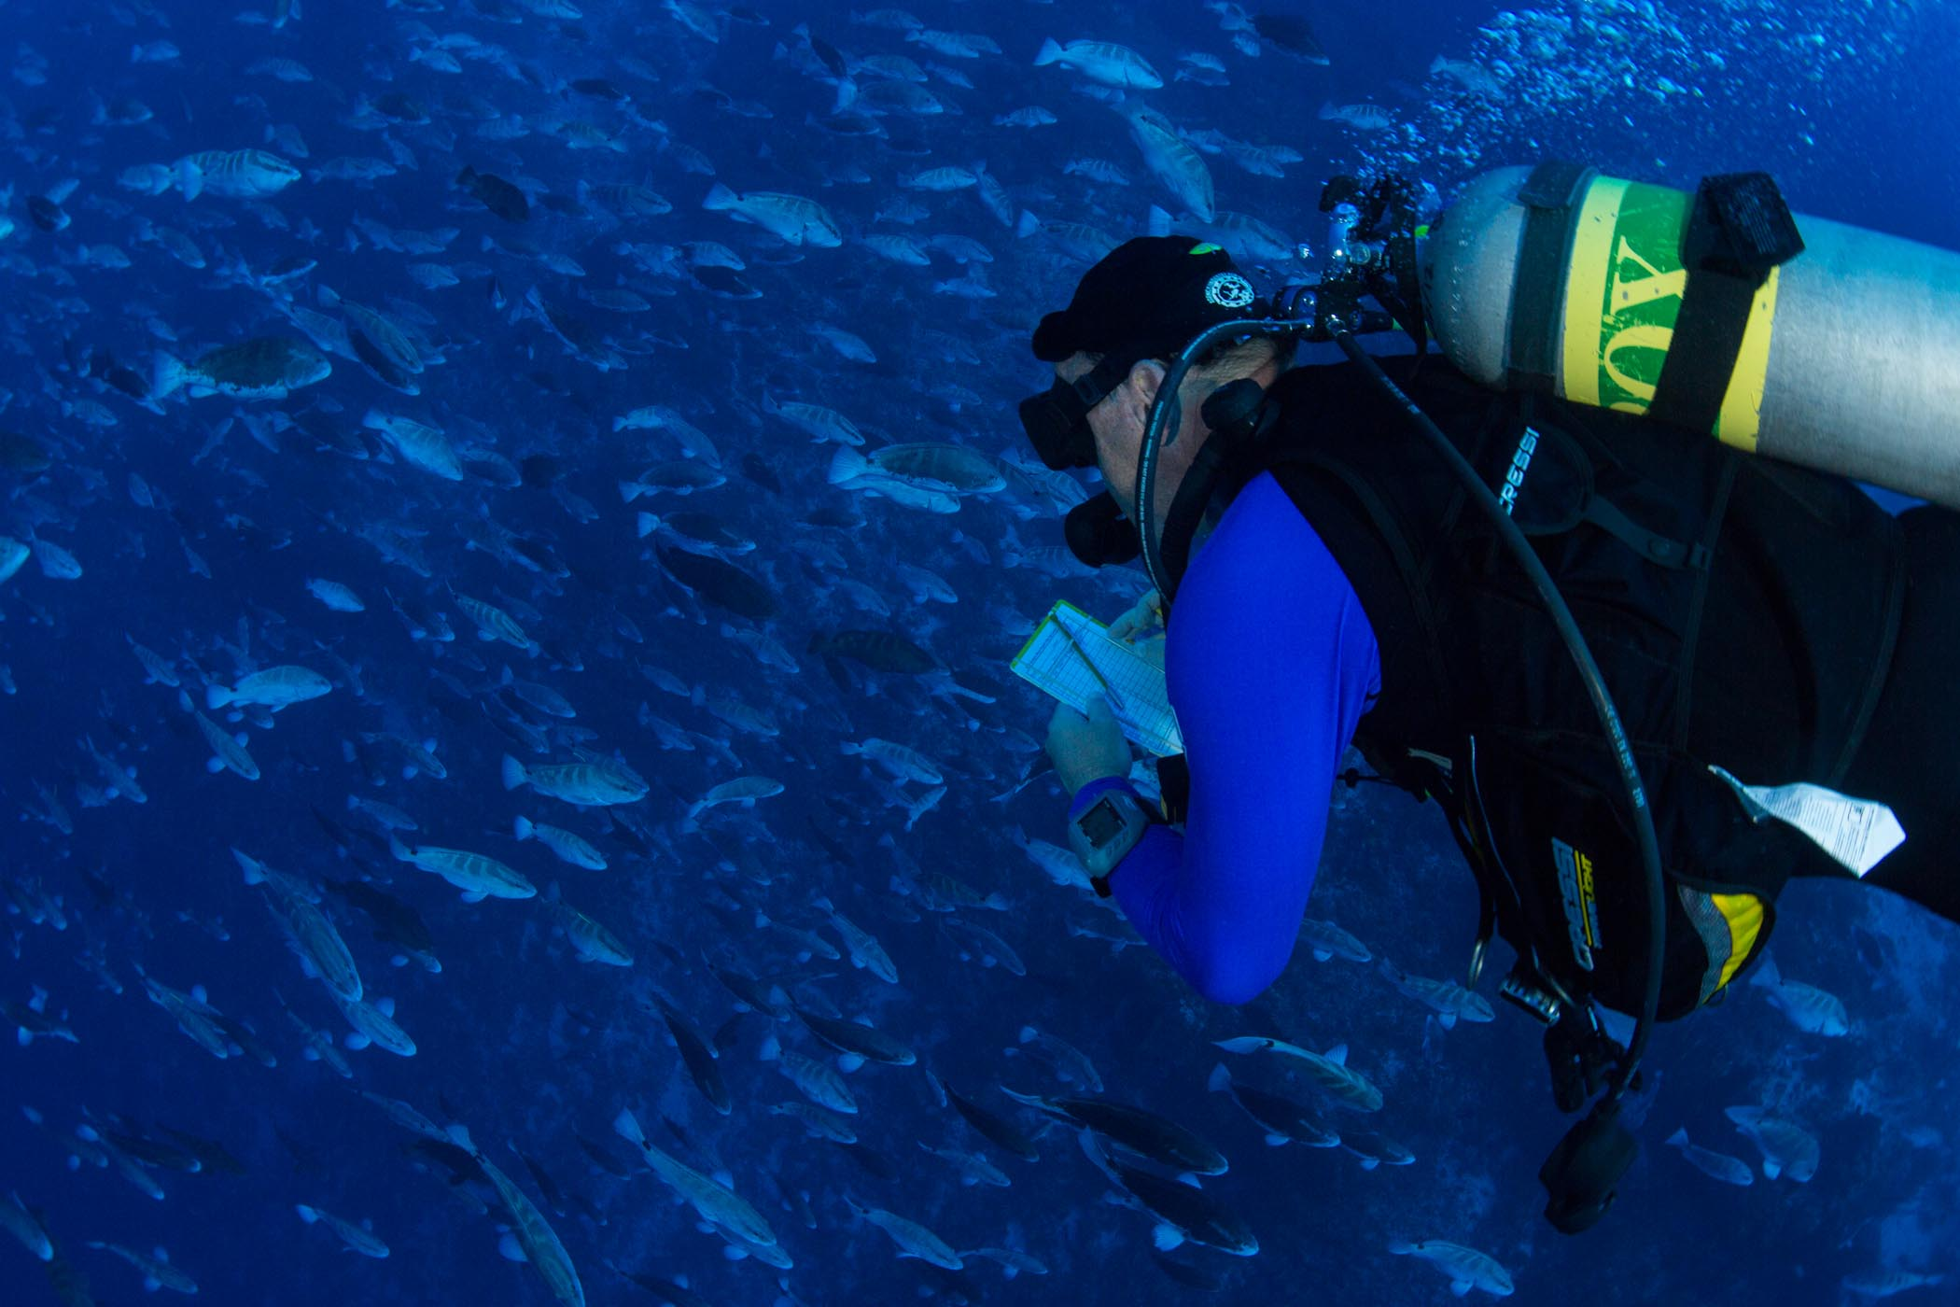
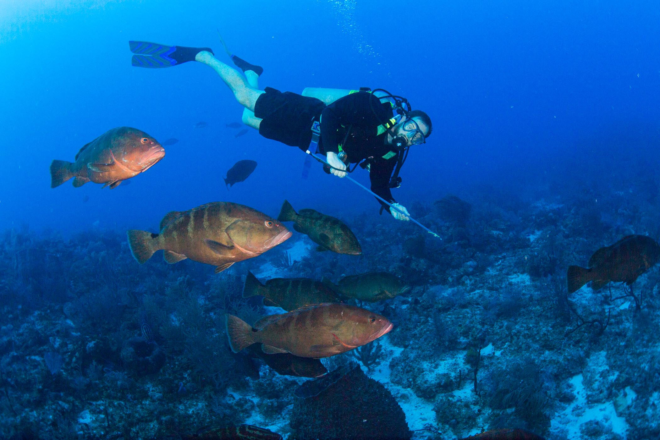
Nassau Grouper – Tagging Study
Tagging done while scuba diving
Tag with pole spear
Tag using plastic tag, unique color every year
Scuba divers conduct surveys and # tags seen in 50 sides of fish
Repeat many, many times
Notes:
Teaching Notes:
Since 2008, scientists working with the Grouper Moon Project have been estimating the abundance of Nassau grouper at the spawning aggregation in Little Cayman using mark-resight studies with tags.
The tagging takes place in approximately 80 feet of water using scuba. Fish are tagged behind their dorsal fin on either their right or left side (the side is assumed to be random). Divers tag the fish using a pole spear and a plastic tag (Billfish tag made by floy tags). Divers then do surveys where they count 50 sides of fish and record how many tags they see. The data is then entered into a model to produce a population estimate and confidence interval.
Photographs:
(Left) Taken by Joshua Stewart in 2013. Showing a scientist tagging Nassau grouper. The diver is holding a pole which is used to do the tagging. Nassau grouper are probably between 30-60cm long.
(Right) Taken by Joshua Stewart in 2013. Showing a scientist conducting tag counts of fish in the spawning aggregation. The scientist is recording the data on a slate.
Additional Information:
http://www.reef.org/groupermoonproject

Slide 8
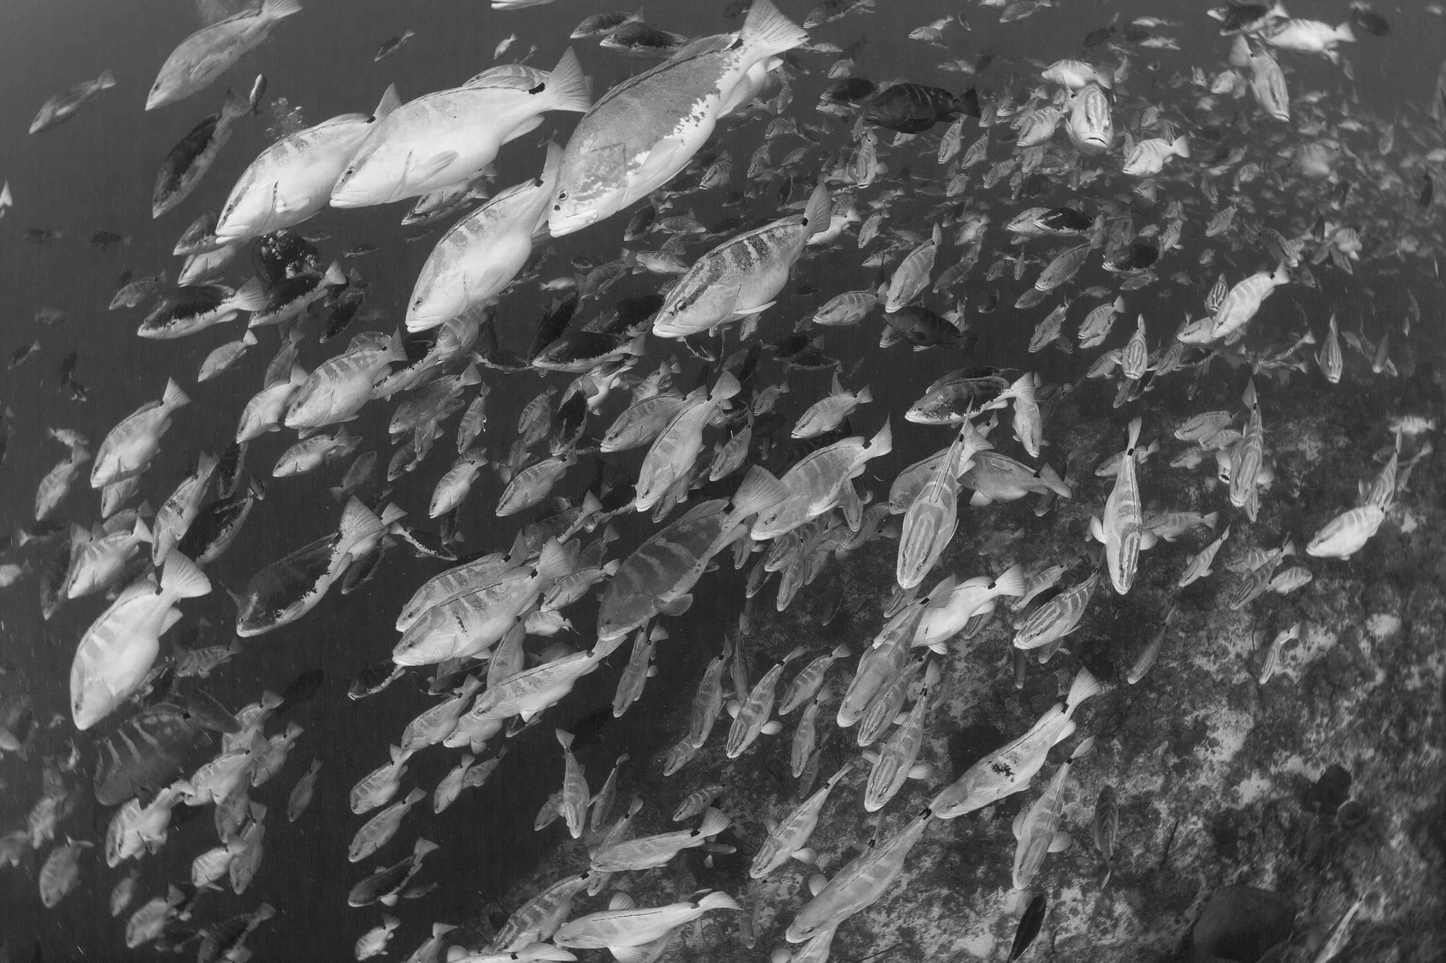
Conclusions
Nassau grouper are endangered throughout much of their range.
Spawning aggregations can be easily overfished.
Scientists and conservationists are working hard to study and protect the Nassau grouper.
Notes:
Teaching Notes:
We have now learned about the status of Nassau grouper. The students should be familiar with:
Life history (max length, max age, max weight, age at reproduction, and age for egg, larvae, juvenile, and adult periods)
Spawning aggegrations
Conservation status
Prey
Preadators
Students have also been introduced with some of the work being done by scientists in the Cayman Islands.
It is easy to overfish a spawning aggregation. This can lead to the decimation of the population.
Scientists and conservationists are working hard to study and protect the Nassau grouper.
Now students should complete the ‘Design A Study for Nassau Grouper Handout’.

