Slide 1
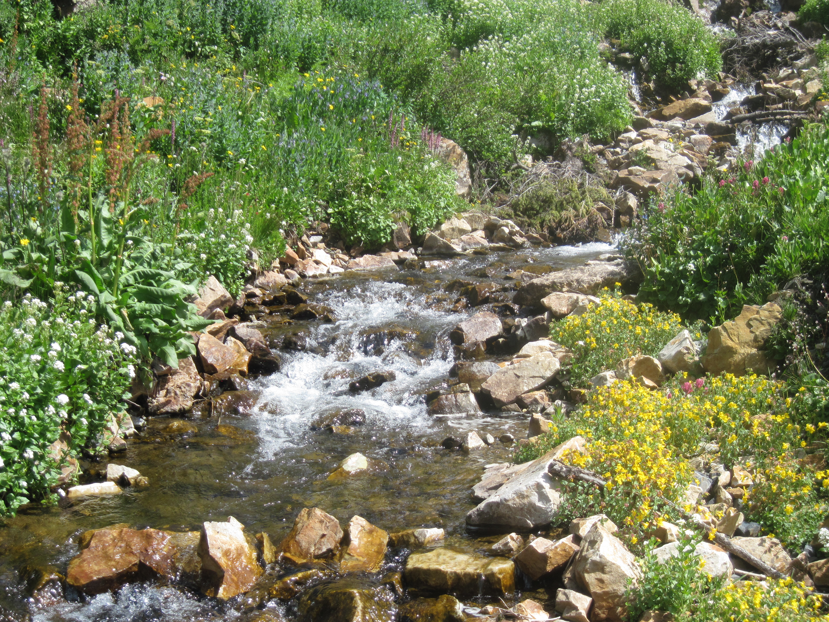
Balancing Cycles and Flow Diagrams
Notes:
Created by: Lynn Waterhouse and Joanne “JJ” Johnson for Scripps Classroom Connection
Photo credit: Lynn Waterhouse. Crested Butte, Colorado.
WHY :
Scientists are realizing that in order to study one species you simply can’t just study that species, you must study the larger context in which it lives. There is more and more emphasize on studying things at the ecosystem level in order to learn about particular species.
For instance if we want to learn about the lion in the savannah, we need to study the plants that grow there, the weather patterns, the other animals that live there, and perhaps even the geology of the place (including the paleobiology, to address what used to live there). When studying a system it can be useful to diagram the system. If a substance flows through the system it may be useful to diagram this flow. Returning to the lion and the savannah example, we may want to study the flow of energy through the savannah food web or we may want to look at the water cycle in the savannah. These diagrams enable scientists to visualize better what is happening in a system.
Climate scientists often create flow diagrams for the carbon dioxide cycle on earth. This enables climate scientists to visualize where the carbon is stored, produced, exported to, and any overall change in the balance of carbon on earth.
We will also be covering exponents in this PowerPoint. It is important to understand exponents in order to read scientific notation. Scientific notation is often used is cycle and flow diagrams.
To ensure students are able to complete flow diagrams and balance cycles for the AP Biology Exam. Also to ensure that students understand exponents.
SUMMARY:
Many biological cycles are closed loops and as such, one can keep track of materials as they flow through these closed systems. In a closed system one can use accounting to determine the amount at each step in the cycle by making use of the other parts. Similarly in an substance flow chart, we can use the amount of substance at any step combined with the retention rate between steps to determine the amount of substance at every step. This skill is required for the AP Biology exam. This lesson also reviews exponents, a skill also required by the AP Biology exam.
PICTURE/GRAPHICS CREDITS:
Photo credits are given on the individual slides.
WEBSITES/RESOURCES USED IN THIS PRESENTATION:
URLs are provided on the individual slides.
ADDITIONAL RESOURCES:
A variety of teachers are making their own AP Biology websites, it may be worth checking for new materials provided by other instructors.
CONTEXTF OR USE:
Designed for use in an AP Biology classroom or Advanced Biology classroom. Could be taught to 9th, 10th, 11th, or 12th graders. This is a stand alone lesson, but would fit in nicely following instruction on photosynthesis, respiration, ecosystem services, or any biological phenomena where cycles were discussed. This lesson assumes the students have been previously taught exponents.
POTENTIAL ISSUES:
Students may not remember how to do exponents.
Students may not know how to do the AP Biology grid in form. It was added to the AP Biology exam in 2012-2013 school year and students have struggled to master it.
EVALUATION TIPS:
Handouts are provided. These can be used throughout the school year to evaluate students mastery of the concept. These handouts could also be modified or adapted to specific topics being taught.
Encourage the students to make their own flow diagrams. You could assign groups to certain topics and have them come up with an example.
TEACHING NOTES:
Take the time to ensure that all students understand exponents. A surprising number do not appear to remember ever being taught exponents, and it is worth taking the time to ensure students understand. Seek help of a mathematics instructor if additional help is required.

Slide 2
Quick Review of Exponents
10⁻³ = ????
10⁻² = ????
10⁻¹ = ????
10⁰ = ????
10¹ = ????
10² = ????
10³ = ????
Notes:
Main Points
This slide is meant to evaluate the students knowledge of exponents. If students imply that they know the answers to all of these, then spend less time on the following slides, you can skip ahead to slide 8 for more practice or slide 10 to begin the section on cycles and flows.
It is important to understand exponents so you can read scientific notation. Scientific notation is often used in cycle and flow diagrams because they deal with very large quantities.
Take time to ask students the answers to each of them.
10^-3 = 0.001 one-one thousandth
10^-2 = 0.01 one-one hundredth
10^-1 = 0.1 one-tenth
10^0 = 1 one
10^1 = 10 ten
10^2 = 100 one hundred or ten squared
10^3 = 1000 one thousand or ten cubed

Slide 3
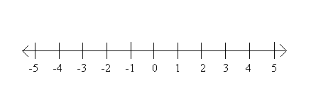
Quick Review of Exponents
General Rule: 10^n moves n-1 to the right
(negative means go left)
10⁻³
10⁻²
10⁻¹
10⁰
10¹
10²
10³
0.001
0.01
0.1
1
10
100
1000
Decimal to
the left
Decimal to
the right
No Change
Notes:
Main Point
10^1 is the point of no change
General rule is that if we have
10^n (ten raised to the power n) we move the decimal place (n-1) spaces to the right
If (n-1) is a negative number that means we move the decimal place to the left

Slide 4
Quick Review of Exponents
10⁻³ = 0.001
10⁻² = 0.01
10⁻¹ = 0.1
10⁰ = 1
10¹ = 10
10² = 100
10³ = 1,000
10¹
10.000¹
10
No change in decimal placement
Notes:
Main Points
More detail on how we do 10^1
10 to the power 1
There is no change in the decimal point.
We move the decimal places
10^1 = 1

Slide 5
Quick Review of Exponents
10⁻³ = 0.001
10⁻² = 0.01
10⁻¹ = 0.1
10⁰ = 1
10¹ = 10
10² = 100
10³ = 1,000
10³
10.000³
1,000
Decimal moves 2 to the right
Notes:
Main Point
More detail on how we do 10^3
10 cubed
We move the decimal place 3-1 = 2 places to the right
10^3 = 1,000

Slide 6
Quick Review of Exponents
10⁻³ = 0.001
10⁻² = 0.01
10⁻¹ = 0.1
10⁰ = 1
10¹ = 10
10² = 100
10³ = 1,000
10⁰
10.0⁰
1
Decimal moves 1 to the left
Notes:
Main Point
10^0
We move the decimal place 0-1= -1 places to the right, and since this is negative we move it one to the left.
10^0 = 1
*note any number to the 0th power is going to be 1

Slide 7
Quick Review of Exponents
10⁻³ = 0.001
10⁻² = 0.01
10⁻¹ = 0.1
10⁰ = 1
10¹ = 10
10² = 100
10³ = 1,000
10⁻²
10.0⁻²
0.01
Decimal moves 3 to the left
Notes:
Main Point
10^-2
We move the decimal point -2-1=-3 places to the right, which is the same as 3 places to the left.
10^-2 = 0.01 or one-one hundredth

Slide 8
Further Exploration of Exponents
6 x 10⁰ = ????
6 x 10¹ = ????
6 x 10² = ????
.6 x 10¹ = ????
.6 x 10⁰ = ????
??? x 10¹ = .6
??? x 10³ = 60
Notes:
Main Point
Here are some examples of scientific notation. For the first 5 translate them out of scientific notation. For the final two, give the correct scientific notation for the given number.
Ask the students to give the answers.
The answers on the following slide.

Slide 9
Further Exploration of Exponents
6 x 10⁰ = ????
6 x 10¹ = ????
6 x 10² = ????
.6 x 10¹ = ????
.6 x 10⁰ = ????
??? x 10¹ = 0.6
??? x 10³ = 60
6
60
600
6
.6
.06
.06
Notes:
Main Point
Answer slide for practicing exponents

Slide 10
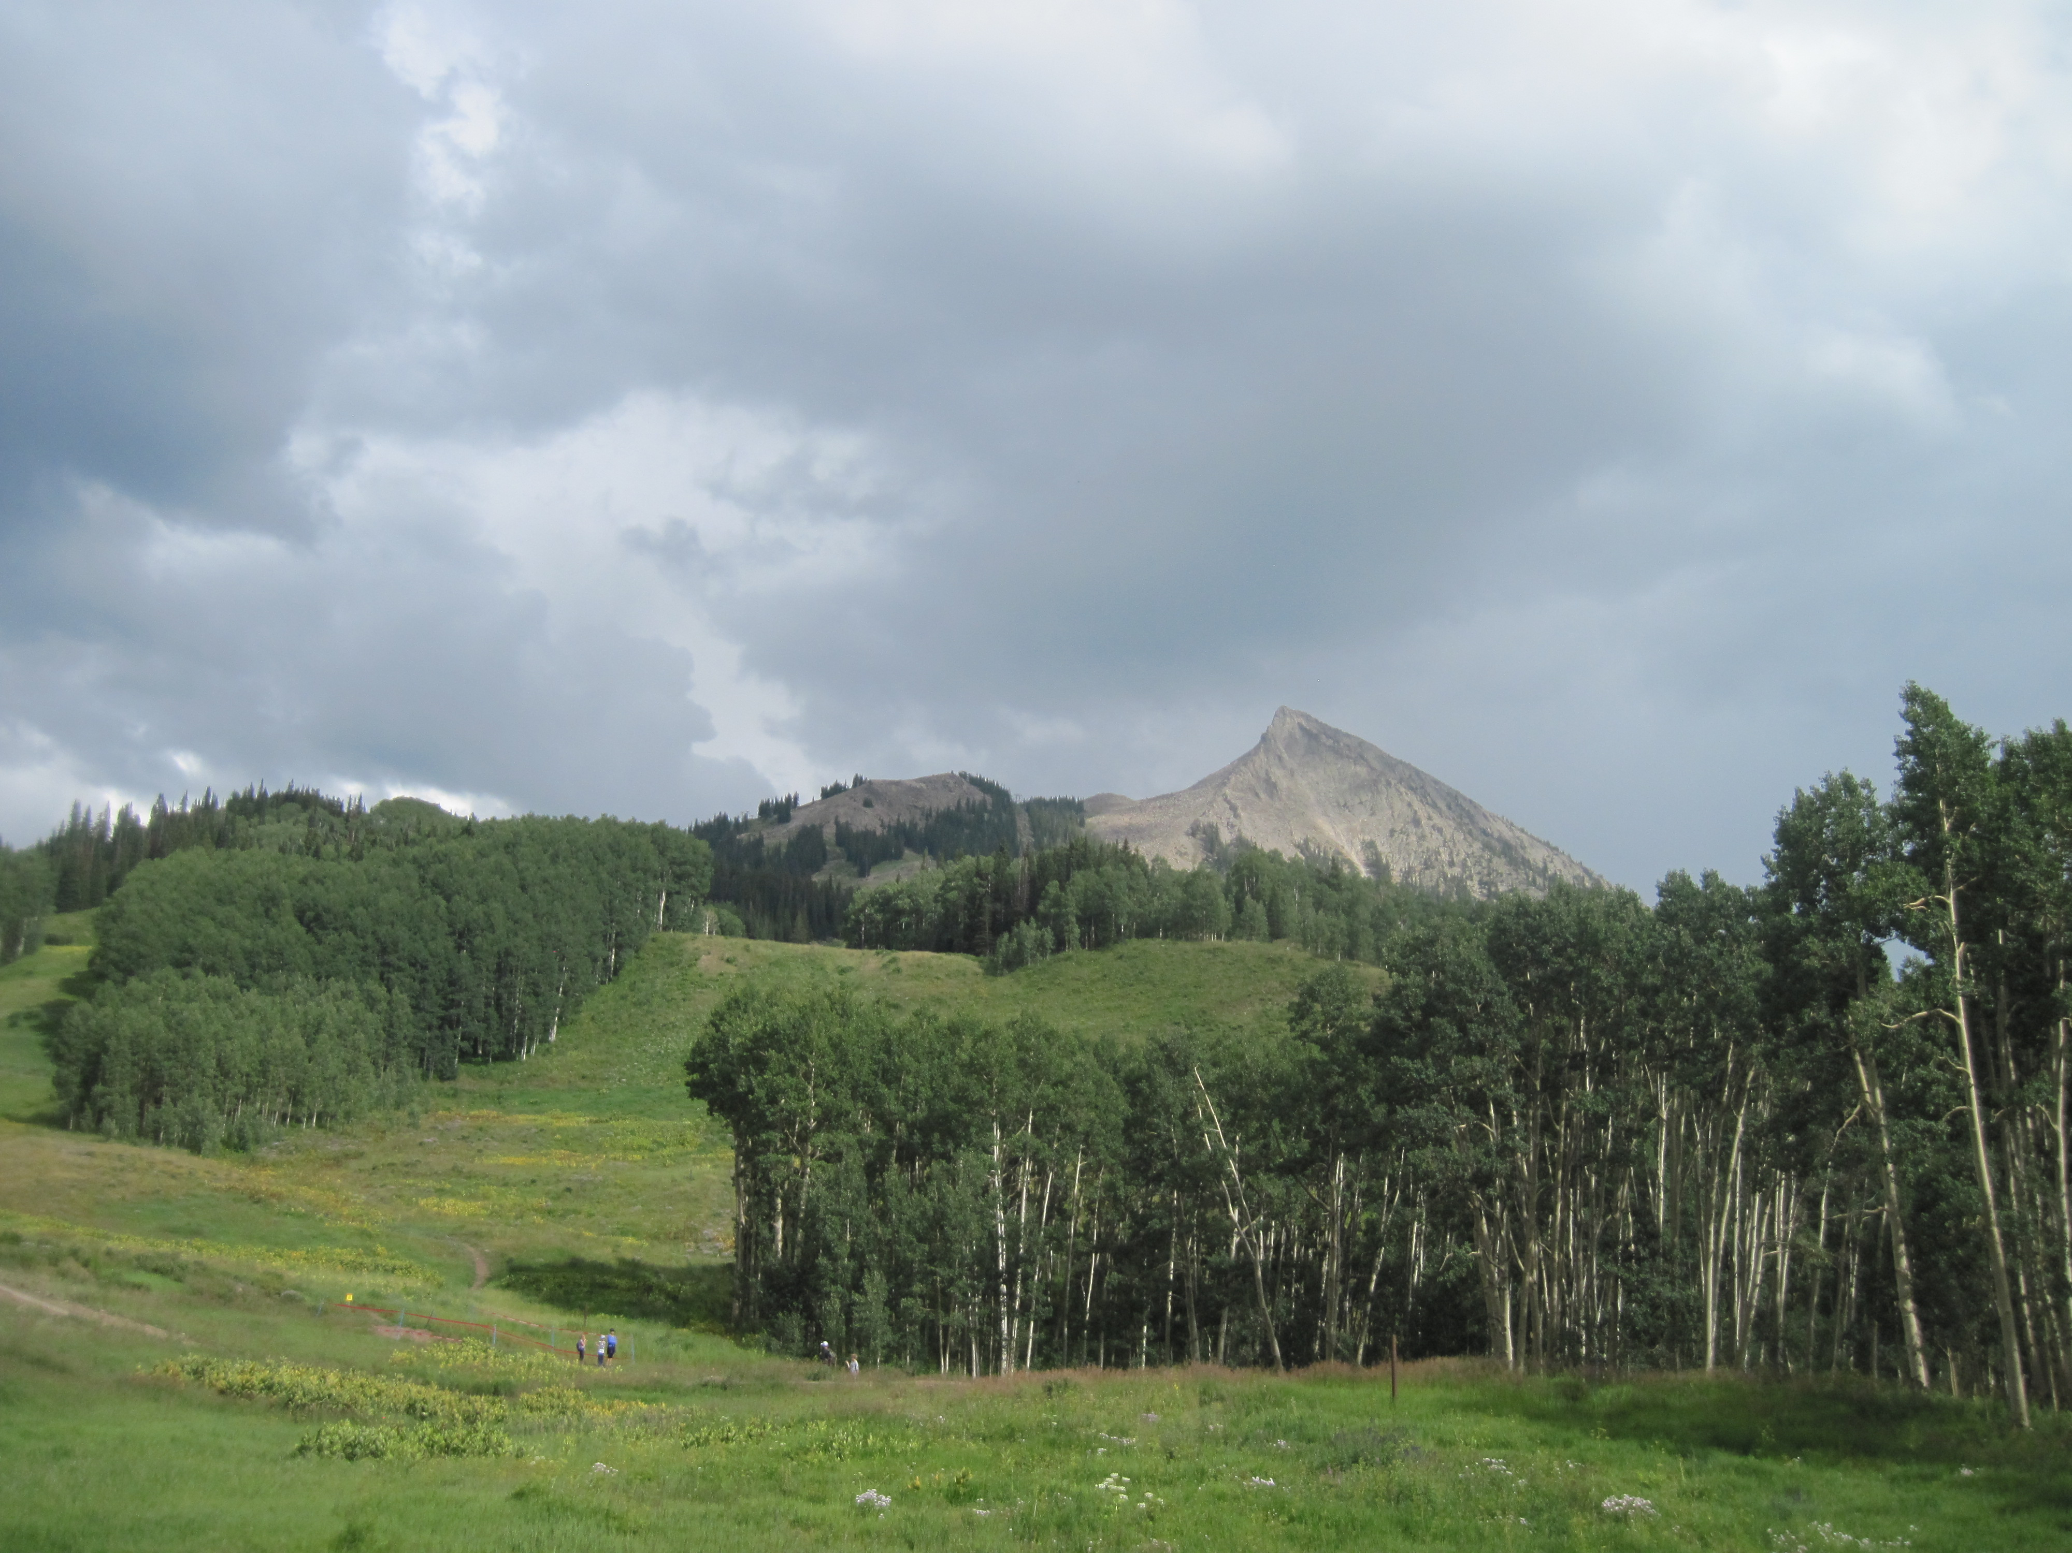
Cycle Diagrams
Cycle is a loop
Grand total of substance in cycle
Assume no loss, no gains
Steady State
Example:
Terrestrial and atmospheric water cycle
Notes:
Main Point:
A cycle can be thought of as a loop. There is a total amount of substance in the cycle. In general we assume that there is no loss out of the system and no gains into the system. A system that fits these requirements is in “Steady State”.
Example: freshwater flowing through an aquifer (no human impact)
Ask students for other examples.
Photo Credit:
Dan Popa, Crested Butte, Colorado.

Slide 11



Cycle Diagrams
Freshwater in System
9.8 x 10^21 kg
Remains in Atmosphere
3.6 x 10^21 kg
Evaporation
_______ kg
Precipitation
________ kg
Melt
10.8 x 10^20 kg
Snow
________ kg
http://earthref.org/SCC
Scripps Classroom Connection
Notes:
Main Point
Here we have an example diagram. We are showing the annual amount of water in each terrestrial or atmospheric state. The arrows indicate the path the water takes in the system. We are giving the total amount of water (kg) that passes through each state (remaining in atmosphere, precipitate, snow, melt, and evaporation) in an entire year. Some of the water remains in the atmosphere for the entire year.
There is a total of 9.8 x 10^21 kg of water in the system. Of that 3.6x10^21 kg remains in the atmosphere. The remainder is precipitated out. Some of that precipitation becomes snow, which later melts, and then evaporates. The total amount of evaporate comes from the precipitate that is not snow and then the melt. The evaporation then goes back into the atmosphere.
Ask students if this is at steady state? Answer: Yes
Why? Answer: Nothing is exiting or entering the system
Scientists are able to measure the total amount of water that passes through each state by measured the fluxes in a given amount of time and then extrapolating out into a year. How would you go about measuring the various fluxes? Examples (snow gauge, rain gauge).
Ask the students to point out something wrong about this diagram.
There is no absorption by soils.
There is no consumption by humans.
There are no glaciers or ice caps.
Diagrams are simplified views of the world. In this case the diagram is meant to just show the amount of water that passes through each state.
Ask students to calculate the missing values. (answer next slide)

Slide 12
Cycle Diagrams
Freshwater in System
9.8 x 10^21 kg
Remains in Atmosphere
3.6 x 10^21 kg
Evaporation
6.2 x 10^21 kg
Precipitation
6.2 x 10 ^21 kg
Melt
10.8 x 10^20 kg
Snow
6.2 x 10 ^21 kg
http://earthref.org/SCC
Scripps Classroom Connection
Notes:
Main Point
Answers for flow diagram.
Precipitation:
Freshwater in system – remains in atmosphere
9.8 x 10^21 – 3.6 x 10^21
Snow:
Snow is only input to melt so must be same value
10.8 x 10^20
Evaporation:
Balances precipitation, so much have same value.
6.2 x 10^21

Slide 13

Flow Diagrams
Transfer of substance from one state to another
No longer need to be a cycle (can be a one way trip)
Value at one state per chain
Rate of decrease (or rate of retention)
Example: energy transfer between trophic levels
http://earthref.org/SCC
Scripps Classroom Connection
Notes:
Main Point
Flow diagrams are another type of diagram you should be familiar with. In a flow diagram we follow the transfer of substance from one state to another. In a flow diagram you need to either know the amount of substance at one state per chain and the retention rates in order to calculate the amount of substance at every state. Chain refers to branches that the substance can flow to. If the substance starts in state A and then it can go to B or C and from B it goes to D and from C it goes to E, we have two chains. A→B→D and A→C→E. By knowing the amount of substance at one state per chain and then the retention we can calculate the amount of substance at every forward state and every previous (backwards) state. As the substance transfers from level to level there is a retention (or consumption or decrease), this is usually given as a percentage.
If you have already discussed energy transfer between trophic levels, students should be familiar with this concept. If not, introduce it now. We are imagining a linear trophic web. If we imagine the lowest trophic level in a food group it starts with a certain amount of energy, and then the next trophic level up (the 2nd trophic level) retains a certain % of this energy. The 3rd trophic level, which consumes the 2nd trophic level, will retain a certain % of energy that the 2nd trophic level contained, and so on.
Ask students if they have other examples?
Examples:
-Amount of water remaining in a pipe as it travels from the water plant through a town. It is lost to leaks in the pipe, business consumption, and residential consumption.
-Amount of energy in a cable. A certain amount leaves the power plant. There may be a faction lost over a certain amount of distance. There will also be energy consumed by anything plugged into this specific cable. Thus only a certain amount can reach the end of the cable.
Photo Credit:
Dan Popa, Crested Butte, Colorado.

Slide 14
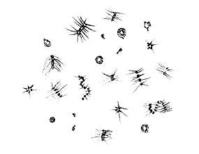
Trophic Flow- Fill in the Blanks.
Plankton 1.9 x 10¹⁶ g Carbon
100%
Consumed
Detritus
0.2 x 10¹⁵ g C
Zooplankton
Fish Larvae
Detritovore
0.1 x 10¹⁴ g C
Fish __________ g C
Sinks
________ g C
100% Consumption
Top Predators
__________ g C
10% Transfer
Notes:
Main Slide
Here we have an example of energy transfer through a trophic diagram for an aquatic habitat. The arrows show which way energy flows through the system. The arrow from plankton to zooplankton means that zooplankton consume plankton and get some of their energy. When an organism consumes something, their body is only capable of metabolizing and storing a certain percent of the energy within what they consumed. Also, some of the energy from what they eat may be lost from messy feeding. The arrows are coded by color to tell you how much of the energy is transferred.
Detritus is dead organic matter. A Detritivore consumes detritus (something that consumes dead organic matter). Sinks refers to dead organic matter than sinks to the bottom in this aquatic system.
This diagram tell us that plankton are composed of 1.9 x 10 ^16 grams of Carbon in this system. Scientists can find out how much carbon something is by comparing wet weights, dry weights, and dry ash weights (ash means the carbon has been burned up).
Ask students what energy is measured by? Answer: grams Carbon
Ask students if this diagram has 100% transfer from one flow level to the next?
Answer: No. The brown arrows are a 10% transfer. Red arrows are 100%.
Now ask students to calculate the missing values. The next slide has the answers.
Vocabulary
Detritovore: organisms that eats dead matter
Detritus: matter composed of parts of dead organisms
Trophic levels: level in the food chain at which an organism is located. Autotrophs are the base in most food chains.
Image Sources:
1. (Top right) Image of Phytoplankton. Ocean Oasis. Activity 10. Teacher’s Guide. San Diego Natural History Museum. http://www.oceanoasis.org/teachersguide/activity10.html

Slide 15
Trophic Flow- Fill in the Blanks.
ANSWER
KEY
Plankton 1.9 x 10¹⁶ g Carbon
100%
Consumed
Detritus
0.2 x 10¹⁵ g C
Zooplankton
Fish Larvae
Detritovore
0.1 x 10¹⁴ g C
Fish __________ g C
Sinks
________ g C
  88 x 10^15
  0.19 x 10^15
100% Consumption
Top Predators
__________ g C
  88 x 10^14
10% Transfer
Notes:
Main Point
To review the answers from the previous slide.
To calculate g C going to Fish (from Zooplankton and Fish Larvae).
Start with 1.9 x 10^16 g C – 0.2 x 10^15 g C = 1.88 x 10^16 g C, which is what goes to Zooplankton and Fish Larvae
But then only 10% of that goes to Fish, so 10% x 1.88 x 10^16 g C = 1.88 x 10^15
To calculate what sinks:
0.2 x 10^15 g C in detritus – 0.1 x 10^14 g C Detritovore = 0.19 x 10^15 g C sinks
To calculate what goes to top predators:
1.88 x 10^15 g C x 10% trophic transfer = 1.88 x 10^14 g C
Vocabulary
Detritovore: organisms that eats dead matter
Detritus: matter composed of parts of dead organisms
Trophic levels: level in the food chain at which an organism is located. Autotrophs are the base in most food chains.
Image Sources:
1. (Top right) Image of Phytoplankton. Ocean Oasis. Activity 10. Teacher’s Guide. San Diego Natural History Museum. http://www.oceanoasis.org/teachersguide/activity10.html

Slide 16
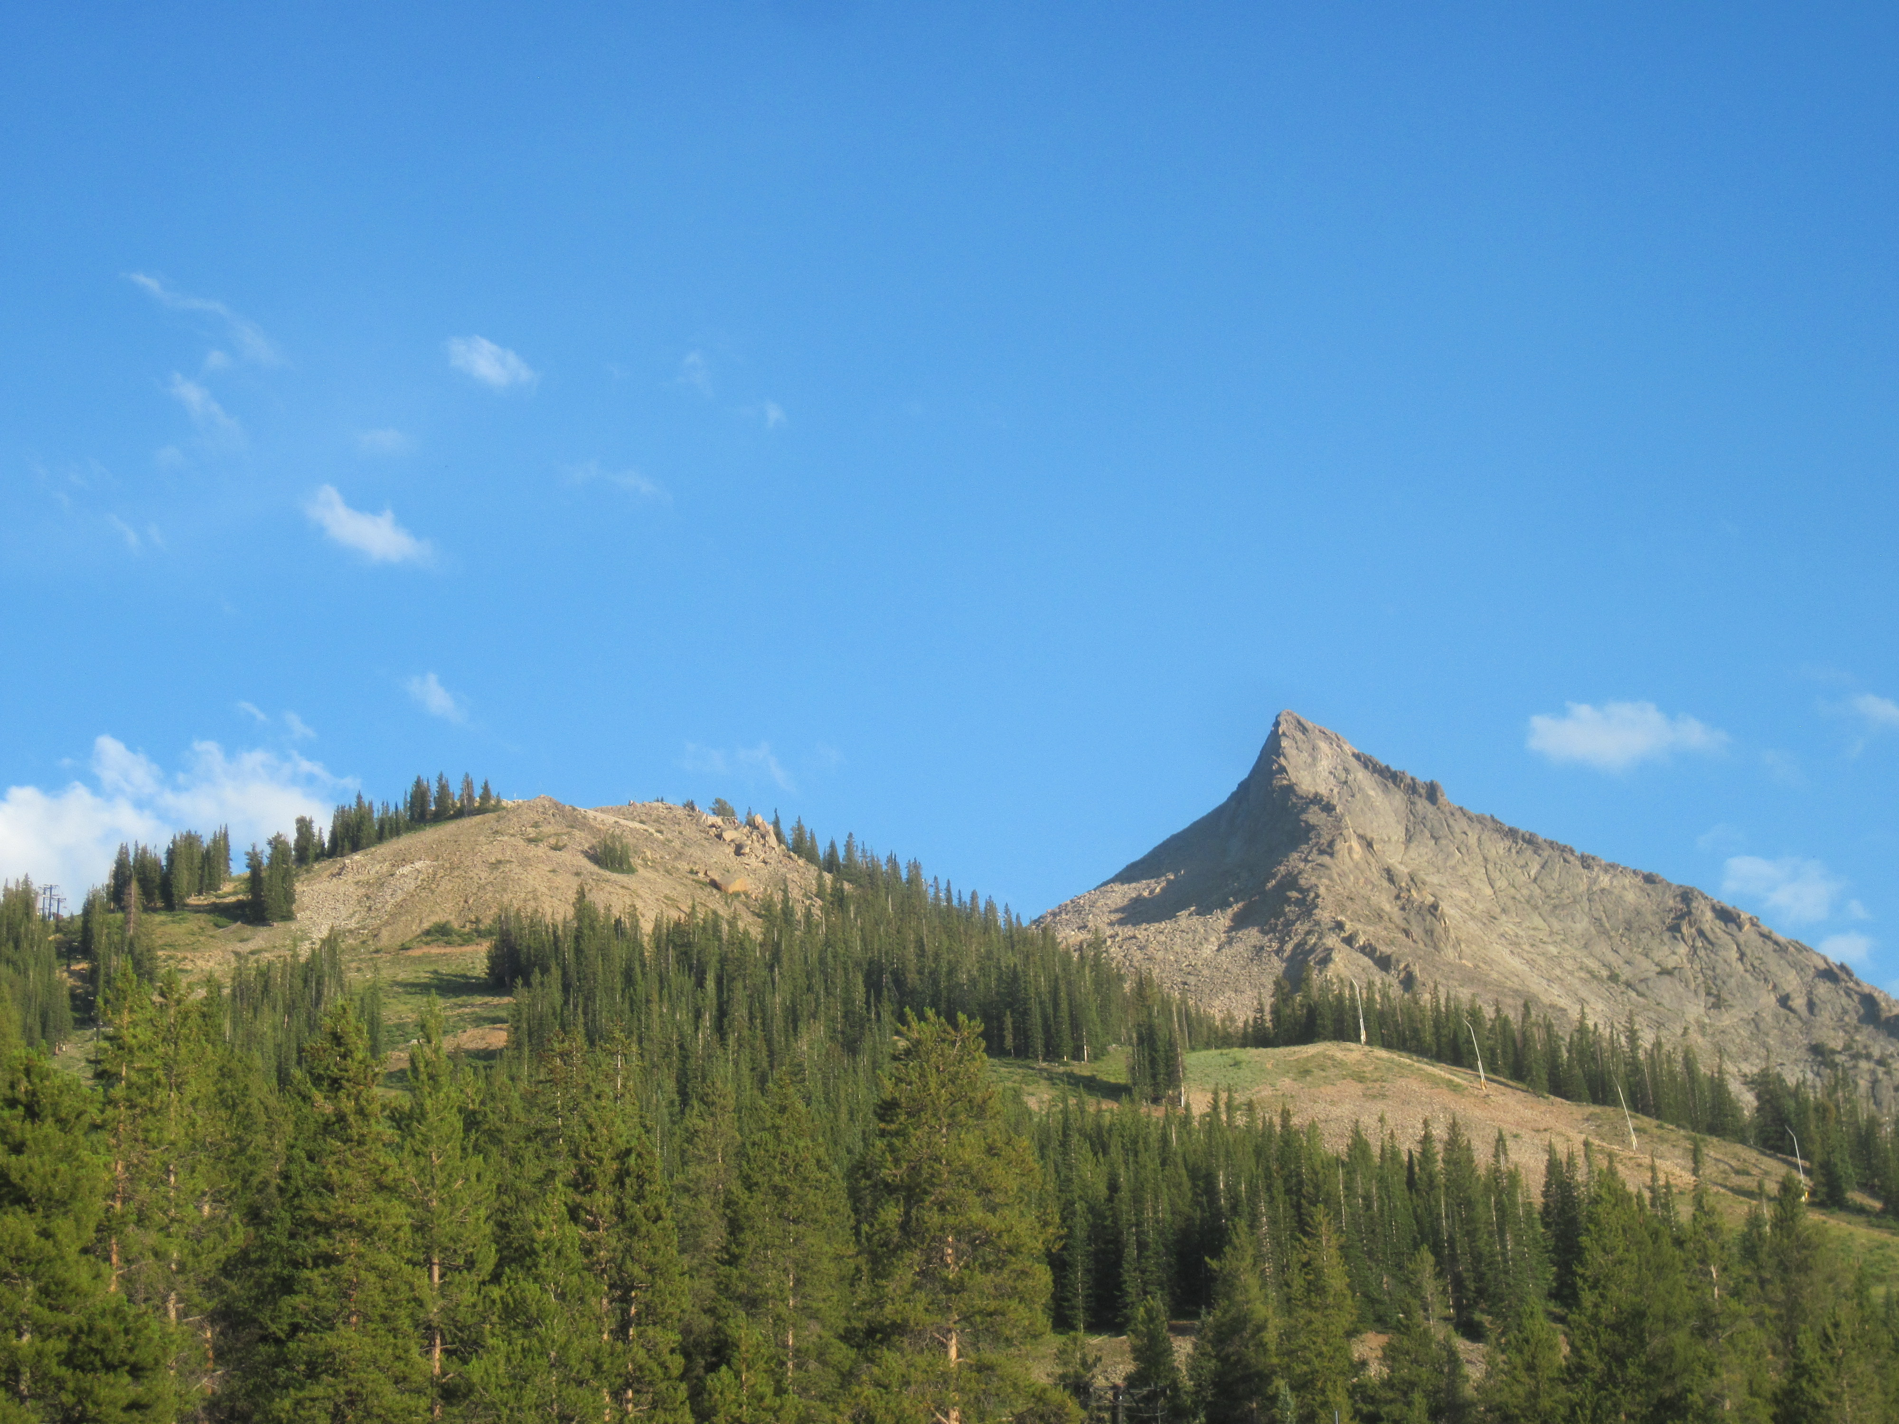
Summary
You are now familiar with:
Scientific notation
Flow diagrams
Cycles
How to balance and find missing values
Notes:
Main Point
After this lesson students should be familiar with scientific notation, flow diagrams and cycles. They should know how to balance these diagrams and find missing values.
In order to read scientific notation students should understand exponents.
To solve for the various states in a cycle we have to know the total amount of substance in the cycle. Then, using the amount in other states we can solve for any missing states.
To solve for the various states in a flow chart, we must know the amount of substance for one state per chain as well as the retention values between every pair of states.
Photo Credit:
Dan Popa, Crested Butte, Colorado.

